Slide 1

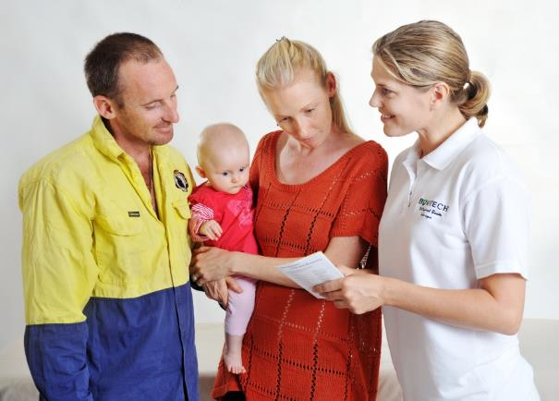
Module 1
Welcome
Certificate in Bowen Therapy - International
Module 3
History of Bowen
The Bowen Technique
Lower & Upper back
Neck & Head
Kidney
Draping, Hygiene, WHS, Client Care
Notes:
Display on arrival

Slide 2



Module 1
Welcome & Orientation
Sign in register & nametags
Payment & receipts
Toilets & breaks
Kitchen & food
Phones off or on silent
No recording, privacy
Exit and emergency meet point, fire extinguisher
Notes:
Run through basic housekeeping. Flow of day for breaks etc.

Slide 3

Module 1
Some movement before we begin
Everyone please stand up
In a moment group together with other students for below criteria
The area you live in
Your experience with bodywork
Your favorite food
What brings you to Bowen
Any particular interest you may have
Notes:
Ice breaker to get them up and chatting, wake them up get comfortable with each other, could use line method demonstrated at Burleigh Heads if you prefer.

Slide 4
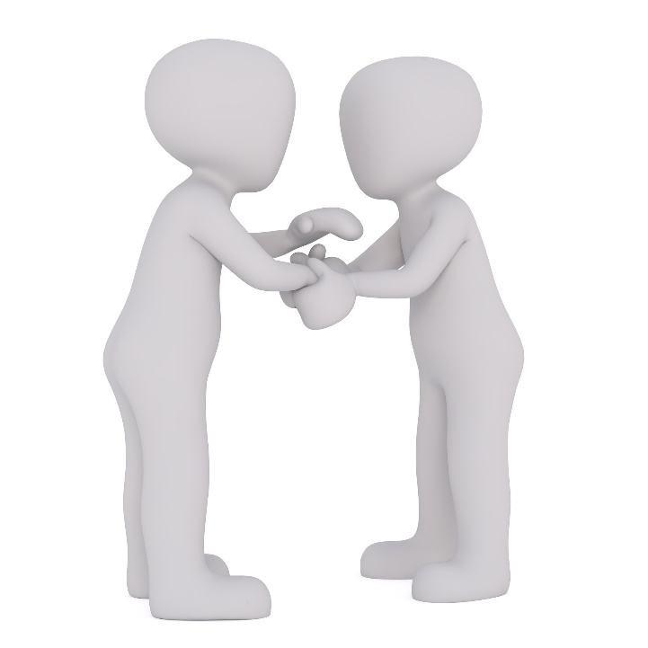
Module 1
Introductions
Please take a few minutes to introduce yourself and where you are from.
Perhaps your work background whether you have body work experience, or this is the first time for you?
How you came to this Bowen Class?
Notes:
Quick introduction of yourself and students

Slide 5
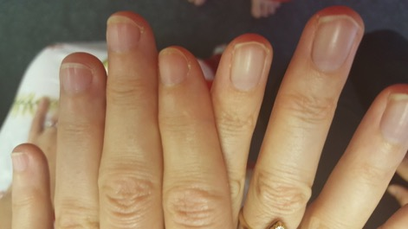
Module 1
Our weekend together
  Thank you for your commitment to be here
  Mindful & respectful to each other
  Personal hygiene
  Short nails
  8.30 arrival for 9am start
  Different learning styles & tools
  Any clarifications, problems or special
  needs - please ask me
Notes:
Thank students for committing their time to be here this weekend. Acknowledge that they are investing their time, energy and money to be here.
Explain we will be a mixed bunch of personalities and learning styles and we have different tools and ways to show students. Explain people have different nail types. Some are short to the quick some are long all the way to end of finger. Harder for those type as even if cut short can still poke people.
Ask to be respectful of where each other are at. Some students will have other skills perhaps massage or naturopathy which is fantastic but remember we are here to focus and learn Bowen.
Questions are encouraged but sometimes also trust that your questions will be answered in time. Sometimes good to hold question in back of your head and wait to see if its just about to be answered. If not still answered please ask.

Slide 6
Module 1
Daily schedule
Day 1
Day 2
History
Introduction
Draping and client care
The Bowen Move
Lower back
Upper back
Introduce Logbooks
Lower back
Upper back
Neck
Working with a client
Kidney
Head
Satisfaction Survey

Slide 7
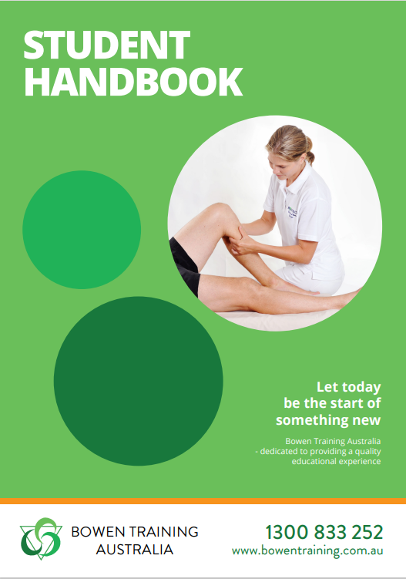


Orientation for Certificate in Bowen Therapy - International
Have you read your Student Handbook?
Student enquiries go to assessments@bowentraining.com.au
Don’t leave things to the last minute
Be patient
www.bowentraining.com.au
Notes:
Begin Orientation. Explain to students where Office is. Staff have specific roles and responsibilities. Audited to meet with legal requirements for government skills assessment. Express that it is a professional establishment with high standards to ensure they get the best training possible.

Slide 8

Bowen Training Australia
STUDENT HANDBOOK
Some examples of the sort of information in your Student Handbook:
Privacy and Information Policy
Assessments information
Complaints and Appeals Policy
Student Protection Policy
Completion Policy
All student information and results are held for a period of 30 years after completion
www.bowentraining.com.au
Notes:
All students are emailed the handbook with their enrolment kit. This is just to familiarise them with the contents.

Slide 9
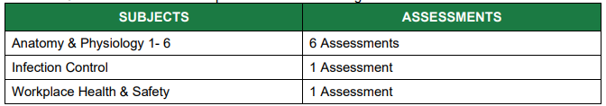
Certificate in Bowen Therapy – International
Mode of Delivery
Online Learning
There are 8 assessments to be completed via online learning:

Slide 10

Certificate in Bowen Therapy – International
Anatomy & Physiology
Infection control
Workplace Health & Safety
First Aid
Online learning –Online access 60 days from purchase https://bowentraining.com.au/our-shop/
Pay as you go
RPL
Notes:
Explain the training units to be completed via distance learning (available online.) Explain RPL. Students need to go to contact BTA to discuss process.

Slide 11
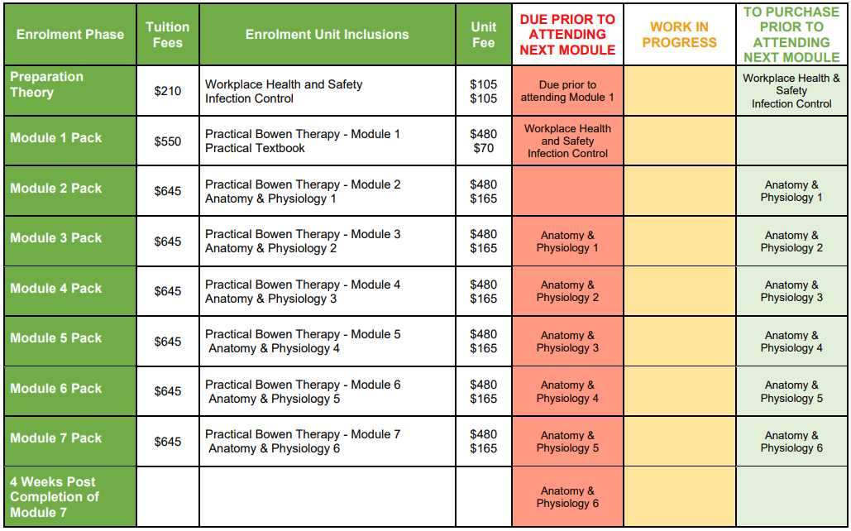
Certificate in Bowen Therapy – International

Slide 12
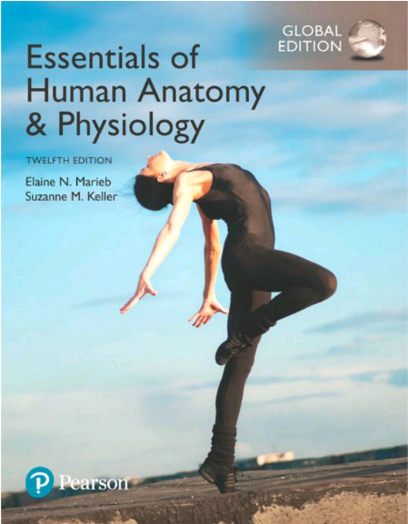
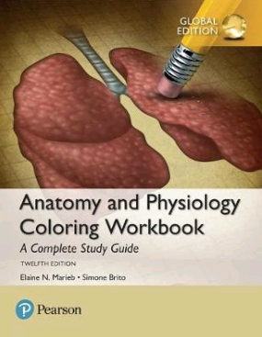
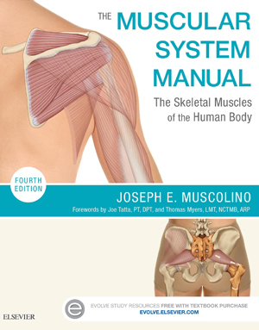
Certificate in Bowen Therapy – International
Recommended Textbooks
Recommended textbooks to complete your studies:
Suggested sources -
  https://www.bookdepository.com/
  http://www.booktopia.com.au
  https://www.elsevierhealth.com.au/the-muscular-system-manual-9780323327701.html
Notes:
Explain the training units to be completed online. Explain the difference between direct credit and RPL. Both need to go to BTA website and download form. Send back with JP certified copies of evidence. Muscolino login and great interactive information

Slide 13

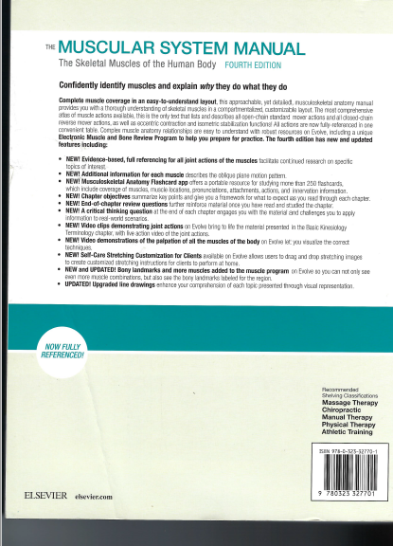
Certificate in Bowen Therapy – International
Recommended Textbooks
Getting the most out of the Muscular System Manual:
Inside the front cover, scratch off to reveal the code to unlock learning aids
Other useful Anatomy Apps:
Essentials Anatomy 5
Muscle System Pro
Skeleton System Pro
Hep 2 go – more relevant for range of motion, exercises, stretch, and strength
Notes:
Explain the training units to be completed online. Explain the difference between direct credit and RPL. Both need to go to BTA website and download form. Send back with JP certified copies of evidence. Muscolino login and great interactive information

Slide 14
Certificate in Bowen Therapy – International
Mode of Delivery
2. Practical Learning
BTA PRACTICAL LEARNING | PRACTICAL ASSESSMENT REQUIREMENTS
Practical Module 1 Practical Module 2 Practical Module 3 Practical Module 4 Practical Module 5 Practical Module 6 Practical Module 7 | Module 7 Case studies (10) – A record of progress over 3 consecutive treatments Logbook – A record of practical experience of 100 hours of treatments completed outside of class.

Slide 15
Student Commitment
To complete the Certificate in Bowen Therapy - International
Attend all modules 1-7 in order
Practice the hands on Bowen Technique 2-3 hours per week
Complete 10 case studies and log 100 practice hours satisfactory
Show competency skills of all procedures learnt at Module 7
Complete all distance units to a satisfactory level
2-3 hours per week dedicated to distance theory subjects
Hold a current first aid certificate
Complete the above within a 12-18 month timeframe
Notes:
Cover all the requirements to complete the International Certificate. Make sure they know the workload. Explain it takes more than just attending the modules. Clarify with students if unclear.

Slide 16
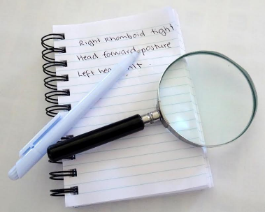
How will students be assessed?
Practical Skills
Assessed progressively during Modules 3-6
Specifically assessed at Module 7
100 hours Logbook practice
10 Case Studies (x3 sessions each)
In class written assessments at modules 3,4,5 & 6
Theory / Online subjects
By individual assessors by email correspondence (BTA) as you complete each unit
Notes:
Logbook – suggest to treat each client only 5 times, no longer than 1 hour. Progressively monitored by instructor demonstrating practice of all procedures learned with constructive feedback between modules. Must not charge for practice sessions and only advertising free ‘Student Practice Sessions’.
Case Study hours cannot be used for logbook records.

Slide 17

Morning Tea
Please complete and return these forms -
Bowtech Registration
Register of Hours signed?
Mod 1 Payment - receipts issued
Notes:
Can go to morning tea - ALL paperwork & payment must be completed at morning tea break.
USI number application online for enrolment

Slide 18
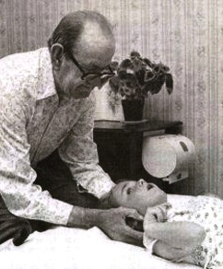
What is the Bowen Technique?
Page vii
Muscle & connective tissue therapy
Tom Bowen Geelong
Measured inputs
Holistic
The body’s innate healing mechanisms
Appropriate to use for all individuals
Notes:
Refer to introduction on page vii. Explain in your own words the introduction to the Bowen technique.

Slide 19
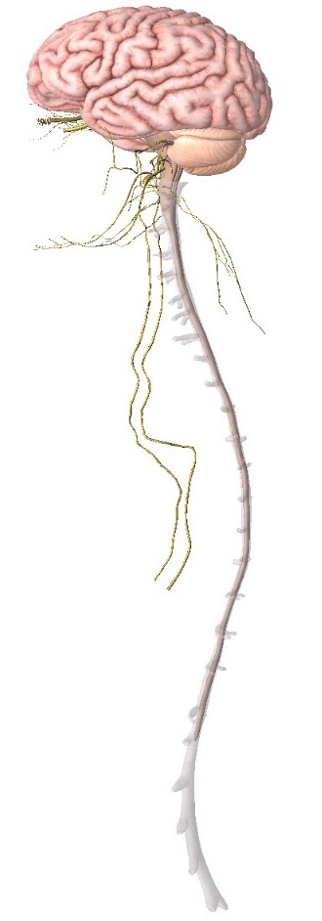
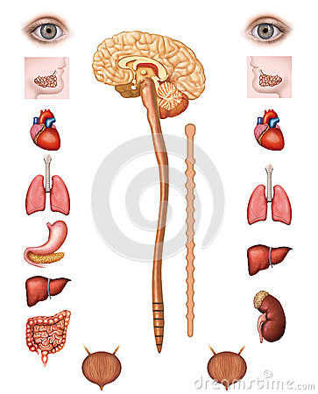
Autonomic nervous system
Page vii
Sympathetic
(Fight or flight)
Parasympathetic
(Rest and digest)
Dilate pupil
Inhibit Salivation
Accelerates Heart
Dilate bronchi
Stimulates Glucose release
Accelerates adrenaline
Relaxes bladder
Constrict pupil
Stimulates Salivation
Slows Heart
Constrict bronchi
Stimulates Digestion
Stimulates Bile release
Stimulates Peristalsis
Contracts bladder
Notes:
Refer to manual ANS info page vii. Controls over 80% bodily functions. External Stressors. Explain difference between sympathetic and parasympathetic and how Bowen catalysts this shift to allow healing. Use your own analogy. Eg 4WD vehicle can be put into 4WD (sympathetic, extra get up and go) then can be taken out of 4WD or just idle, not using much fuel etc. Eg, zebra being chsed by a lion, then relaxes once chase is over.

Slide 20
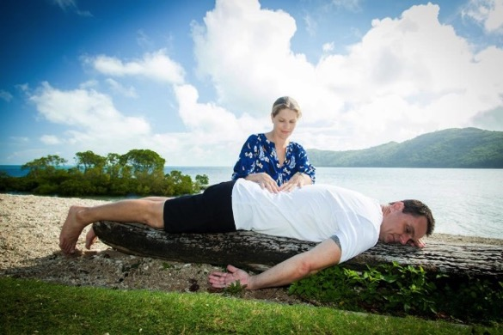
Bowen Technique sessions
Page vii
Anywhere
15 - 45 minutes
Gentle but purposeful
No forceful manipulation
Minimal intervention
Responses for up to 5 days
No other treatments for 5 days
Notes:
Expand on above points and refer back to manual.

Slide 21
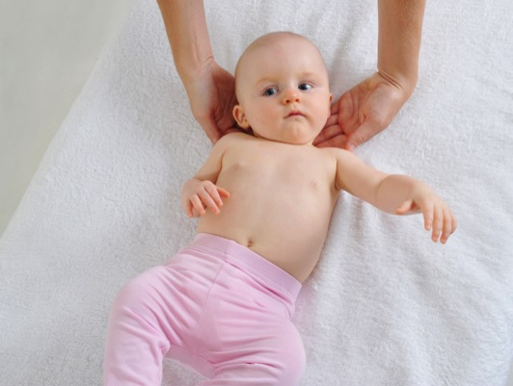
Why is Bowen so Unique?
Page vii
Other modalities - practitioner imposes corrections
Bowen – allows healing with minimal intervention
Bowen – works with body’s natural ability to regulate itself
Notes:
Use your own descriptions to discuss the unique way Bowen works. Explain the difference with Bowen. How the moves send signals for the nervous system to respond to. We have a natural inbuilt ability to heal ourselves. EG broken bone, cut skin. Bowen works with this part of the body. Homeostatic regulation? Homeostasis – The body’s programming to check in and make changes to maintain optimal function and performance. Blueprint of optimal health.

Slide 22
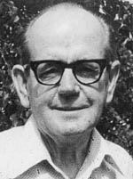
Mr. Thomas Ambrose Bowen
Page vii
Thomas Ambrose Bowen
(1916 – 1982)
1950’s Geelong, Victoria
No formal training
Rene Horwood
1975 - 13, 000 treatments a year
Free clinics for children, disabled and community service workers
Photographs from Ossie & Elaine Rentsch, Bowtech Instruction Manuals
Notes:
Introduce Mr Bowen in your own words and refer back to manual for students to read

Slide 23

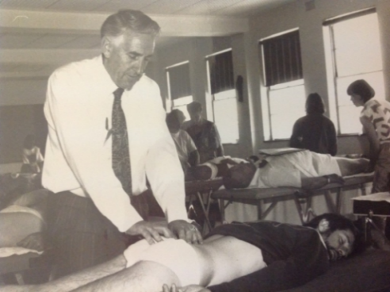
1974 - Oswald Rentsch met Mr. Bowen
1976 – Hamilton Clinic using methods
1987 - Named it Bowtech the Bowen Technique
1987 - Founded the Bowen Therapy Academy of Australia
1990 - Teaching through out Australia
Now taught in over 40 countries
25,000 practitioners since 2013
www.bowtech.com
www.bowtech.com Watch 10 minutes ‘Good morning NZ’ with Ossie and Elaine BTAA Enrolment, Bowenhands, BTAA flyer
Notes:
Explain Bowtech, Ossie and Elaine and enrol to BTAA, also hand out Bowenhands, Bowtech enrolment form. Can show “Good morning New Zealand” to meet Ossie & Elaine

Slide 24
How does Bowtech work?
Page viii
Stretch Reflex
Joint Proprioceptors
Segmental viscerosomatic spinal reflexes
Harmonic Vibration
Detoxification
Notes:
Explain in your own words how Bowen works to each point above. Refer back to manual

Slide 25
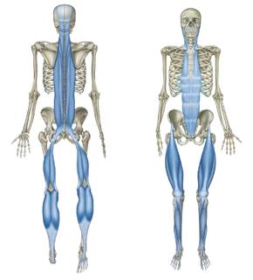
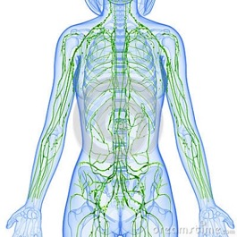
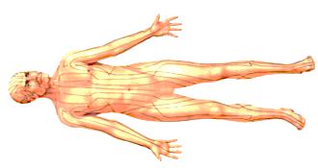
How does Bowtech work?
Page viii
Fascia
Acupuncture points and Meridians
Lymphatics and detoxification
Image resource Thomas Myers, Anatomy Trains, Churchill Livingston, Elsevier
Illustration Reference: Anatomica, Archimedes Press
Notes:
Just note the information and research regarding Fascia is relatively new, last 15-20 years.
This research is beginning to explain another one of the reasons Bowen works as well as it does ☺
Simply touch on or explain Lymphatics and Meridians.

Slide 26
What can you use Bowtech for?
Page ix
Back Pain and Sciatica
Digestive and Bowel problems
Earache and TMJ problems
Migraines and other types of headaches
Fibromyalgia and chronic fatigue syndrome
Hip, knee, ankle and foot problems
Menstrual and hormonal irregularities
Groin pain, pelvic tilt and uneven leg length
Respiratory problems and hay fever
RSI, carpal tunnel syndrome and tennis elbow
Sports and other traumatic injuries
Neck and shoulder problems (including ‘frozen’ shoulder)

Slide 27
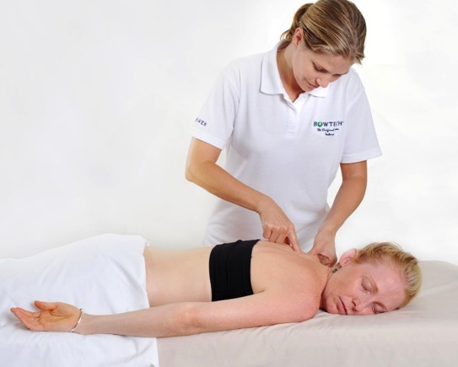
Work on skin or through clothes?
Best on bare skin
Undress to underwear
Bra left on
Professional draping
Can be done with light, comfortable clothing
Anywhere
Seated or standing
In class we will be working on skin, fully draped
Notes:
Explain that Bowen is best performed on skin, you can see body imbalances and feel tension much better.
However the fantastic thing is how versatile the Bowen can be, given through light clothing, seated, standing, practically anywhere, anytime.
But in class we will be learning on the skin. Discuss options for modesty, wear swimsuit, suitable underpants. They will be learning professional draping to feel secure in class. If any one has any concerns disrobing to let me know.

Slide 28
Infection Control
During your Bowen Training practical modules you are required to demonstrate and apply consistent INFECTION CONTROL measures -
Hand washing / sanitise prior to each treatment
Demonstrate appropriate Personal Hygiene, clean presentation
Disinfect the treatment bed surfaces, face hole and bolsters
Use clean linen and store used linen for washing (in a bag)
Use of disposable face hole covers, table covers, bolster cover (feet)
Avoid Cross-contamination, barriers or gloves used where necessary
Personal protection i.e., face mask (colds), wounds, cuts, ports (surgery)
Monitor and ensure a safe clean treatment environment free from contaminants
Hand out wash hands procedure
Notes:
Expand on the importance of Infection Control standards, practice protocols in preparation to working in clinic!
Explain elements of infection control being used during training. Using your own linen, paper towel under face, hand washing.

Slide 29
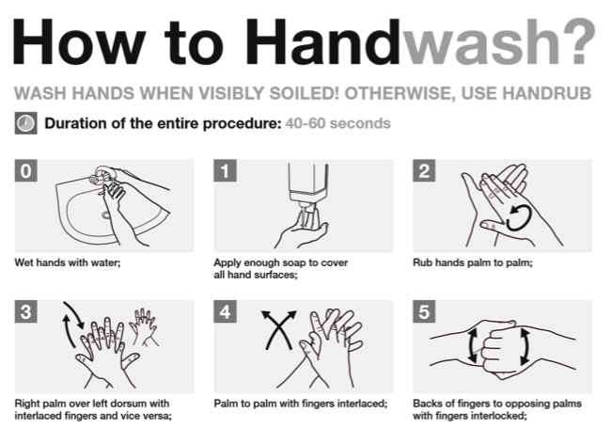
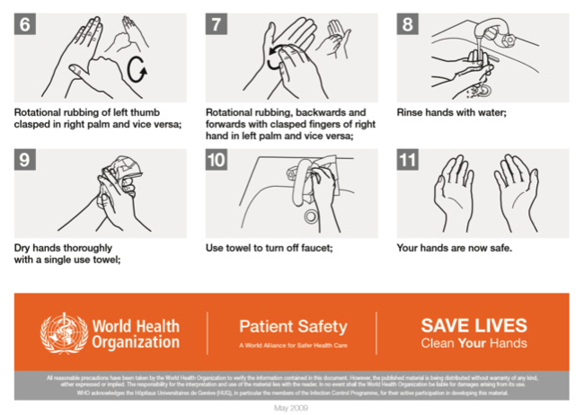
Infection Control
Hand out wash hands procedure
Notes:
Hand out handwashing flyer and also display in training room. Explain elements of infection control being used during training. Using your own linen, paper towel under face, hand washing.

Slide 30
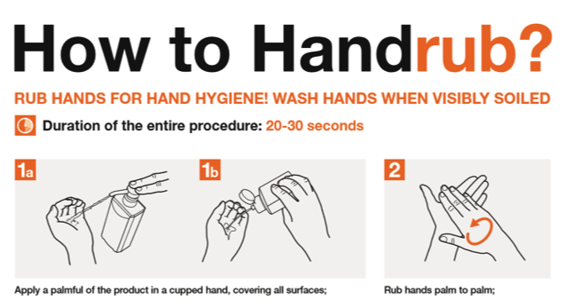
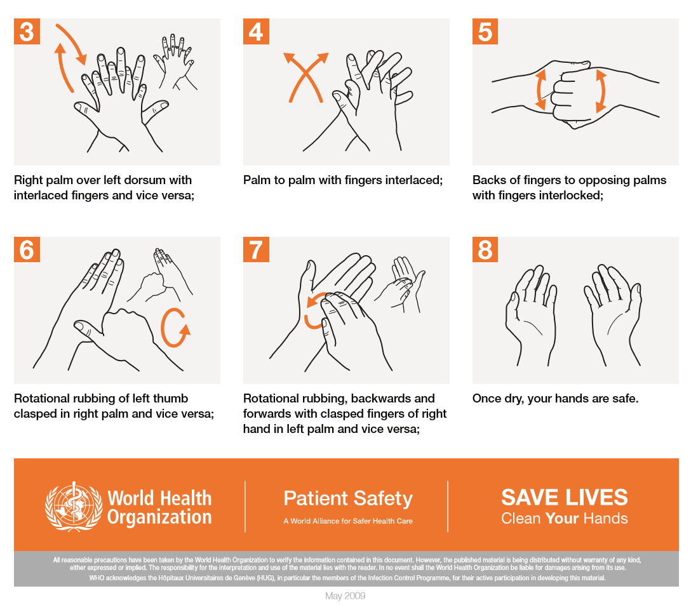
Infection Control
Hand out wash hands procedure
Notes:
Hand out handwashing flyer and also display in training room. Explain elements of infection control being used during training. Using your own linen, paper towel under face, hand washing.

Slide 31
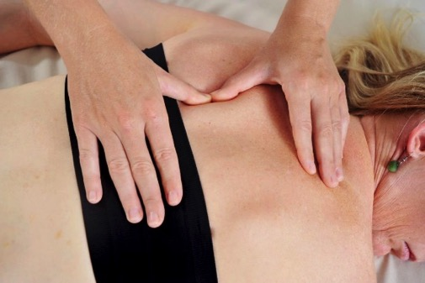
The Bowen Move page 1.2
The Bowen Move consists of four separate and distinct steps
Position the fingers
Take the slack
Sink & Challenge
Make the move
Notes:
Explain the over view of the Bowen move

Slide 32
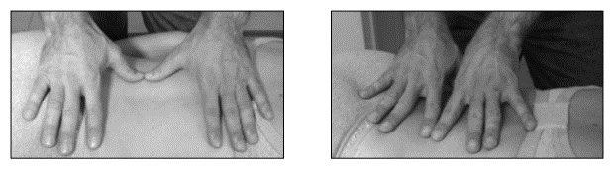
Step 1 Position your fingers page 1.2
Place your thumbs or fingers as appropriate on the crest (most raised part) of the muscle belly, tendon or other structure. Rest the other fingers lightly on the body.
Photographs from Ossie & Elaine Rentsch, Bowtech Instruction Manuals
Notes:
Discuss the crest of a muscle, show how to find

Slide 33
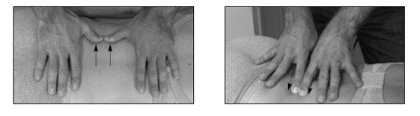
Step 2 Take the slack page 1.2
At the end of exhalation
Gently pull or push and skin slack towards the edge of the structure in the opposite direction of the move to be made
Where the skin is loose, take only enough to allow you to reach the edge of the structure. Where the skin is tight, take what you can
It is vital that you only apply enough pressure to move the skin WITHOUT influencing the structure underneath
If too much pressure is applied while taking the slack, it will send conflicting messages to the brain
Photographs from Ossie & Elaine Rentsch, Bowtech Instruction Manuals
Notes:
Discuss why we take the slack, for what purpose.
Discuss no pressure during the slack stage, it does not disturb structures beneath the skin whilst taking slack.
Sticky Spider fingers, just enough to take skin across the body but no pressure into the body.
You can use your whole hand to take slack not just the fingers making the move.

Slide 34
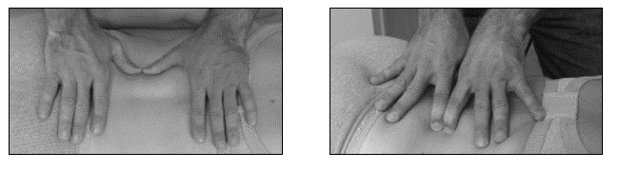
Step 3 Sink & Challenge page 1.2
While taking available slack, allow your thumbs or fingers to ‘sink’ down beside the structure
Nudge up against the structure to stretch the fascia
The pressure will vary with each move but should never be so firm as to cause pain, or to cause the tissue to tense
Hold this ‘challenge’ for approximately two to three seconds
Photographs from Ossie & Elaine Rentsch, Bowtech Instruction Manuals
Notes:
How much pressure for challenge?
Discuss the body letting you drop in rather than forcing in?
Enough pressure to stretch the muscle fibers but not so much to induce a protection response or flinch.
Meeting the same pressure within the body, if it relaxes more you can challenge a little more.
Use RTL analogy of someone knocking on your front door. Hard smash at front door you don’t want to let them in. Nice gentle tap sounds friendly. You have to ask nicely, so the body lets you in. Not to much force or it wants to shut you out. This tissue sense will come with time. First we will learn the technique and locations, then later your tissue sense will increase

Slide 35
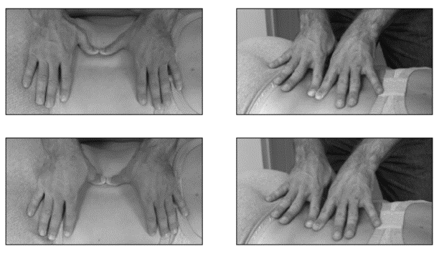
Step 4 Make the Move page 1.2
Maintain the pressure of the challenge as you roll your thumbs or fingers across the structure using the skin slack to travel from one side to the other
Influence as much of the structure as possible to make the move effective
Using your wrists while rolling will help maintain pressure
Photographs from Ossie & Elaine Rentsch, Bowtech Instruction Manuals
Notes:
MQ demonstration – get students to gently slide finger over surface of skin (tickle like) on forearm and ask what they can feel? This pressure is too light for Bowen just skimming over the skin.
Ask students to push finger tip hard into forearm and move back and forward, ask what they can feel? It may be poky or painful and might feel tendons either side.
Place finger pad on forearm and move back and forward taking skin slack with you, ask what they can feel? Should be able to feel structures beneath the skin, tendons, tension. This is the pressure we are looking for the Bowen move. Like goldilocks, not too heavy, not too light, but just right. This may change for each client but looking to influence structures beneath skin but not aggravate them. This skill will also come with practice.

Slide 36
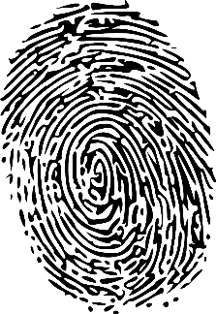
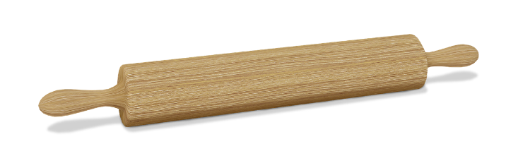
Step 4 Make the Move page 1.2
Each Bowen move requires its own pressure, challenge and speed, depending on where it is on the body and the sensitivity of the client.
Use firm enough pressure to stimulate the receptors within the structure being addressed, without causing pain or discomfort.
Steam Roller OK
Rolling pin OK
Fingerprint roll OK
NOT Bulldozer shove
Notes:
Demonstrate all 4 parts of move and get students to practice on their own leg to get feel for movement at wrists for each part of move.
Emphasize the rolling of the wrists rather than shoving off the thumbs and fingers. Ask students to visualize what works for them. Rolling pin, thumb print at police station, steam roller.

Slide 37
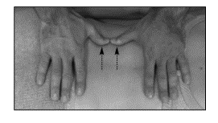
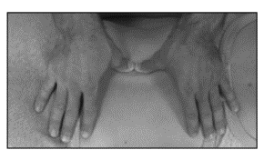
Lets practice the Bowen Move
Position the fingers (rest on crest of muscle)
Take the slack (no pressure, along the body, not into the body)
Challenge (sink into the body, challenge against side of muscle)
Make the move (maintain that pressure as you roll over edge of muscle, imagine rolling a perfect fingerprint)
Position
Slack
Challenge
Roll
Photographs from Ossie & Elaine Rentsch, Bowtech Instruction Manuals
Notes:
Practice on table, on leg for students to get the basic feel of rolling the wrists. Or what ever current technique you are using. Practise on a partner prone somewhere that is easy for the students to work and find. Top stopper location is easier to get a roll for first practice than bottom stoppers. Just let students feel and play with the Bowen move over erector spinae between the shoulder blades before we begin BRM 1

Slide 38
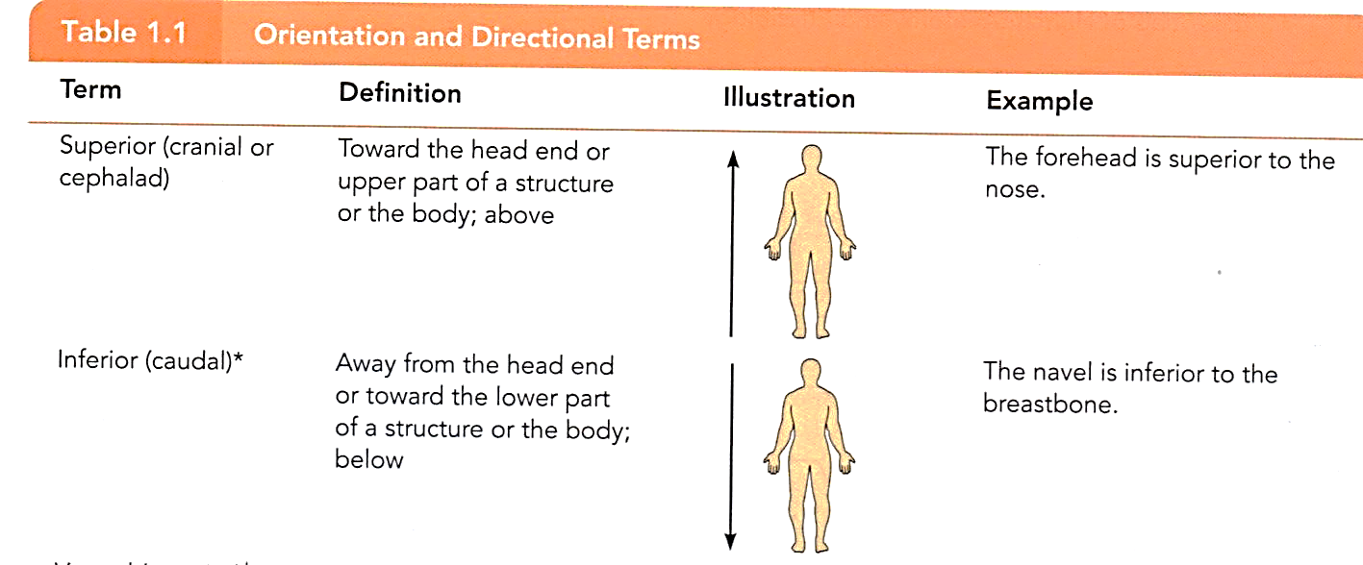
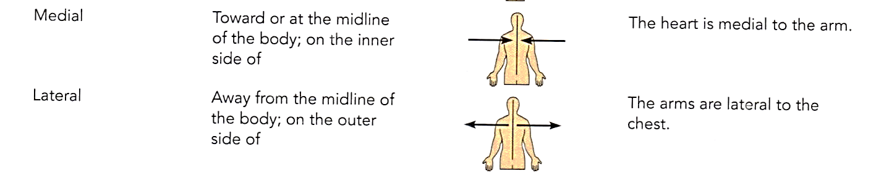
Directional Terms
Image resource: Anatomy & Physiology, Marieb
Notes:
Explain the need to know directional terms. Start A&P as soon as possible. Also can refer to glossary in back of manual page 2.21

Slide 39
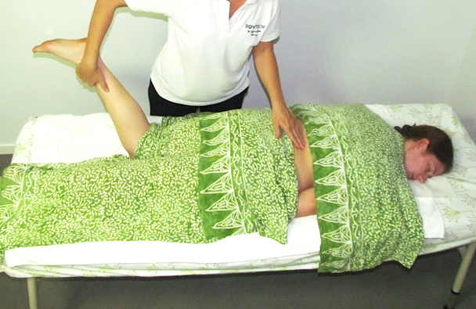
Professional Draping
Bra left on
Only uncover area needed
Full cover elsewhere
May need 2 top sheets
Underwear always covered
Safe and secure
Notes:
Hand out draping information and explain I will be demonstrating correct draping for each procedure. ‘T’ Towel

Slide 40
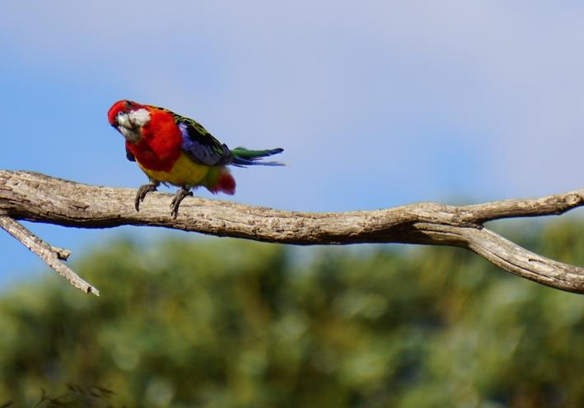
Lunch

Slide 41
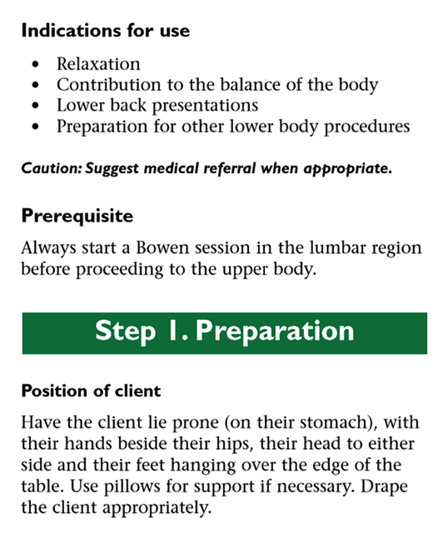
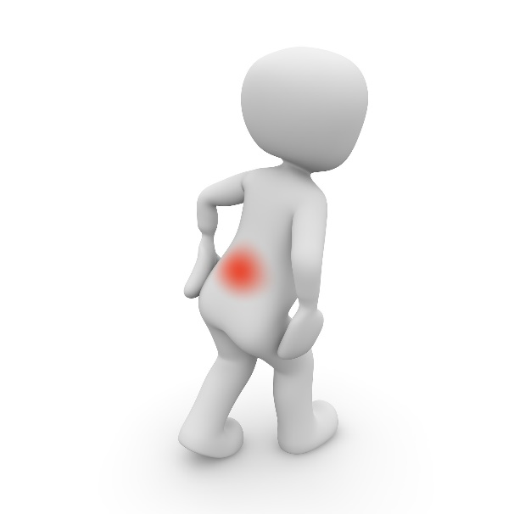
New procedure
Lower back (BRM1) page 1.4
Notes:
Introduce students to concept of BRM’s Bowen Relaxation Moves. Show how to position a client ready for treatment. Introduce concept of standing on and working prone from the clients left side. Explain what are indications and how we use them. Introduce concept of prerequisites.

Slide 42
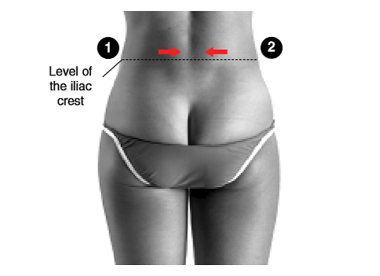
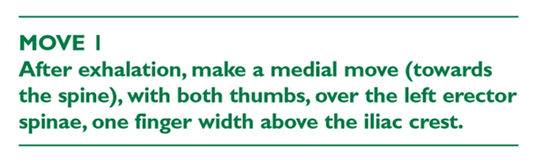
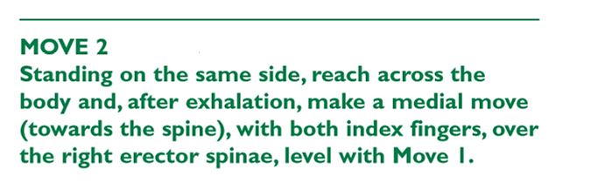
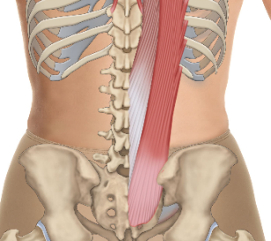
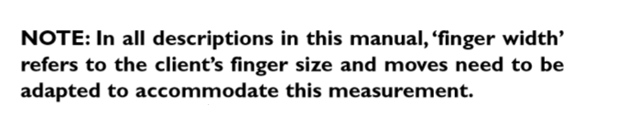
New Procedure – Lower Back
BRM 1 moves 1 & 2 page 1.4
Photographs from Ossie & Elaine Rentsch, Bowtech Instruction Manuals Muscle Illustrations from Joseph Muscolino, The Muscle System Manual
Notes:
Demonstrate and practice moves 1 & 2 in detail, inform students to pay attention to what sensations they experience, where, what it felt like, did it move or stay. (stoppers)

Slide 43
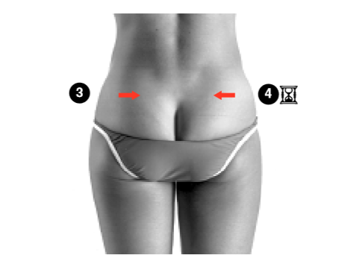
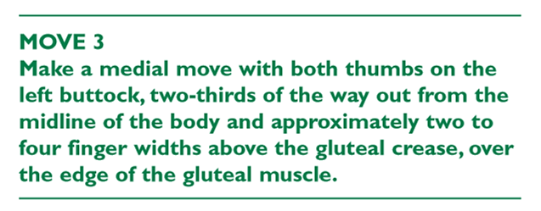
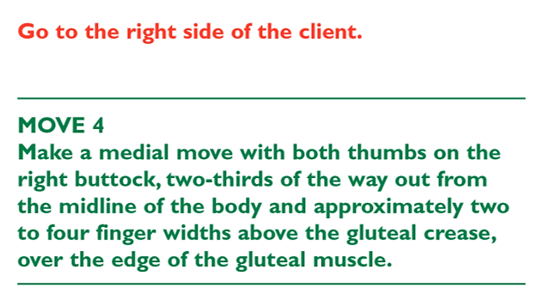
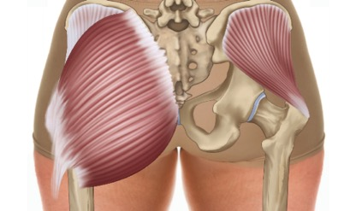


New Procedure – Lower Back
BRM 1 moves 3 & 4 page 1.4
Go to the right side of the client
Photographs from Ossie & Elaine Rentsch, Bowtech Instruction Manuals Muscle Illustrations from Joseph Muscolino, The Muscle System Manual

Slide 44








New Procedure – Lower Back
BRM 1 moves 5 - 8 page 1.5
Stand at the left side of the client
Go to the right side of the client
Repeat these moves on the right leg
Photographs from Ossie & Elaine Rentsch, Bowtech Instruction Manuals Muscle Illustrations from Joseph Muscolino, The Muscle System Manual

Slide 45




New Procedure – Lower Back
BRM 1 moves 9&10 page 1.6
Stand at the left side of the client
Go to the right side of the client
Photographs from Ossie & Elaine Rentsch, Bowtech Instruction Manuals Muscle Illustrations from Joseph Muscolino, The Muscle System Manual

Slide 46




New Procedure – Lower Back
BRM 1 moves 11&12 page 1.7
Photographs from Ossie & Elaine Rentsch, Bowtech Instruction Manuals Muscle Illustrations from Joseph Muscolino, The Muscle System Manual

Slide 47

Your class kit
Please bring to every class
Massage Table, if you have one
Massage cover
Base sheet
Face paper towel
Covers x2
Extra towels for support
Pillow for support if needed
Antibacterial Hand Wash
Notes:
Explain to students how to put together a clinic/class kit. What they need to bring to each class. Nail clippers, water bottle

Slide 48
Assist your client to arise page 1.15
Client’s hands behind their lower back, use to push to sit up
If can’t do this they can roll to side, then up use arm to lever up
Still can’t , they may need assistance leverage like in a hospital
Check eyes
Ask if dizzy
Rest if needed
Both feet on floor at the same time to come off table

Slide 49



New Procedure
BRM 2 Upper back page 1.8

Slide 50








New Procedure Upper back
BRM 2 Moves 1 -4 page 1.8
Photographs from Ossie & Elaine Rentsch, Bowtech Instruction Manuals Muscle Illustrations from Joseph Muscolino, The Muscle System Manual

Slide 51





New Procedure Upper back
BRM 2 Moves 5 - 8 page 1.9
Photographs from Ossie & Elaine Rentsch, Bowtech Instruction Manuals Muscle Illustrations from Joseph Muscolino, The Muscle System Manual

Slide 52




New Procedure Upper back
BRM 2 Moves 8a/8b page 1.10
Photographs from Ossie & Elaine Rentsch, Bowtech Instruction Manuals Muscle Illustrations from Joseph Muscolino, The Muscle System Manual

Slide 53

End of Day 1
Eat a good dinner
Drinks lots of water
Gentle walk
See you tomorrow 8.30am ☺

Slide 54

Module 1
Welcome back Day 2

Slide 55

Module 1
Welcome back Day 2
TODAY
Drink lots of water
Lower and Upper back revision
New procedure - Neck (BRM3)
New procedure - Head
New procedure - Kidney
Session management
How is everyone feeling?
How did you sleep?
Notice anything different?

Slide 56





How to use your manual page vi
Steps
Waiting times
Changes in Position
Egg timer denotes waits 
Arrows
Midpoint = start point to take slack towards tail
Point = move direction
Tail = challenge
Brief move summary
NOTES
Comments

Slide 57










Re- demonstrate Lower back
BRM 1 page 1.4
Photographs from Ossie & Elaine Rentsch, Bowtech Instruction Manuals Muscle Illustrations from Joseph Muscolino, The Muscle System Manual
Notes:
If hit the lat doesn’t go first time, wait 5 minutes then try again.
Sometimes if the leg is externally rotated it is hard to hit the lat, best to support leg in anatomical position if heavy external rotation to perform hit the lat

Slide 58

Lower Stoppers
Lower back (BRM1) Moves 1 & 2
Purpose of Lower Stoppers
contain energy in a designated area
activate the body to respond to subsequent moves
‘turn on the computer’
‘kick start’ the system like jump starting your car
assessment tool
begin the relaxation process
Photographs from Ossie & Elaine Rentsch, Bowtech Instruction Manuals Muscle Illustrations from Joseph Muscolino, The Muscle System Manual
Notes:
Explain the significance of bottom stoppers, what function they have and how they can be used. Explain it is like jump starting your car, you only need to do it once, you don’t do it over and over again.

Slide 59

Morning Tea
Notes:
Have all signed forms been handed up?

Slide 60




Re- demonstrate Upper back
BRM 2 moves 1- 8 page 1.8
Photographs from Ossie & Elaine Rentsch, Bowtech Instruction Manuals Muscle Illustrations from Joseph Muscolino, The Muscle System Manual

Slide 61







Upper back continued
BRM 2 Moves 9-16 page 1.10
Photographs from Ossie & Elaine Rentsch, Bowtech Instruction Manuals Muscle Illustrations from Joseph Muscolino, The Muscle System Manual

Slide 62



New Procedure Neck
BRM 3 page 1.12

Slide 63









New Procedure Neck
BRM 3 page 1.12
Photographs from Ossie & Elaine Rentsch, Bowtech Instruction Manuals Muscle Illustrations from Joseph Muscolino, The Muscle System Manual
Notes:
Moves 3 & 4 activate detox and regulates blood pressure

Slide 64









New Procedure Neck
BRM 3 page 1.12
Photographs from Ossie & Elaine Rentsch, Bowtech Instruction Manuals Muscle Illustrations from Joseph Muscolino, The Muscle System Manual

Slide 65

Lunch
Fill in and return student survey

Slide 66

Working with a client page 1.15
Before treatment
Explain how Bowen works
Explain purpose of breaks
Assess body alignment
Check for contra-indications
Gain client consent
Client comfort and draping
Slow and deliberate with your moves
Allow minimum 2-minute wait for integration
Remember ‘less is best’
Notes:
Expand and explain above points. Students to refer back to manual.

Slide 67

Working with a client page 1.15
After treatment
Help client to sit upright
Check if lightheaded or dizzy
WALK
WATER
WAIT
New injury or re-injury
Pregnant
Asthma
No heat or ice
Next session between 5 & 10 days
Give exercises
If symptoms persist, advise to see their doctor
Notes:
Expand and explain above points. Students to refer back to manual. Avoid other forms of bodywork for next 7 days (best to schedule 3 consecutive Bowen sessions)

Slide 68
Assessment A
100 Log hours and 10 Case studies
Certificate in Bowen Therapy - International
Assessment Task A for Professional Skills: Logbook
        encourages you to analyse what takes place in Bowen
        develop an awareness of how a client can progress over a number treatments
        requires you to keep and maintain client records
Logbook
You must complete 10 to 15 logbook hours between each module
At each Practical Module, the student must bring the completed Logbook hours to the Instructor, who will initial each page as evidence
Client report for each treatment of 100 hours total
Cumulative hours sheet
Logbook hours include time to interview and aftercare, not just table time
Case Studies
To be discusses at Module 2
Notes:
Hand out and explain the log hours and case study assessment requirements. Make students aware that they are not permitted to charge for their practice sessions, until Certificate is attained.

Slide 69


Client Record Form - is completed only once for each new client

Slide 70

Client Report Form – to be completed for every Bowen Therapy treatment and follow up treatment

Slide 71


New Procedure
Kidney page 1.16
Notes:
Run through basic housekeeping. Flow of day for breaks etc.

Slide 72


New Procedure
Kidney Assessment page 1.16

Slide 73




New Procedure
Kidney page 1.16
Stand at
this side

Slide 74





New Procedure
Kidney page 1.17
Stand at
this side
Stand at
this side
Photographs from Ossie & Elaine Rentsch, Bowtech Instruction Manuals Muscle Illustrations from Joseph Muscolino, The Muscle System Manual

Slide 75


New Procedure
Kidney page 1.17

Slide 76


New Procedure
Head page 1.18

Slide 77










New Procedure
Head page 1.18

Slide 78

Session Management
Minimum Practice 2-3 hours a week
Student practice suggestions
Notes:
Discuss timing, whole body balance, give out practice suggestions
Hand out and discuss student practice suggestions

Slide 79
Buying a massage table
Things to consider
New or used
Width
Adjustable height
Weight
Portable
Shape
Brands
Price
Head piece
Notes:
Discuss variables when looking to buy a massage table. Give the students an idea of options and suggest best option for practice use.

Slide 80


Stay calm
and use the manual
When in doubt, stay calm and refer back to the manual
Green for move summary
Black for detailed anatomical description

Slide 81

Homework to complete by Module 2
Read your manual
Answer the study questions page 1.20
Practice the procedures, record in your logbook
Refer to suggested combinations
Minimum 2 hours a week practice
Find a buddy to swap with
Bring your kit, manual and logbook for Module 2
Call or email if you have any questions
Notes:
Discuss timing, whole body balance, give out practice suggestions

Slide 82


Thank you
See you at Module 2
Notes:
Practice makes Professional!

