Slide 1

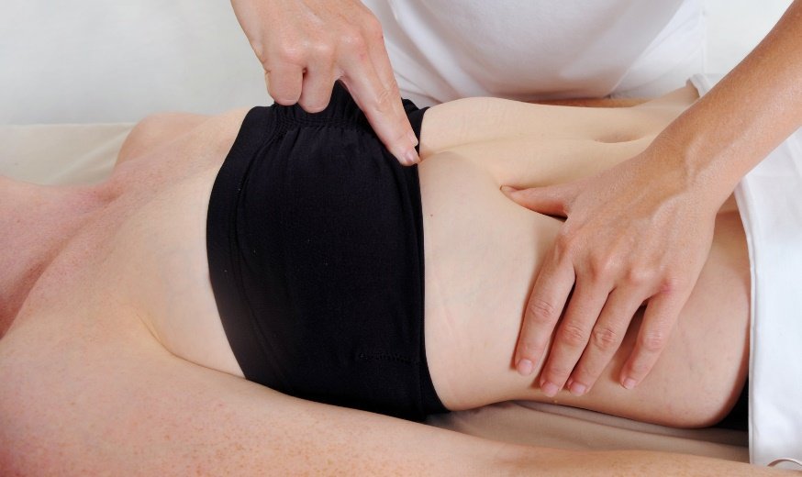
Module 2
Welcome
Certificate in Bowen Therapy - International
Module 3
Review Module 1 procedures
Respiratory
Shoulder assisted
Shoulder unassisted
Hamstring
Cramp
Notes:
Display on arrival

Slide 2

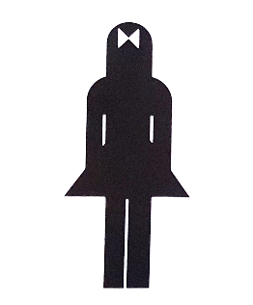
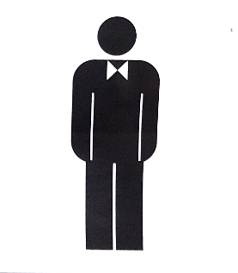

Module 2
Welcome
Sign in register & nametags
Payment & receipts
Toilets
Breaks
Phones off or on silent
Exit and emergency meet point, fire extinguisher
Any special needs?
Notes:
Run through basic housekeeping. Flow of day for breaks etc.

Slide 3
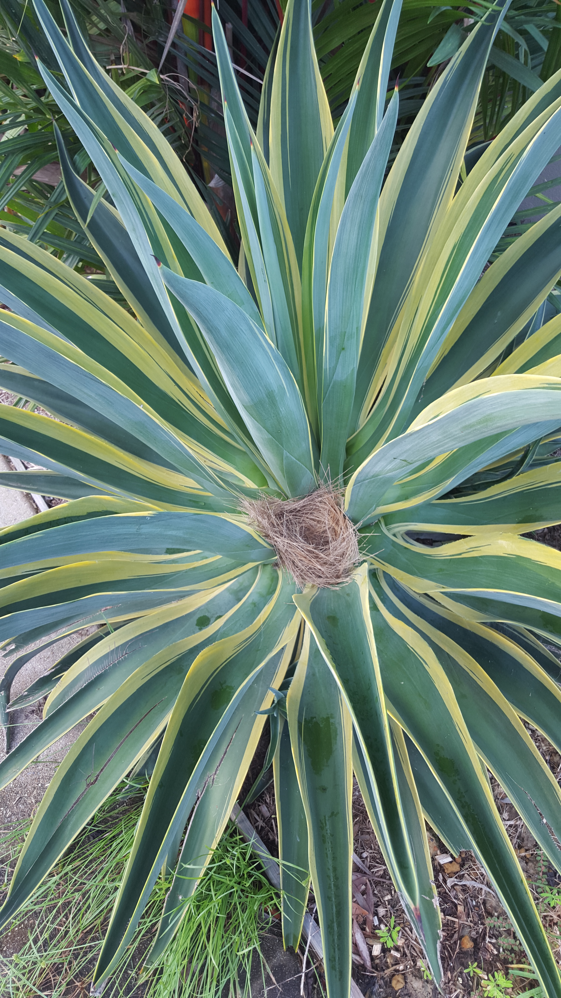
Module 2
Welcome
Welcome back
Any clarification from Module 1
BTA welcome email
Any clarification re: Online units
Hand in Log Hours
Notes:
Check all students received welcome email. Check they have completed infection control and WHS and purchased A&P 1. Answer any questions.

Slide 4
Module 2
Schedule
Module 1 Revision
Module 2 New Procedures
Re-demonstrate and Practice
BRM 1 Lower Back
BRM 2 Upper Back
Kidney
Neck
Head
Demonstrate and Practice
Respiratory
Shoulder (with an assistant)
Hamstring
Shoulder (without an assistant)
Cramp
Introduce Case Studies
Notes:
Explain schedule for weekend. Revise all Mod 1 procedures and 5 new procedures for Mod 2

Slide 5
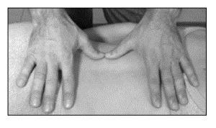
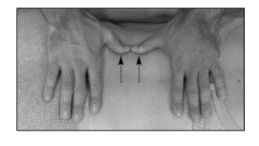
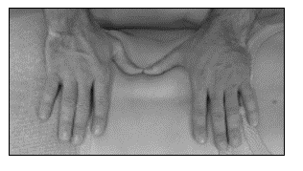
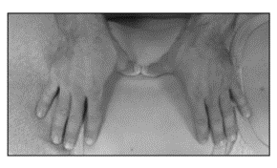
Revision
The Bowen Move
Position the fingers (rest on crest of muscle)
Take the slack (no pressure, across the body, not into the body)
Challenge (sink into the body, challenge against side of muscle for 2-3 seconds)
Make the move (maintain pressure as you roll over edge of muscle, imagine rolling a perfect fingerprint, lifting wrists)
Position
Slack
Challenge
Roll
Photographs from Ossie & Elaine Rentsch, Bowtech Instruction Manuals Muscle Illustrations from Joseph Muscolino, The Muscle System Manual
Notes:
Revise the parts of the Bowen Move. Demonstrate and discuss

Slide 6
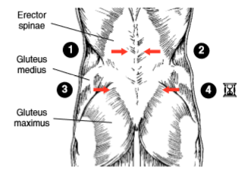
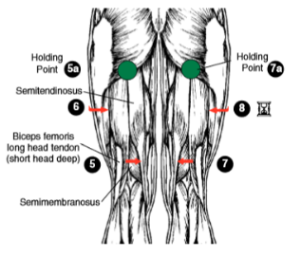
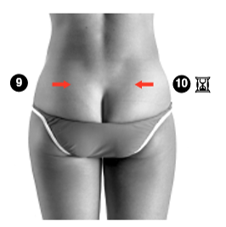
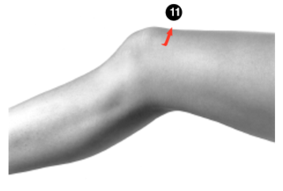



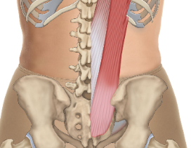
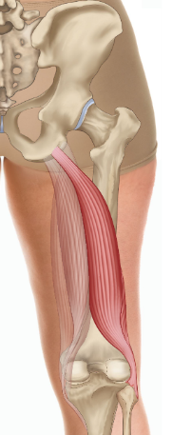
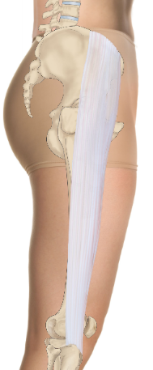
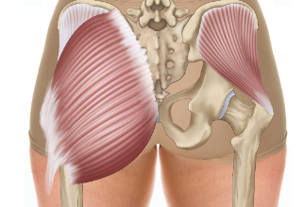
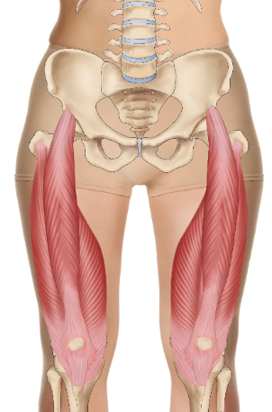
Re- demonstrate and practice
BRM 1 Lower back page 1.4
Turn client supine
Go to left knee
Gluteus medius
Erector Spinae
Gluteus maximus
Rectus
femoris
Gluteus medius
Semi-
tendinosus
Iliotibial band
Vastus
medialis
Gluteus maximus
Biceps femoris long head
Vastus lateralis
Photographs from Ossie & Elaine Rentsch, Bowtech Instruction Manuals Muscle Illustrations from Joseph Muscolino, The Muscle System Manual
Notes:
Demonstrate and practice BRM 1 – Lower back procedure

Slide 7
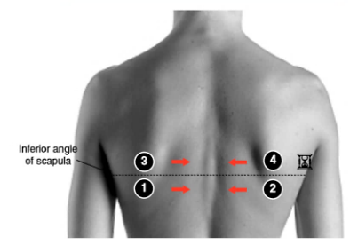
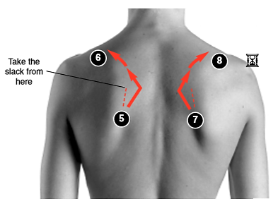
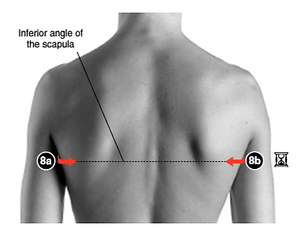
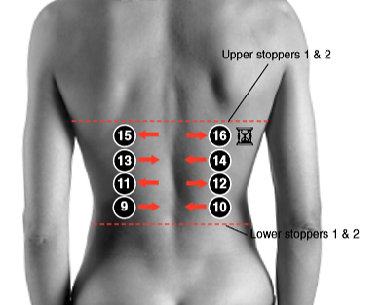
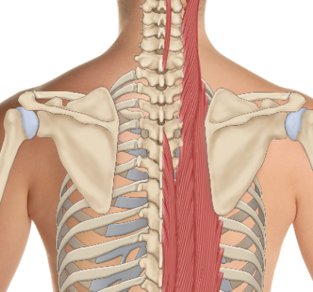
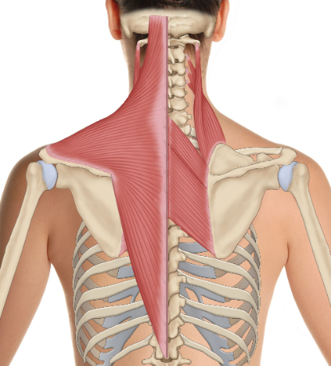
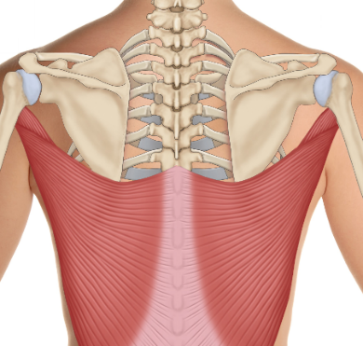
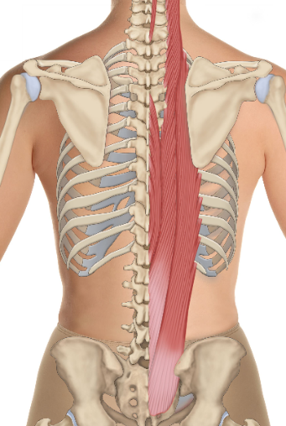
Re-demonstrate and practice
BRM 2 Upper back page 1.8
Levator scapulae
Trapezius
Iliocostalis
Longissimus
Spinalis
Rhomboids
Erector spinae
Latissimus dorsi
Erector spinae
Photographs from Ossie & Elaine Rentsch, Bowtech Instruction Manuals Muscle Illustrations from Joseph Muscolino, The Muscle System Manual
Notes:
Demonstrate and practice BRM 2 – Upper back procedure
Can show video if you like

Slide 8
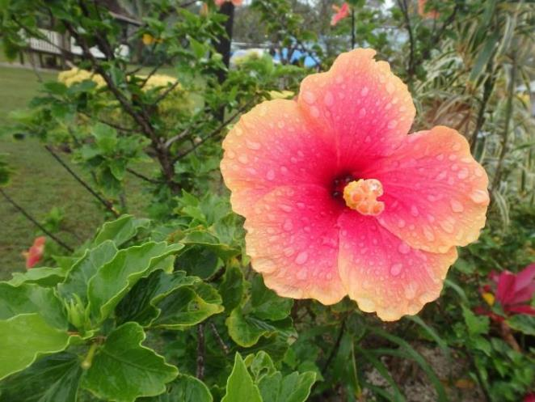
Morning Tea

Slide 9
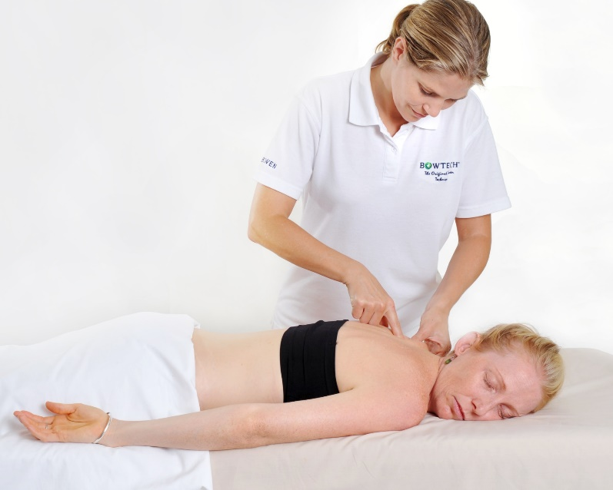
Revision
Work on skin or through clothes?
Best on bare skin
Undress to underwear
Bra left on
Professional draping
Through light, comfortable clothing
Anywhere
Seated or standing
In class we will be working on skin, fully draped
Notes:
Explain that Bowen is best performed on skin, you can see body imbalances and feel tension much better.
However the fantastic thing is how versatile the Bowen can be, given through light clothing, seated, standing, practically anywhere, anytime.
But in class we will be learning on the skin. Discuss options for modesty, wear swimsuit, suitable underpants. They will be learning professional draping to feel secure in class. If any one has any concerns disrobing to let me know.

Slide 10
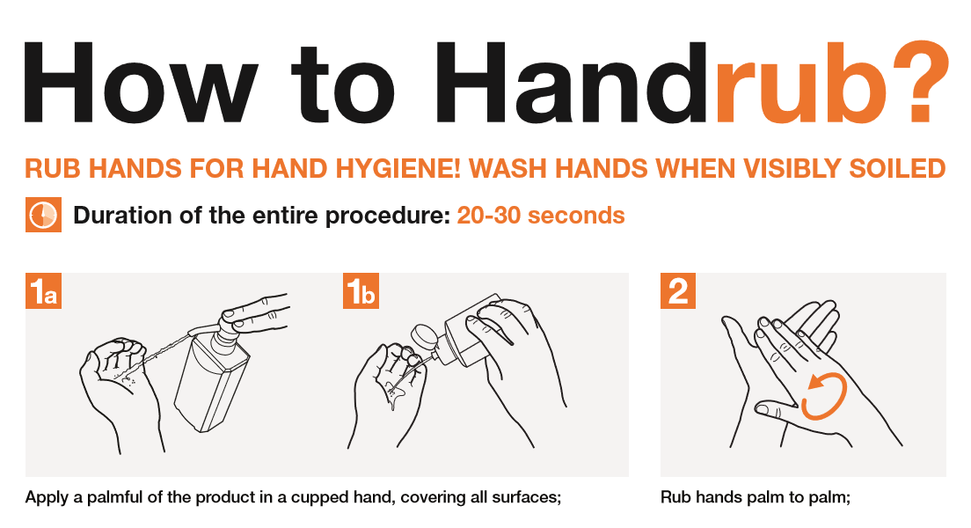
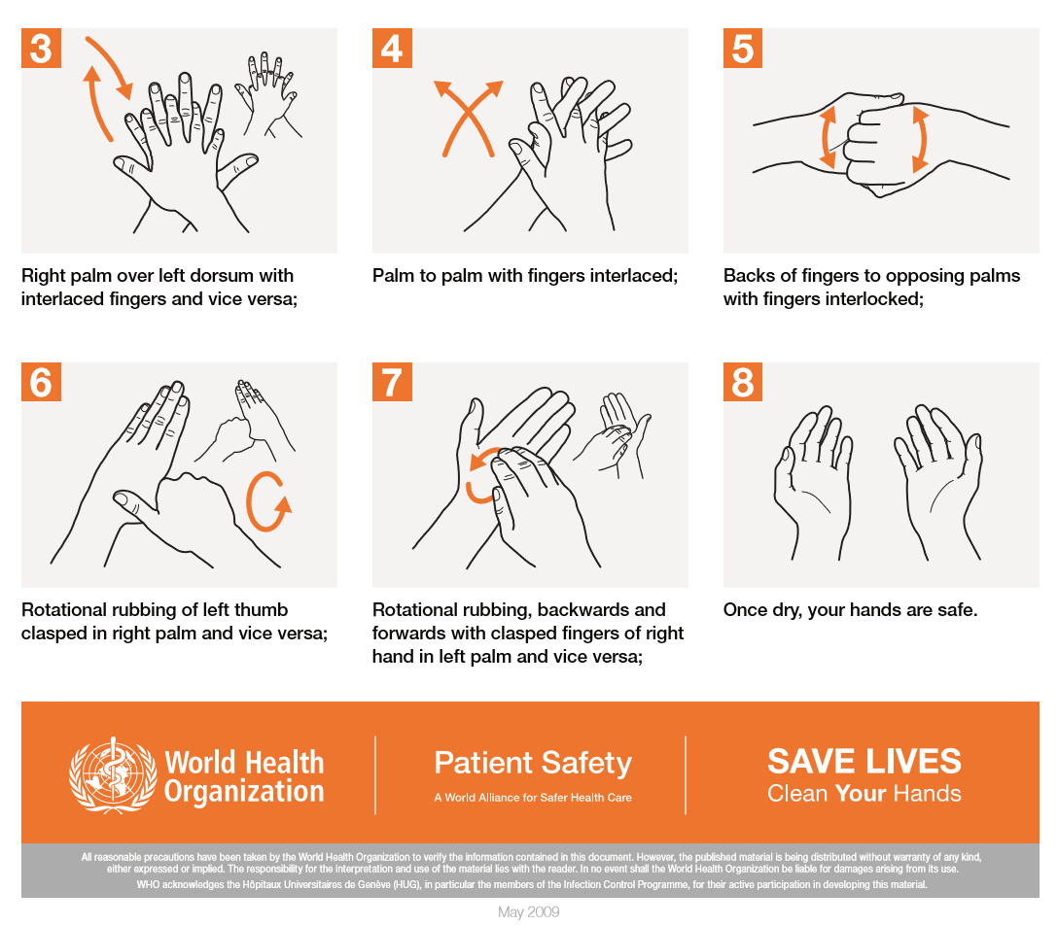
Revision - Infection Control
Hand out wash hands procedure
Notes:
Hand out handwashing flyer and also display in training room. Explain elements of infection control being used during training. Using your own linen, paper towel under face, hand washing.

Slide 11
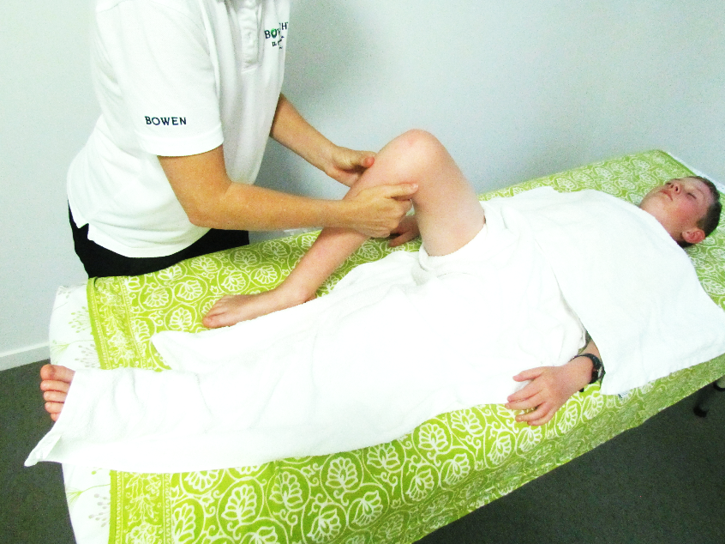
Revision
Professional Draping
Bra left on
Only uncover area needed
Full cover elsewhere
May need 2 top sheets
Underwear always covered
Safe and secure
Notes:
Hand out draping information and explain I will be demonstrating correct draping for each procedure.

Slide 12
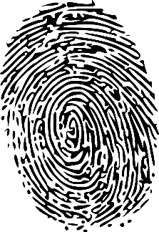
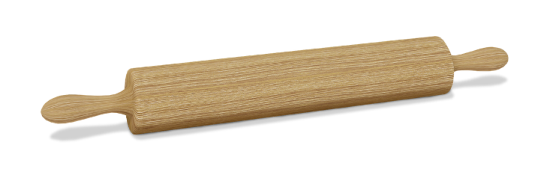
Revision
Make the Move page 1.2
Each Bowen move requires its own pressure, challenge and speed, depending on where it is on the body and the sensitivity of the client.
Use firm enough pressure to stimulate the receptors within the structure being addressed, without causing pain or discomfort.
Steam Roller OK
Rolling pin OK
Fingerprint roll OK
NOT Bulldozer shove
Notes:
Demonstrate all 4 parts of move and get students to practice on their own leg to get feel for movement at wrists for each part of move.
Emphasize the rolling of the wrists rather than shoving off the thumbs and fingers. Ask students to visualize what works for them. Rolling pin, thumb print at police station, steam roller.

Slide 13
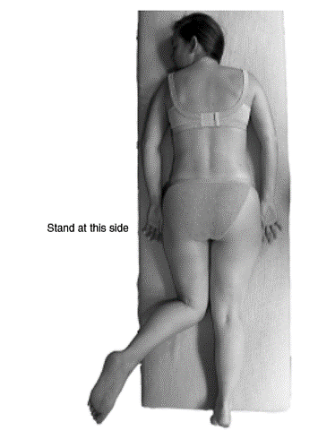
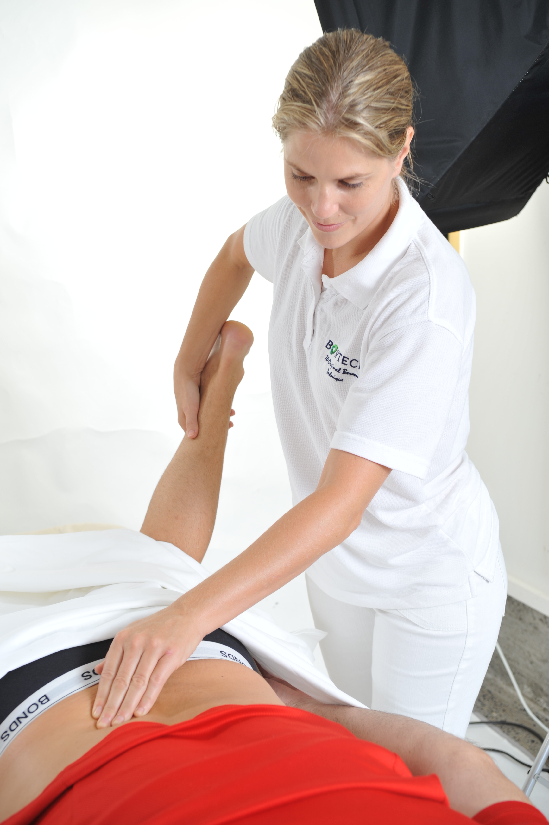
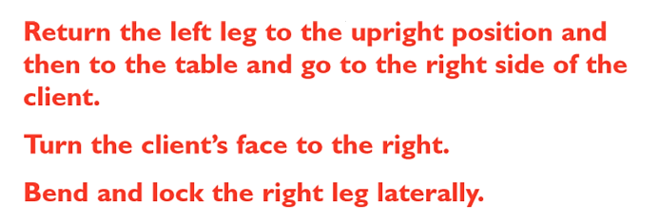
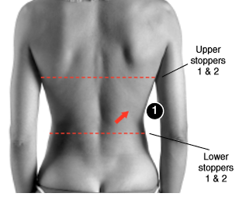
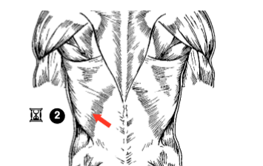
Re-demonstrate and practice
Kidney page 1.17
  Indications for use
  Prerequisites
  3 types of assessment
  Work better side first
  Leg lock
  Work across the body on opposite side
  You, the face and the foot on same side
  Recommendation
Stand at this side
Stand at this side
Erector spinae
Photographs from Ossie & Elaine Rentsch, Bowtech Instruction Manuals Muscle Illustrations from Joseph Muscolino, The Muscle System Manual
Notes:
Ask students to answer the above points about the kidney procedure. Can look at manual if cant remember. Demonstrate and practise Kidney

Slide 14
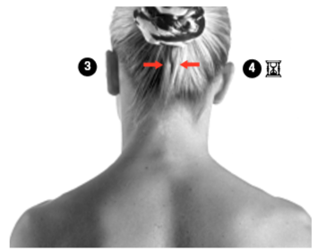
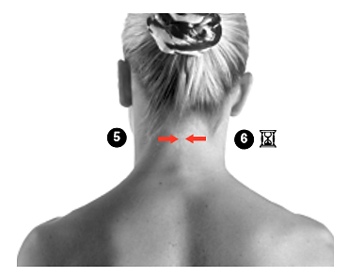
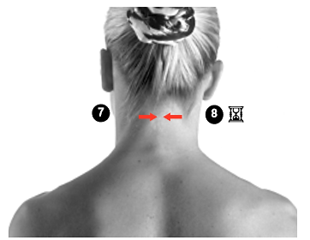
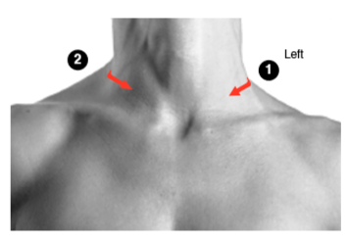
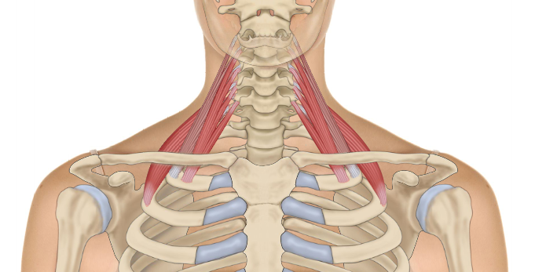
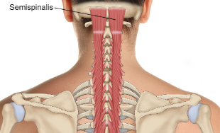
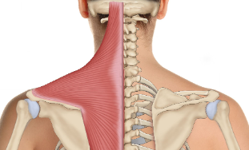
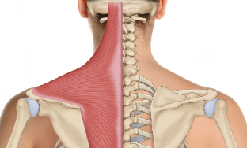
Re- demonstrate and practice
BRM 3 Neck page 1.12
Posterior and middle Scalenes
Semispinalis capitis
Trapezius
Trapezius
Photographs from Ossie & Elaine Rentsch, Bowtech Instruction Manuals Muscle Illustrations from Joseph Muscolino, The Muscle System Manual
Notes:
Demonstrate and practice BRM 3 – Neck
Show video if you like

Slide 15
Revision page 1.15
Assist your client to arise
Clients hands behind their lower back, use to push to sit up
If can’t do this they can roll to side, then up use arm to lever up
Still can’t, they may need assistance leverage like in a hospital
Check eyes
Ask if dizzy
Rest if needed
Both feet on floor at the same time to come off table

Slide 16
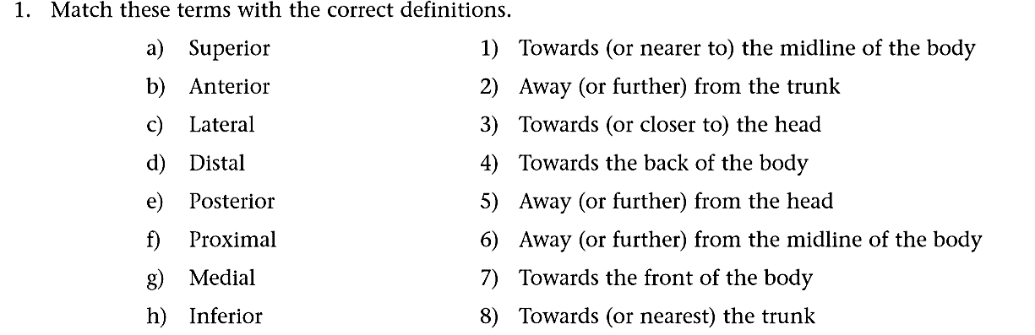
Module 1
Study questions page 1.20
2. Define these directions: posterolateral anteromedial inferomedial superolateral
3. Describe in detail the process of helping a client up after a session.
4. What instructions for self-care might you give a client after a session?
5. What are the main muscles addressed in the BRM Lower Back Procedure?
6. How would you explain the mandatory waits to your client?
7. Which procedures would you use on a client who just needed to relax?
8. For which situations would you consider using the Kidney Procedure?
9. How long after a first session would you schedule a return visit?
10. Describe in your own words the four steps of the Bowen Move
Notes:
Group activity to go through study questions.

Slide 17

Lunch

Slide 18
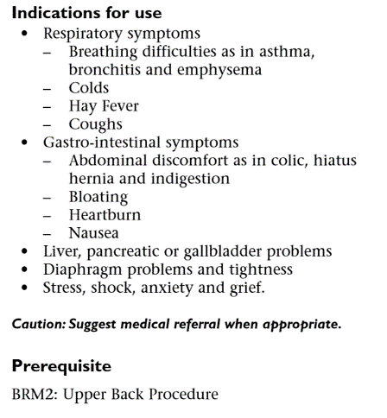
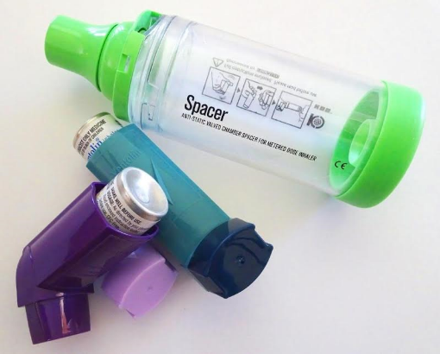
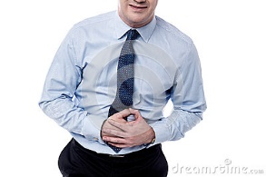
New Procedure
Respiratory page 2.2
Photographs from Ossie & Elaine Rentsch, Bowtech Instruction Manuals Muscle Illustrations from Joseph Muscolino, The Muscle System Manual
Notes:
Discuss and explain indications for Respiratory procedure.

Slide 19
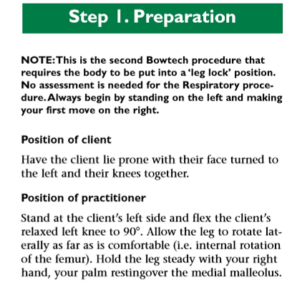

New Procedure
Respiratory page 2.2
Photographs from Ossie & Elaine Rentsch, Bowtech Instruction Manuals Muscle Illustrations from Joseph Muscolino, The Muscle System Manual
Notes:
Introduce the concept of the leg lock. Point out how the diaphragm lifts up into the rib cage on exhalation.

Slide 20



New Procedure
Respiratory page 2.2
With leg lock
Erector spinae
Photographs from Ossie & Elaine Rentsch, Bowtech Instruction Manuals Muscle Illustrations from Joseph Muscolino, The Muscle System Manual
Notes:
Discuss prone moves

Slide 21




New Procedure
Respiratory page 2.3
Xiphoid process
Complete the supine moves of
this procedure before making
any other moves
Photographs from Ossie & Elaine Rentsch, Bowtech Instruction Manuals Muscle Illustrations from Joseph Muscolino, The Muscle System Manual
Notes:
Discuss prone moves. Explain importance of waiting for exhalation for supine moves

Slide 22

New Procedure
Respiratory page 2.3
Photographs from Ossie & Elaine Rentsch, Bowtech Instruction Manuals Muscle Illustrations from Joseph Muscolino, The Muscle System Manual
Notes:
Discuss and demonstrate how the diaphragm moves during inhalation and exhalation. And why we have to wait for the client to fully exhale before doing supine moves of respiratory.

Slide 23






Overview
Respiratory page 2.2
Turn client supine
Prone
With leg lock
Moves 3, 4 and 5
All done from
right side of client
Xiphoid process
Erector spinae
Rectus abdominus
Photographs from Ossie & Elaine Rentsch, Bowtech Instruction Manuals Muscle Illustrations from Joseph Muscolino, The Muscle System Manual
Notes:
Demonstrate and practise the respiratory procedure.
Can show video if you want

Slide 24

New Procedure
Respiratory page 2.4
You may perform this procedure on asthma sufferers on demand.
Teach the client to do move 5 on themselves for self help.
Asthma sufferers to avoid exposure to:
Dairy Products
Cats and dogs in the house
Acacia, tea-tree, rye grass and pine tree pollens, as well as fresh cut flowers
Photographs from Ossie & Elaine Rentsch, Bowtech Instruction Manuals Muscle Illustrations from Joseph Muscolino, The Muscle System Manual

Slide 25


New Procedure
Shoulder Assisted page 2.5
Photographs from Ossie & Elaine Rentsch, Bowtech Instruction Manuals Muscle Illustrations from Joseph Muscolino, The Muscle System Manual
Notes:
Discuss indications for shoulder

Slide 26



New Procedure
Shoulder Assisted page 2.5
Position of client
Elbow flexed 90 degrees
Shoulder abducted 35 degrees
Client palm facing the floor
Forearm horizontal approximately mid chest
Posterior deltoid should be parallel with the floor
Palm facing the floor
Image resource : Anatomy of movement, Blandine Calais-Germain
Notes:
Show students how to assess arm abduction and record. In pairs or as a group together. Explain the importance of arm position for procedure. Palm should stay facing the floor and arm should not come forward to allow better ROM

Slide 27





New Procedure
Shoulder Assisted page 2.5
Posterior deltoid
Middle deltoid
Anterior deltoid
Photographs from Ossie & Elaine Rentsch, Bowtech Instruction Manuals Muscle Illustrations from Joseph Muscolino, The Muscle System Manual
Notes:
Demonstrate and practise Shoulder assisted. Show video if you like.

Slide 28

Shoulder Assisted
Procedure frequency page 2.7
If necessary, repeat the shoulder procedure in seven days, then again 4 weeks later
1 2 3 4 5 6
X X X
From weeks 2 to 6 you can still treat with other procedures
Photographs from Ossie & Elaine Rentsch, Bowtech Instruction Manuals Muscle Illustrations from Joseph Muscolino, The Muscle System Manual
Notes:
Discuss frequency of shoulder procedure and why. This is frequency for frozen shoulder.

Slide 29

Shoulder Exercises page 2.7
Photographs from Ossie & Elaine Rentsch, Bowtech Instruction Manuals Muscle Illustrations from Joseph Muscolino, The Muscle System Manual
Notes:
Advise conditions for shoulder exercises. Not if there is any pain. Only do 2nd exercise if can already abduct arm to 90 degrees. Not on day of treatment. Begin following day.

Slide 30

Revision page 1.15
Working with a client
Before treatment
Explain how Bowen works
Explain purpose of breaks
Assess body alignment
Check for contra-indications
Gain client consent
Client comfort and draping
Slow and deliberate with your moves
Allow minimum 2 minute wait for integration
Remember ‘less is best’
Notes:
Expand and explain above points. Students to refer back to manual.

Slide 31

Revision page 1.15
Working with a client
After treatment
Help client to sit upright
Check if light headed or dizzy
Encourage movement every 30 minutes
Walk, Water, Wait
Next session between 5 & 10 days
Advise not to apply heat or ice after treatment
Give exercises
If symptoms persist, advise to see their doctor
Notes:
Expand and explain above points. Students to refer back to manual.

Slide 32

Clinical interview & session
Collecting information
W Where - Client to show you the location
O Onset - When did it start, acute or chronic
C Consistency - When does the pain come
S Severity - Scale out of 10
N Nature - Description of pain, sharp, burning
O Other - Additional areas of concern
R Relationship - Is pain related to anything else
Notes:
Discuss the detective skills required to interview a client and create a treatment plan.
Where is the pain? Get client to point. Hand out this slide for students to keep.
What was the onset acute or chronic?
Consistency, how often does the pain come?
Severity, what is the pain scale 1-10?
Nature, description of the pain, sharp, throbbing?
Other, other things going on as well as primary issue?
Relationship, is the pain related to anything else?

Slide 33



Assessments & Observations
Collecting information
What does ‘Good’ posture look like
How to see unbalanced posture at spine, head, shoulders and hips
Ideal Posture Kyphotic-lordotic Flat back Sway back
Stacked Posture Compensation pattern
Muscle patterns even Unbalanced muscle pattern
Image resource, Muscles testing and function, Florence Kendall, LWW & Fundamentals of therapeutic massage, Sandy Fritz, Mosby
Notes:
Explain and demonstrate the basic postural observations to note in client forms. Also discuss recording palpation differences during treatment,

Slide 34

Assessments & Observations
Collecting information
What can you see?
Image resource, Anatomy Trains, Thomas Myers, Churchill Livingstone
Notes:
Image ask students if they can see any imbalance?
Shoulders and hips both lower on right side
Head tilts slightly to left
Right hip lower
Centre line from side shows head forward posture
Increased kyphosis at thoracic with decreased lordosis at lumbar

Slide 35

Assessments & Observations
Collecting information
What can you see?
Image resource, Anatomy Trains, Thomas Myers, Churchill Livingstone
Notes:
Ask students if they can see any imbalance in this body
Hips appear even but shoulders and thoracic drop to left side
Head tilts to right
Waist shifts clearly to left . Can see by looking at distance from trochanter to wasitline. Small gap on left, larger gap on right. Can also see with the hands and wear they sit. Left hand out form the body, right hand in front of leg. Also not height difference in hands, again shows that right shoulder is lower as right hand sits lower.
Centre line looks good on left side but right side shows head and shoulder forward which makes sense from waist shift to left
Increased lordosis at lumbar
Can also notice tighter neck muscles from left side which makes sense with right head tilt

Slide 36

Assessments & Observations
Collecting information
What is range of movement
Recording ROM on client form
Recording palpable differences
When to refer
180 degrees
90 degrees
90 degrees
45 degrees
Notes:
Explain how to record ROM and palpated differences during a session. And how to do basic neck and shoulder ROM.

Slide 37


For tomorrow
Role Play
Role play
Explain how Bowen works
Discuss a typical session and need for waiting
Complete client form
Notes:
Hand out Role play to take home and prepare answers Hand out descriptions of Bowen to take home and read. Explain Role play for morning.

Slide 38

End of Day 1
Drinks lots of water
Gentle walk
See you tomorrow 8.30am ☺

Slide 39

Module 2
Welcome back Day 2
  How is everyone feeling?
  How did you sleep?
  Anything you noticed changing?
  Drink lots of water today.
  Any clarifications?

Slide 40
Roleplay activity
“Therapist”
Explain how Bowen works
Discuss a typical session and need for waiting
ROM Assessments
Posture observations
Plan for session
Referral to other health care professionals
“Client”
Ask questions about Bowen
Fill in client form
Enact ROM for recording
Have posture checked
Use your posture or create one
Work from scenario given
Notes:
Work through the role play as you have been doing in class, pairs,

Slide 41
Assessment A
100 Log hours and 10 Case studies
Certificate in Bowen Therapy - International
Assessment Task A for Professional Skills: Log Book
        encourages you to analyse what takes place in Bowen
        develop an awareness of how a client can progress over a number treatments
        requires you to keep and maintain client records
Logbook – Any clarification/discussion for treatments recorded so far?
Case Studies
10 individual case studies
3 consecutive visits for each case study
client report for each treatment
100 log hours plus 10 case studies = 130 hours in total
Only allocate each visit in one place, either log hours or case studies, not both
Log book hours include time to interview and aftercare, not just table time
Notes:
Hand out and explain the log hours and case study assessment requirements. Make students aware that they are not permitted to charge for their practice sessions, until Certificate is attained.

Slide 42



Case Studies page 2.16
Notes:
Explain the additional 10 case studies on top of 100 log hours. Hand out folders and schedule

Slide 43


New Procedure
Hamstring page 2.10

Slide 44






New Procedure
Hamstring page 2.10
Client prone
Repeat on other leg
Semitendinosus
Biceps femoris long head
Biceps femoris
short head
Semimembranosus
Photographs from Ossie & Elaine Rentsch, Bowtech Instruction Manuals Muscle Illustrations from Joseph Muscolino, The Muscle System Manual

Slide 45







New Procedure
Hamstring page 2.10
Client supine
Hamstrings upper leg
face clients feet
HAMSTRING MUSCLES
Semimembranosus
Semitendinosus
Biceps femoris long head
Biceps femoris short head
Gastrocnemius lower leg
face clients head
Gastrocnemius
Achilles tendon
Repeat on other leg
Photographs from Ossie & Elaine Rentsch, Bowtech Instruction Manuals Muscle Illustrations from Joseph Muscolino, The Muscle System Manual

Slide 46

Overview
Hamstring page 2.10
Client prone
Client supine
HAMSTRING MUSCLES
Semimembranosus
Semitendinosus
Biceps femoris long head
Biceps femoris short head
Gastrocnemius
Achilles tendon
Repeat on other leg
Photographs from Ossie & Elaine Rentsch, Bowtech Instruction Manuals Muscle Illustrations from Joseph Muscolino, The Muscle System Manual

Slide 47

Revision
Hamstring Exercise

Slide 48

Morning Tea

Slide 49

Re-demonstrate and practice
Shoulder Assisted page 2.5
Deltoid
posterior fibres
Deltoid
middle fibres
Deltoid
anterior fibres
Photographs from Ossie & Elaine Rentsch, Bowtech Instruction Manuals Muscle Illustrations from Joseph Muscolino, The Muscle System Manual
Image resource: Muscles testing and function, Kendall, LWW
Notes:
Demonstrate and practise Shoulder assisted.

Slide 50


New Procedure
Shoulder Unassisted page 2.8
Deltoid
anterior fibres
Deltoid
posterior fibres
Deltoid
middle fibres
Photographs from Ossie & Elaine Rentsch, Bowtech Instruction Manuals Muscle Illustrations from Joseph Muscolino, The Muscle System Manual
Notes:
Demonstrate and practise Shoulder assisted.

Slide 51

Lunch

Slide 52

Re-demonstrate and practice
Respiratory page 2.2
Turn client supine
Prone
With leg lock
Xiphoid process
Erector spinae
Rectus abdominus
Photographs from Ossie & Elaine Rentsch, Bowtech Instruction Manuals Muscle Illustrations from Joseph Muscolino, The Muscle System Manual

Slide 53


New Procedure
Cramp page 2.14
Erector spinae
Latissimus dorsi
Photographs from Ossie & Elaine Rentsch, Bowtech Instruction Manuals Muscle Illustrations from Joseph Muscolino, The Muscle System Manual

Slide 54











Re-demonstrate and practice
Head page 1.18

Slide 55

Session Management
Minimum Practice 2-3 hours a week
Student practice suggestions
Notes:
Discuss timing, whole body balance, give out practice suggestions
Hand out and discuss student practice suggestions

Slide 56


Stay calm and use the manual
When in doubt, stay calm and refer back to the manual
Green for move summary
Black for detailed anatomical description

Slide 57

Homework to complete by Module 3
Refer back to your manual
Answer the study questions page 2.15
Log hours 10 - 15
2 case studies
Refer to suggested combinations
Minimum 2 hours a week practice
Purchase and complete A&P 1
Bring your kit and manual for Module 3
Call me if you have any questions
Notes:
Discuss timing, whole body balance, give out practice suggestions.

Slide 58

Thank you
See you at Module 3
Notes:
Confirm date for Mod 3.

