Slide 1

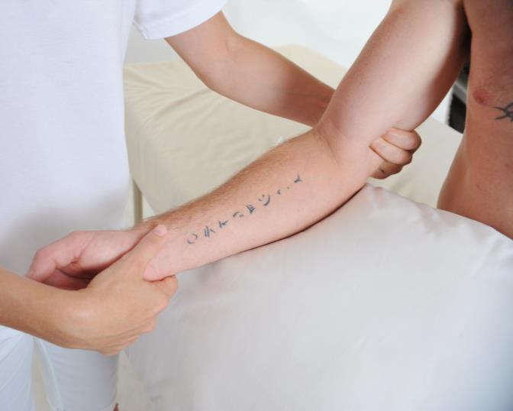
Module 3
Welcome
Certificate in Bowen Therapy - International
Modu
Pelvic
Elbow / Wrist
Sacral
Knee
Collect 2 case studies
Check log hours
Notes:
Display on arrival

Slide 2

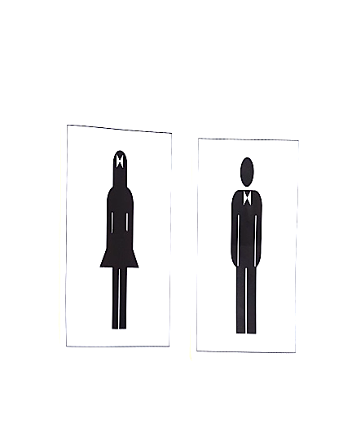
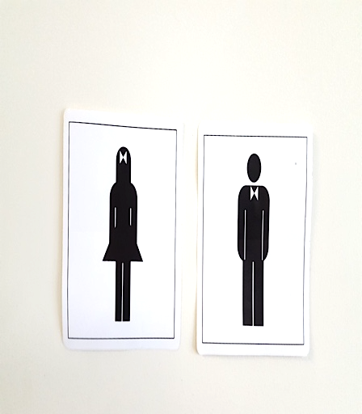

Module 3
Welcome
Register
Payment & receipts
Toilets
Breaks
Phones off or on silent
Exit and emergency meet point, fire extinguisher
Notes:
Run through basic housekeeping. Flow of day for breaks etc.

Slide 3

Module 3
Welcome
Welcome back
Any clarification from Module 2
A&P 1
Hand in Case studies & Log Hours
Fill in CEU card
Notes:
Check all students received welcome email. Check they are all enrolled and started A&P. Answer any questions.

Slide 4
Module 3
Program
REVISION
Hamstring
Cramp
Shoulder
Respiratory
Collect case studies
Check log hours
NEW PROCEDURES
Pelvic
Elbow / Wrist
Sacral
Knee
BAA student membership
Written assessment 1

Slide 5
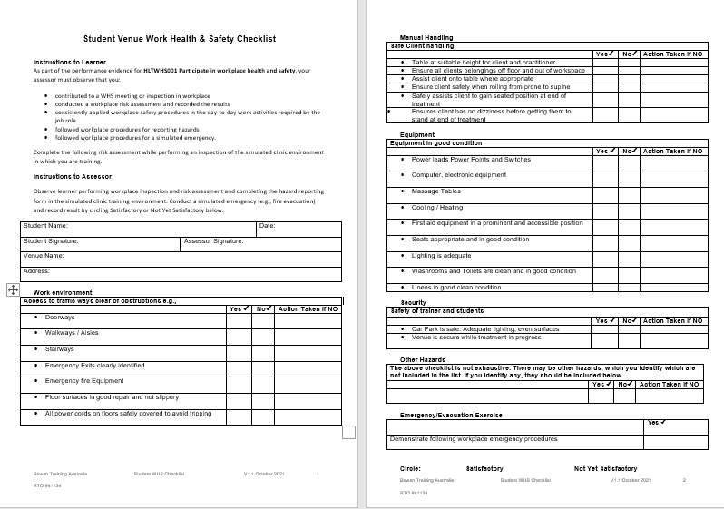
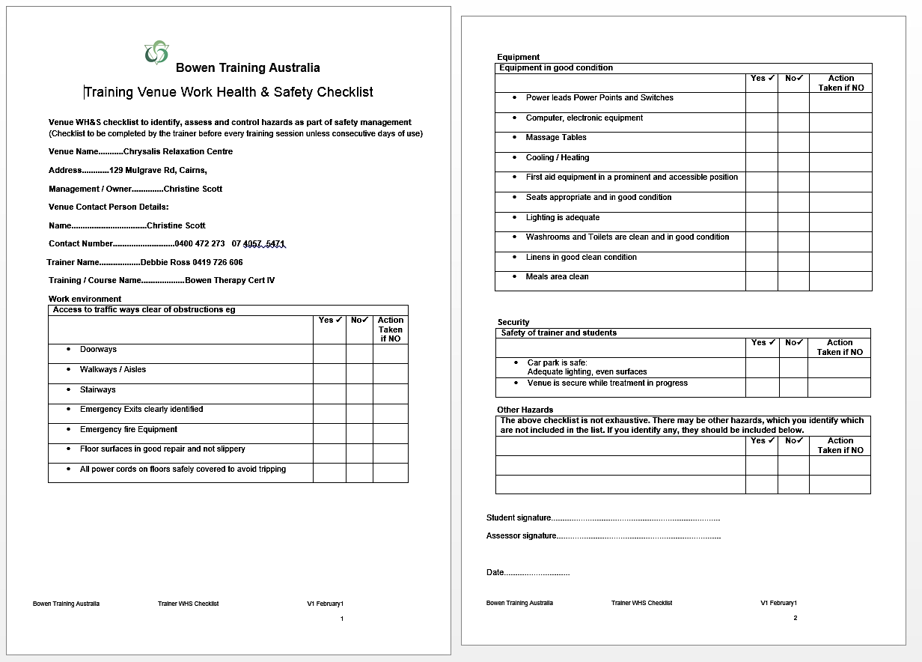
Work Health & Safety Checklist
Notes:
Take learners through WHS inspection and reporting and discuss emergency procedures

Slide 6
Practice
As if working with a client in a session
  BRM 1 Lower back
  BRM 2 Upper back
  BRM 3 Neck
  Hamstring
  Make your treatment plan
  Explain to your client
  Drape well
  Assist to sit up
  Explain any aftercare
  Explain Hamstring exercise

Slide 7
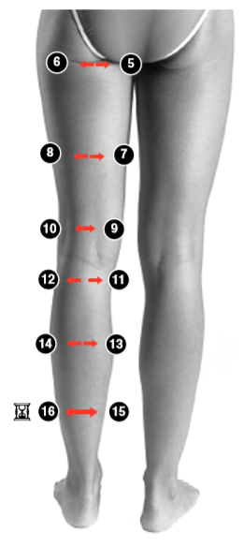
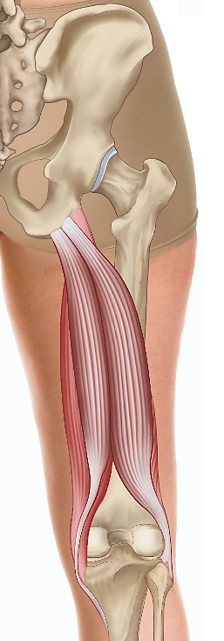
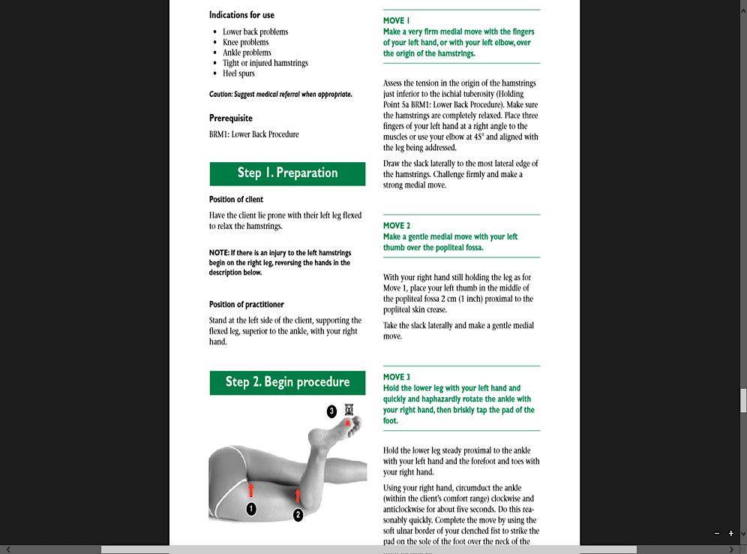
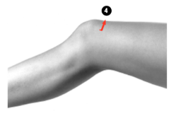
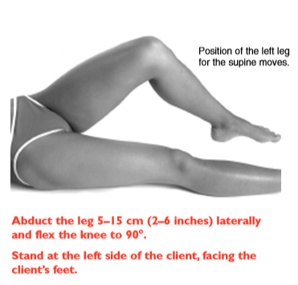
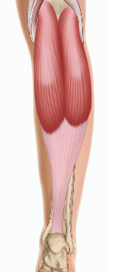
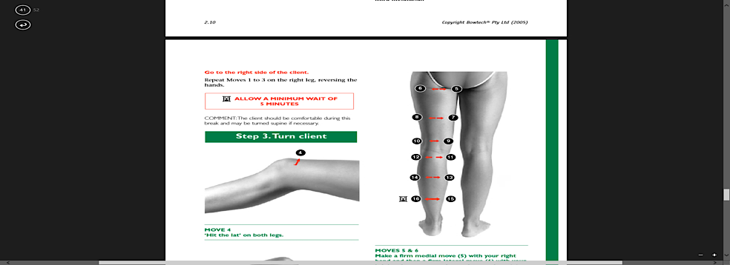

Re-demonstrate
Hamstring page 2.10
Practice BRM 1, 2, 3 and Hamstring like a session with a client
Client prone
Client supine
HAMSTRING MUSCLES
Semimembranosus
Semitendinosus
Biceps femoris long head
Biceps femoris short head
Gastrocnemius
Achilles tendon
Repeat on other leg
Photographs from Ossie & Elaine Rentsch, Bowtech Instruction Manuals Muscle Illustrations from Joseph Muscolino, The Muscle System Manual

Slide 8
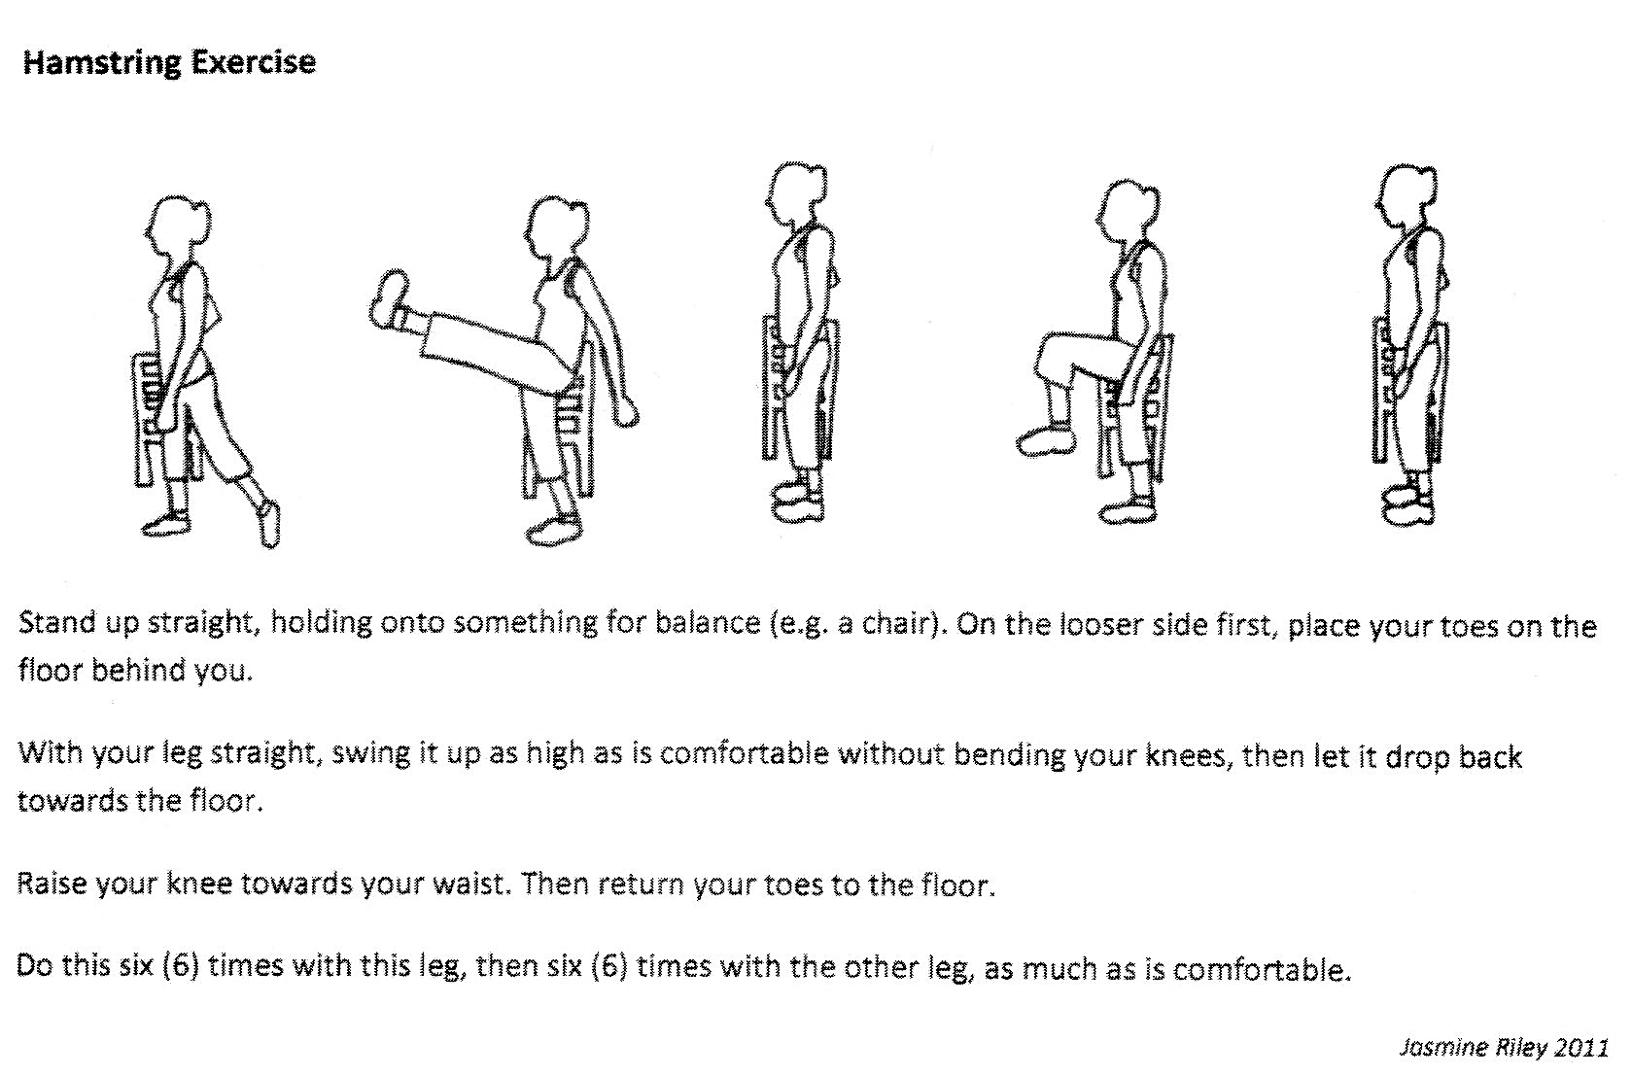
Revision
Hamstring Exercise

Slide 9
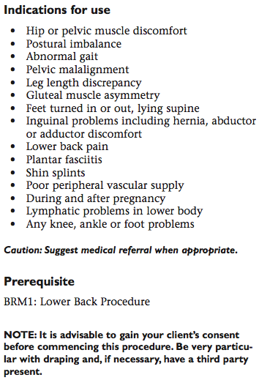
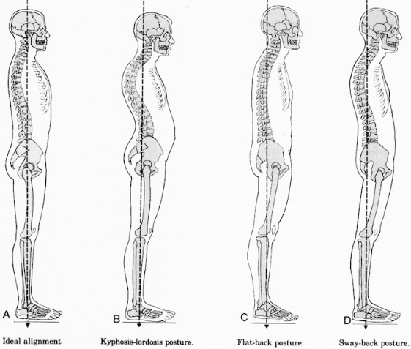
New Procedure
Pelvic Page 3.2
Image resource, Muscles testing and function, Florence Kendall,

Slide 10
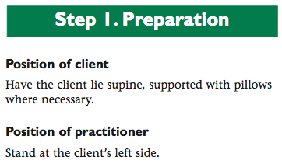
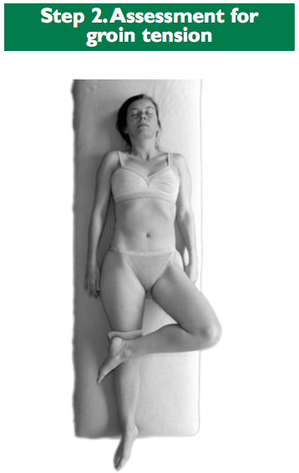
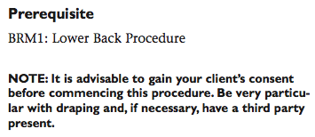
New Procedure
Pelvic Page 3.2
Photographs from Ossie & Elaine Rentsch, Bowtech Instruction Manuals
Muscle Illustrations from Joseph Muscolino, The Muscle System Manual

Slide 11
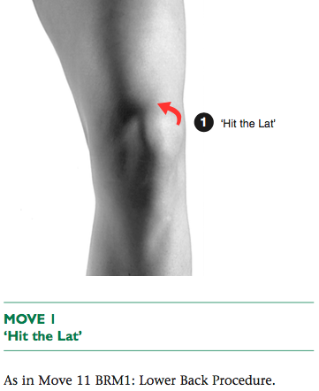
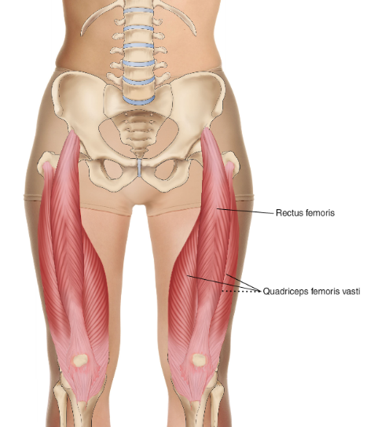
New Procedure
Pelvic Page 3.3
Quadriceps muscles
Rectus femoris
Vastus lateralis
Vastus medialis
Vastus intermedius
Photographs from Ossie & Elaine Rentsch, Bowtech Instruction Manuals
Muscle Illustrations from Joseph Muscolino, The Muscle System Manual

Slide 12
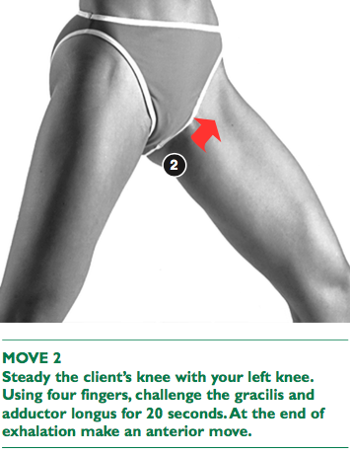
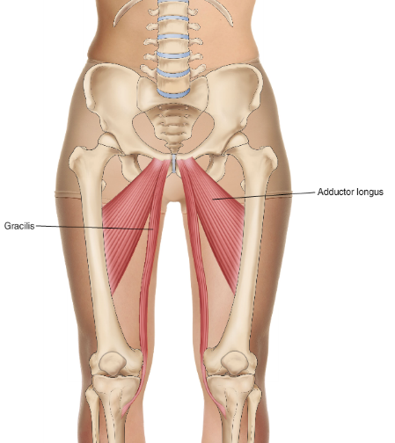
New Procedure
Pelvic Page 3.3
Adductor longus
Gracilis
Photographs from Ossie & Elaine Rentsch, Bowtech Instruction Manuals
Muscle Illustrations from Joseph Muscolino, The Muscle System Manual

Slide 13
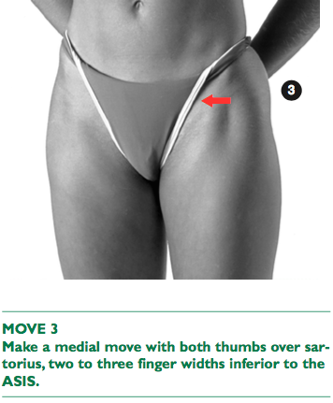
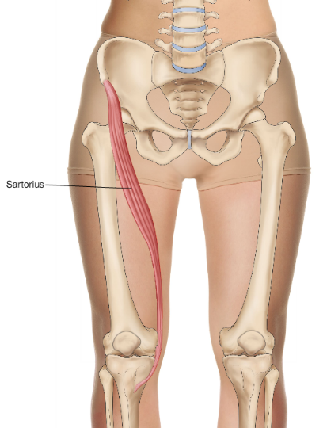
New Procedure
Pelvic Page 3.3
Sartorius
Photographs from Ossie & Elaine Rentsch, Bowtech Instruction Manuals
Muscle Illustrations from Joseph Muscolino, The Muscle System Manual

Slide 14
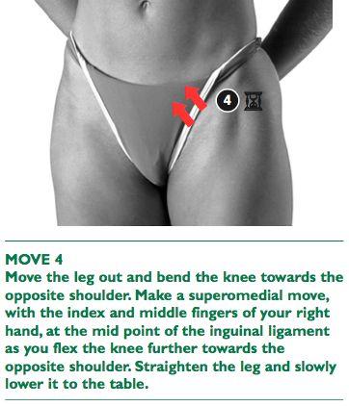
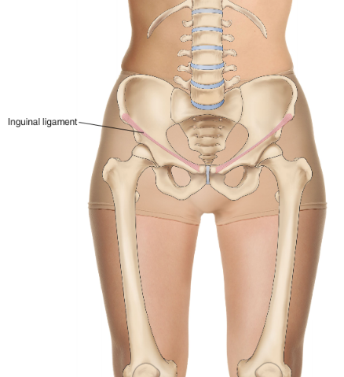

New Procedure
Pelvic Page 3.4
Inguinal ligament
Photographs from Ossie & Elaine Rentsch, Bowtech Instruction Manuals
Muscle Illustrations from Joseph Muscolino, The Muscle System Manual

Slide 15
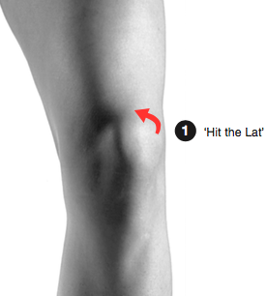
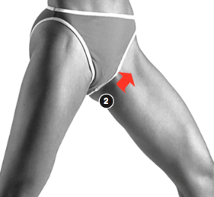
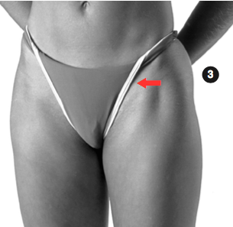
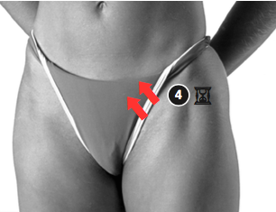
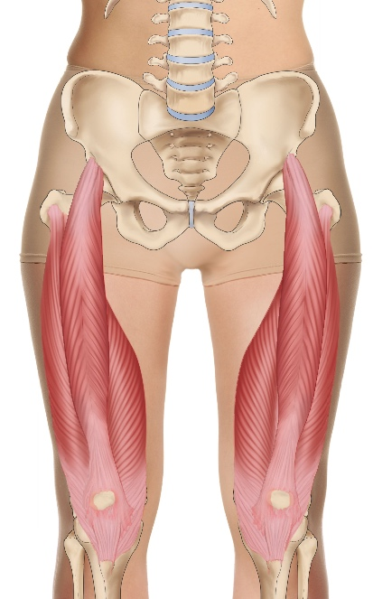
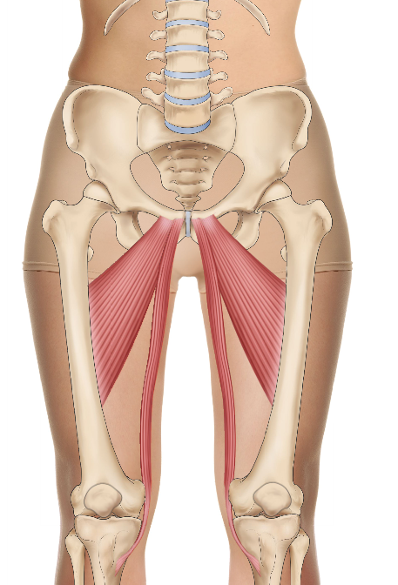
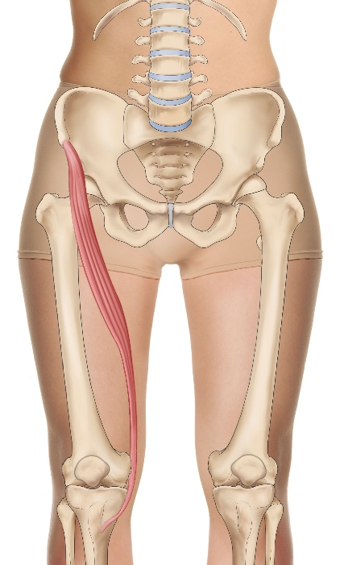
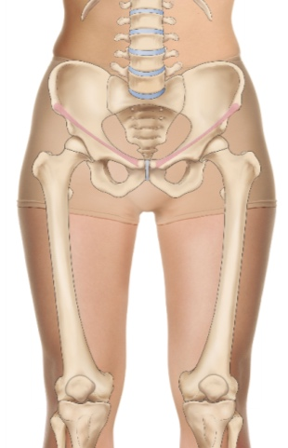
Overview
Pelvic Page 3.3
Practice pelvic with assessment
Vastus Lateralis Gracilis & Sartorius Inguinal ligament
Adductor Longus
Photographs from Ossie & Elaine Rentsch, Bowtech Instruction Manuals
Muscle Illustrations from Joseph Muscolino, The Muscle System Manual

Slide 16
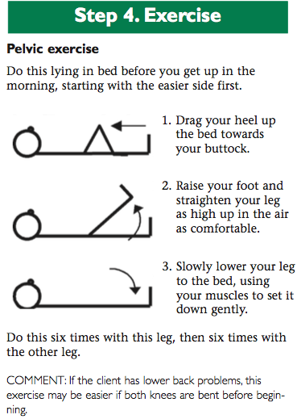
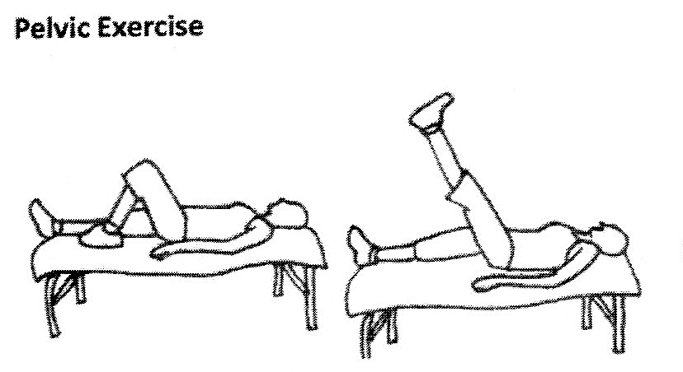
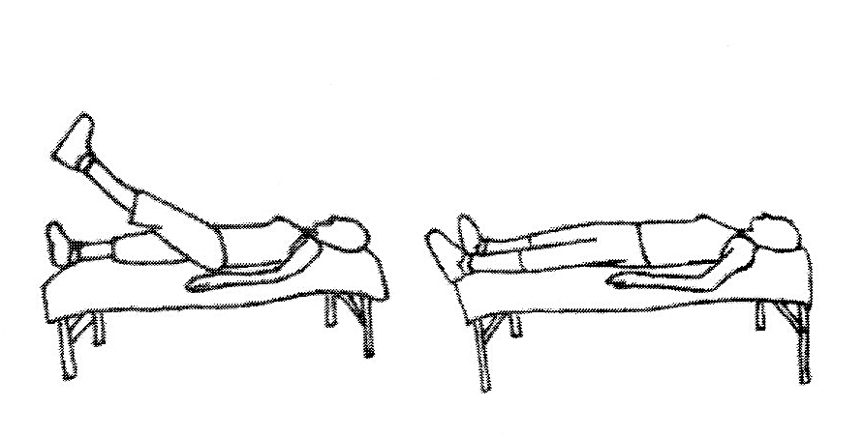
New Exercise
Pelvic Page 3.4
Start the exercise the day after appointment
Photographs from Ossie & Elaine Rentsch, Bowtech Instruction Manuals
Muscle Illustrations from Joseph Muscolino, The Muscle System Manual

Slide 17
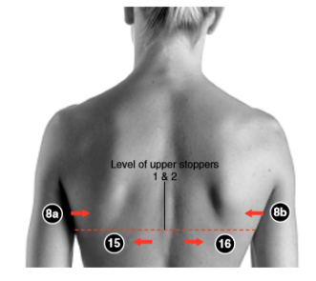
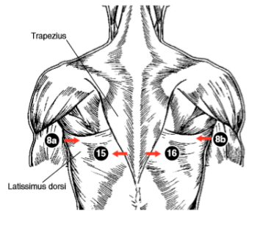
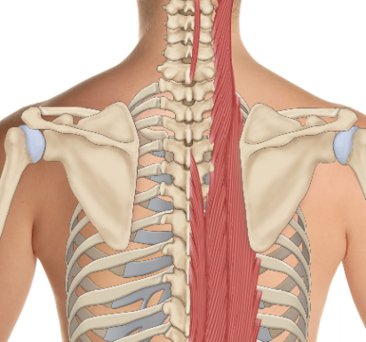
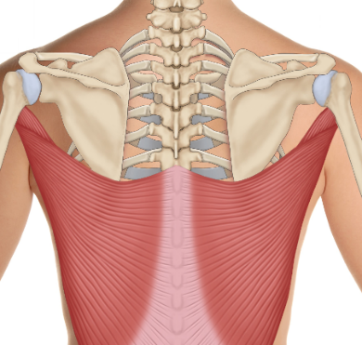
Re-demonstrate and practice
Cramp page 2.14
Erector spinae
Latissimus dorsi
Photographs from Ossie & Elaine Rentsch, Bowtech Instruction Manuals Muscle Illustrations from Joseph Muscolino, The Muscle System Manual

Slide 18
Scenario 1
Client presents with: Anxiety with hand tremors
Questioning reveals:
Presently on self managed plan with NDIS
Taking prescribed antidepressant medication
Head forward posture
Upper back hunched (thoracic kyphosis)
Overweight and has oedema
What procedures could you use?
BRM 1, 2, 3, pelvic, kidney, elbow/wrist, head
Today we will do: Kidney

Slide 19
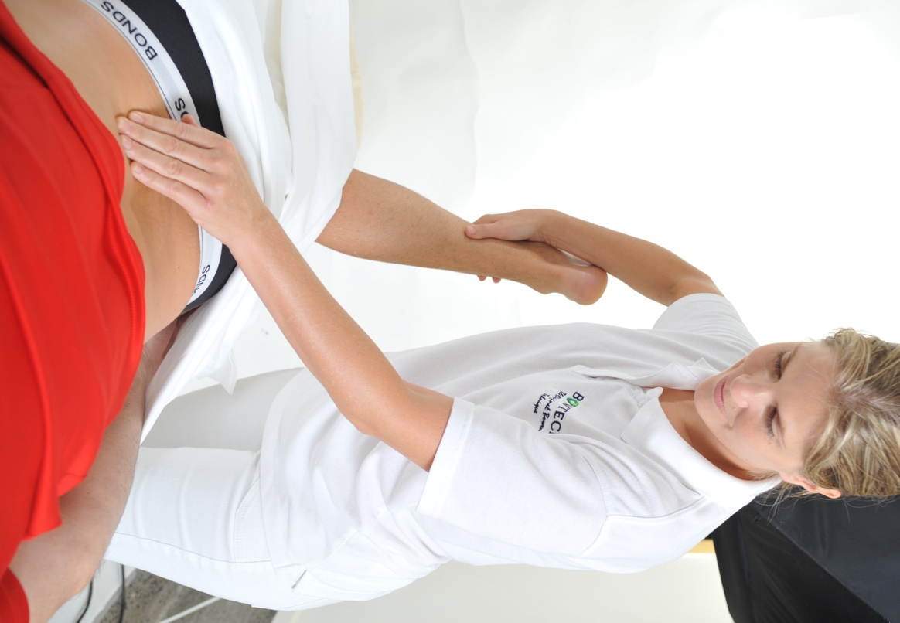
Practice
Kidney page 1.17
Practice Kidney with assessment
Photographs from Ossie & Elaine Rentsch, Bowtech Instruction Manuals Muscle Illustrations from Joseph Muscolino, The Muscle System Manual
Notes:
Ask students to answer the above points about the kidney procedure. Can look at manual if cant remember. Demonstrate and practise Kidney

Slide 20

LUNCH

Slide 21
Study Questions
Module 2 page 2.15
How would you explain Bowenwork to a new client?
If a client is receiving Bowenwork, what advice would you give them about using other therapies?
How would you sequence, in one session, BRM1, 2, 3 and the Hamstring and the Respiratory procedures?
For what complaints would you choose the Respiratory Procedure?
What are the main muscles addresses in the BRM2: Upper Back Procedure?
In what situation would you use the Shoulder Procedure?
If a client has a severely frozen shoulder, you may have to consider long term treatment. What time frame would you use to schedule sessions for this client?
In what circumstances would you consider using an assistant to perform the Shoulder Procedure?
The BRMs 1, 2, and 3 are considered the foundation of a Bowenwork session. Why?
Describe 3 ways of assessing for the Kidney procedure, and which side you would start on first.
Photographs from Ossie & Elaine Rentsch, Bowtech Instruction Manuals Muscle Illustrations from Joseph Muscolino, The Muscle System Manual
Notes:
Ask students to answer the above points about the kidney procedure. Can look at manual if cant remember. Demonstrate and practise Kidney

Slide 22
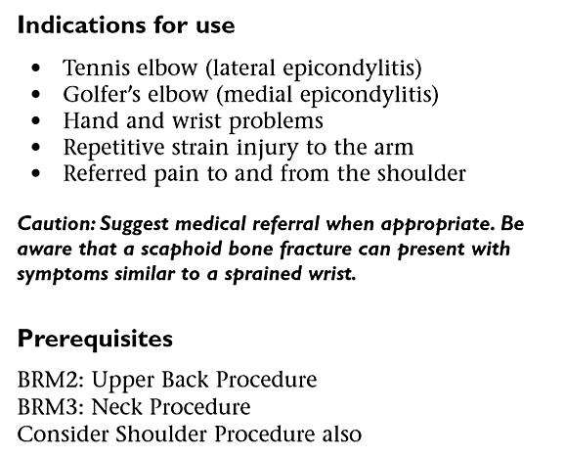
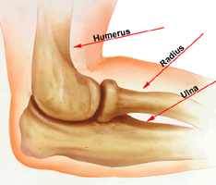
New Procedure
Elbow / Wrist Page 3.5
Photographs from Ossie & Elaine Rentsch, Bowtech Instruction Manuals
Muscle Illustrations from Joseph Muscolino, The Muscle System Manual

Slide 23
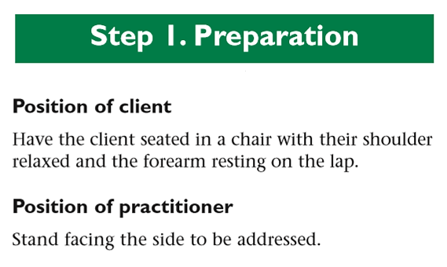
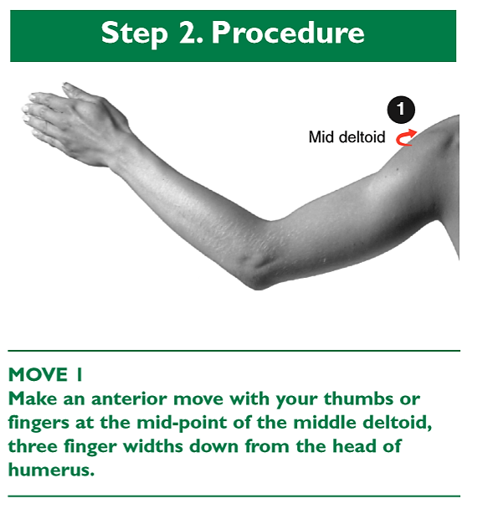
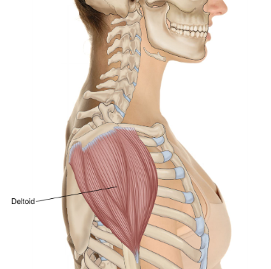
New Procedure
Elbow / Wrist Page 3.5
Middle fibres of Deltoid
Photographs from Ossie & Elaine Rentsch, Bowtech Instruction Manuals
Muscle Illustrations from Joseph Muscolino, The Muscle System Manual

Slide 24
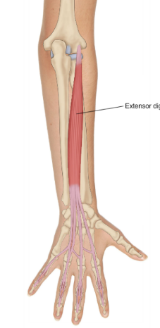
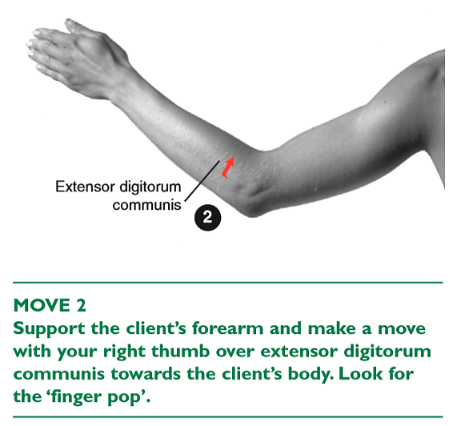
New Procedure
Elbow / Wrist Page 3.5
Extensor digitorum
Photographs from Ossie & Elaine Rentsch, Bowtech Instruction Manuals
Muscle Illustrations from Joseph Muscolino, The Muscle System Manual

Slide 25
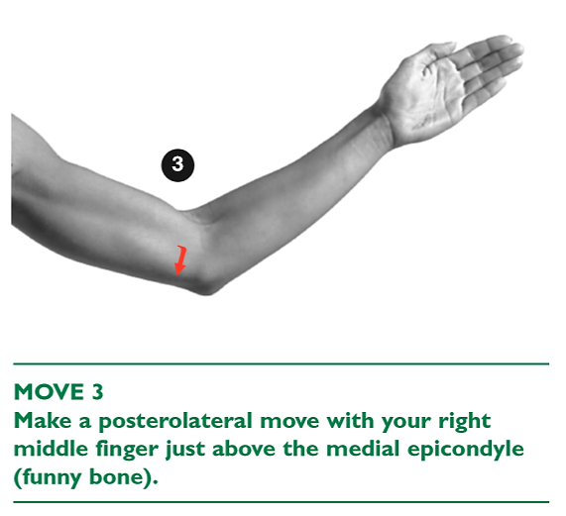

New Procedure
Elbow / Wrist Page 3.6
Photographs from Ossie & Elaine Rentsch, Bowtech Instruction Manuals
Muscle Illustrations from Joseph Muscolino, The Muscle System Manual

Slide 26



New Procedure
Elbow / Wrist Page 3.6
Photographs from Ossie & Elaine Rentsch, Bowtech Instruction Manuals
Muscle Illustrations from Joseph Muscolino, The Muscle System Manual

Slide 27




New Procedure
Elbow / Wrist Page 3.6
Extensor tendons
Photographs from Ossie & Elaine Rentsch, Bowtech Instruction Manuals
Muscle Illustrations from Joseph Muscolino, The Muscle System Manual

Slide 28








Overview
Elbow / Wrist Page 3.5
Photographs from Ossie & Elaine Rentsch, Bowtech Instruction Manuals
Muscle Illustrations from Joseph Muscolino, The Muscle System Manual

Slide 29

Case Studies and log hours
Discuss
Clarification
Hand in
Case studies
Log hours
Notes:
Explain the additional 10 case studies on top of 100 log hours. Hand out folders and schedule

Slide 30

Practice
Head Procedure page 1.18

Slide 31

END OF DAY

Slide 32

Module 3
Welcome back Day 2
  How is everyone feeling?
  How did you sleep?
  Anything you noticed changing?
  Drink lots of water today.
  Any questions?

Slide 33

BTA
Bowen Training Australia
BTA - Bowen Training Australia Is a Training Organisation delivering the Certificate in Bowen Therapy – International.
Contact BTA for information on: Contact details: Phone: 07 3284 3349 or 1300 833 252 Email: assessments@bowentraining.com.au Website: www.bowentraining.com.au | Course information, dates, classes and venues Enrolment in courses Recognition of Prior Learning Online units See website for details CEU classes- Revision - Practitioner days
Notes:
Explain the differences of above and give handout
Just have to use BTA for now

Slide 34

BTAA
Bowen Therapy Academy of Australia
BTAA - Bowtech The Bowen Therapy Academy of Australia Established by Oswald and Elaine Rentsch who are the owners of the copyright material of Bowtech the Original Bowen Technique.
Contact BTAA for information on: Contact details: PO Box 733, Hamilton Vic 3300 Phone: 03 5572 3000 Fax 03 5572 3144 Email: bowtech@h140.aone.net.au Website: www.bowtech.com | Membership of BTAA Bowen Hands quarterly magazine SP1 review classes SP2 Master class enrolment Bowtech merchandise incl. brochures Practitioner listing on website International business and class listing See website for details
Notes:
Explain the differences of above and give handout
Just have to use BTA for now

Slide 35


BAA
Bowen Association of Australia
BAA - The Bowen Association of Australia: Is a not-for-profit Association made up of, and run by, Australian Bowtech-trained Bowen practitioners.
Contact BAA for information on: Contact details: PO Box 319 Mortdale NSW 2223 Phone: 1300 780 638 Email: admin@bowen.org.au Website: www.bowen.org.au | Membership of BAA Professional indemnity and public liability insurance information CEU requirements Industry changes BAA newsletter Practitioner listing on website Supporting research into Bowen Therapy Supporting lobbying efforts See website for details
Your trainer will hand out BAA student membership forms this module so that you can get connected and stay informed.
Student membership is free.
Notes:
Explain the differences of above and give handout
Just have to use BTA for now

Slide 36


Re-demonstrate and practice
Pelvic Page 3.3
Practice Pelvic with assessment and exercise
Vastus Lateralis Gracilis & Sartorius Inguinal ligament
Adductor Longus
Photographs from Ossie & Elaine Rentsch, Bowtech Instruction Manuals
Muscle Illustrations from Joseph Muscolino, The Muscle System Manual

Slide 37



New Procedure
Sacral Page 3.8

Slide 38

New Procedure
Sacral Page 3.8
Inferior Lateral Angle (ILA)

Slide 39



New Procedure
Sacral Page 3.8
Sacrotuberous
ligament
Gluteus maximus
Photographs from Ossie & Elaine Rentsch, Bowtech Instruction Manuals
Muscle Illustrations from Joseph Muscolino, The Muscle System Manual

Slide 40



New Procedure
Sacral Page 3.8
Gluteus maximus
Photographs from Ossie & Elaine Rentsch, Bowtech Instruction Manuals
Muscle Illustrations from Joseph Muscolino, The Muscle System Manual

Slide 41





Overview
Sacral Page 3.8
Sacrotuberous
ligament
Gluteus maximus
Gluteus maximus
Photographs from Ossie & Elaine Rentsch, Bowtech Instruction Manuals
Muscle Illustrations from Joseph Muscolino, The Muscle System Manual

Slide 42








Re-demonstrate and practice
Shoulder Solo page 2.8
Practice Shoulder Solo with assessment and exercises
Palm facing the floor
Deltoid
posterior fibres
Deltoid
middle fibres
Deltoid
anterior fibres
Photographs from Ossie & Elaine Rentsch, Bowtech Instruction Manuals Muscle Illustrations from Joseph Muscolino, The Muscle System Manual
Image resource: Muscles testing and function, Kendall, LWW
Notes:
Demonstrate and practise Shoulder assisted. Show video if you like.

Slide 43

Revision
Shoulder Exercise page 2.9

Slide 44
Re-demonstrate and practice
Elbow / Wrist Page 3.5
Practice Elbow/wrist
Photographs from Ossie & Elaine Rentsch, Bowtech Instruction Manuals
Muscle Illustrations from Joseph Muscolino, The Muscle System Manual

Slide 45

LUNCH

Slide 46









Re-demonstrate and practice
Respiratory page 2.2
Give aftercare suggestions for Asthma sufferers
Turn client supine
Prone
With leg lock
Xiphoid process
Erector spinae
Rectus abdominis
Photographs from Ossie & Elaine Rentsch, Bowtech Instruction Manuals Muscle Illustrations from Joseph Muscolino, The Muscle System Manual

Slide 47



New Procedure
Knee Page 3.10
Photographs from Ossie & Elaine Rentsch, Bowtech Instruction Manuals
Muscle Illustrations from Joseph Muscolino, The Muscle System Manual

Slide 48


Assessment
Knee Page 3.10
Photographs from Ossie & Elaine Rentsch, Bowtech Instruction Manuals
Muscle Illustrations from Joseph Muscolino, The Muscle System Manual

Slide 49





New Procedure
Knee Page 3.10
Retinacular fibres
Vastus
lateralis
Patellar ligament
Photographs from Ossie & Elaine Rentsch, Bowtech Instruction Manuals
Muscle Illustrations from Joseph Muscolino, The Muscle System Manual

Slide 50







New Procedure
Knee Page 3.10
Vastus Medialis
Gastrocnemius
Soleus
Photographs from Ossie & Elaine Rentsch, Bowtech Instruction Manuals
Muscle Illustrations from Joseph Muscolino, The Muscle System Manual

Slide 51



New Procedure
Knee Page 3.10
Gastrocnemius
Soleus
Achilles tendon
Photographs from Ossie & Elaine Rentsch, Bowtech Instruction Manuals
Muscle Illustrations from Joseph Muscolino, The Muscle System Manual

Slide 52





New Procedure
Knee Page 3.10
Flexor digitorum longus
Tibialis posterior
Flexor hallucis longus
Flexor retinaculum
Photographs from Ossie & Elaine Rentsch, Bowtech Instruction Manuals
Muscle Illustrations from Joseph Muscolino, The Muscle System Manual

Slide 53









Overview
Knee Page 3.10
Practice knee with assessment, exercise and washing soda instructions
Tibialis posterior
Retinacular fibres
Vastus Medialis
Flexor digitorum longus
Gastrocnemius
Flexor hallucis longus
Photographs from Ossie & Elaine Rentsch, Bowtech Instruction Manuals
Muscle Illustrations from Joseph Muscolino, The Muscle System Manual

Slide 54


Washing Soda Pack
Knee Page 3.14
Photographs from Ossie & Elaine Rentsch, Bowtech Instruction Manuals
Muscle Illustrations from Joseph Muscolino, The Muscle System Manual

Slide 55


Exercise
Knee Page 3.10
Photographs from Ossie & Elaine Rentsch, Bowtech Instruction Manuals
Muscle Illustrations from Joseph Muscolino, The Muscle System Manual

Slide 56

Written Assessment

Slide 57

Homework to complete by Module 4
10 – 15 log hours
That’s approx. 3 hours per week
2 case studies
Purchase and complete A&P 2
Lock in date for Module 4
Answer Module 3 study questions

