Slide 1

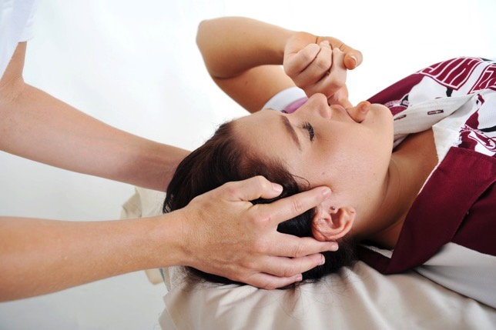
Module 4
Welcome
Certificate in Bowen Therapy - International
Module 3
Ankle & Strapping
Upper Respiratory/TMJ
Forearm
Seated
Babies
Hammertoe
Bunion
Notes:
Display on arrival

Slide 2

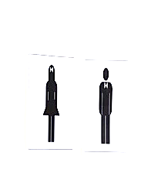
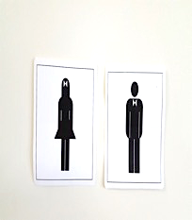

Module 4
Welcome
Register
Payment & receipts
Toilets
Breaks
Phones off or on silent
Exit and emergency meet point, fire extinguisher
Notes:
Run through basic housekeeping. Flow of day for breaks etc.

Slide 3
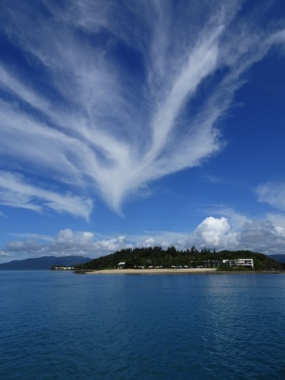
Module 4
Welcome
Welcome back
Any clarification from Module 3
A&P 2
Hand in Case studies & Log Hours
Fill in CEU card
Notes:
Check all students received welcome email. Check they are all enrolled and started A&P. Answer any questions.

Slide 4
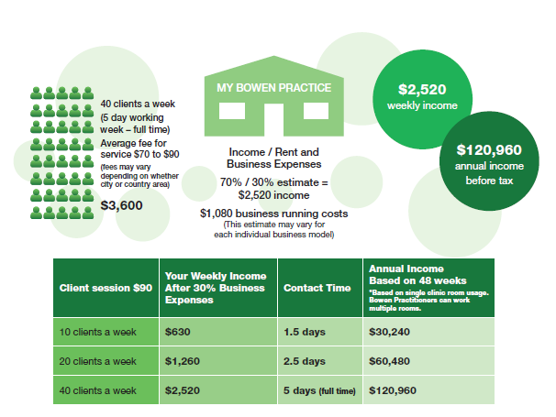
Where you could go…

Slide 5
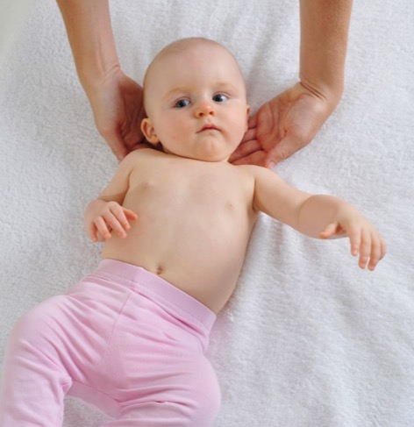
Module 4
Program
NEW PROCEDURES
Ankle & Strapping
Upper Respiratory/TMJ
Forearm
Seated
Babies
Hammertoe
Bunion

Slide 6
Module 4
Program
REVISION
Module 3 procedures
Pelvic
Elbow/Wrist
Sacral
Knee
PRACTICE and ASSESS
Modules 1 & 2 procedures
BRM 1, 2 & 3
Kidney & Respiratory
Shoulder
Hamstring
Cramp
Head

Slide 7
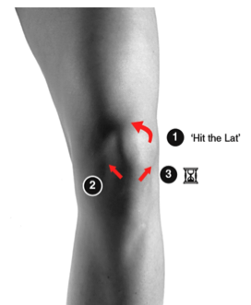
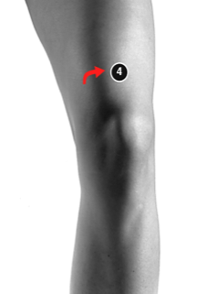
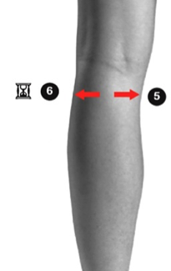
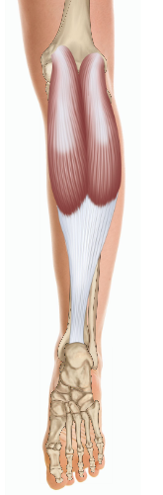
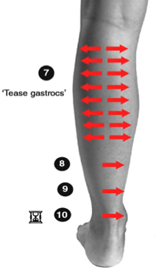
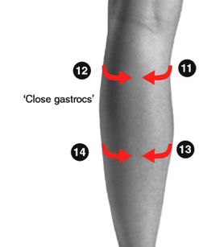
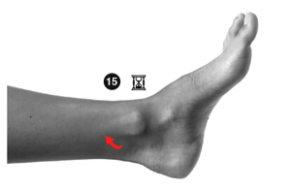

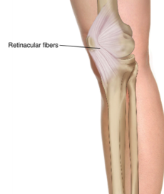
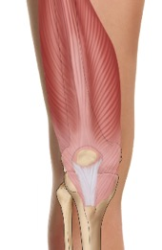
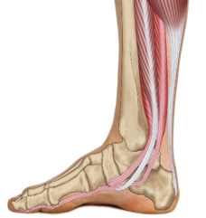
Re-demonstrate
Knee Page 3.10
Practice prerequisite BRM1 – Lower back
Practice knee with assessment and exercise
Tibialis posterior
Retinacular fibres
Vastus Medialis
Flexor digitorum longus
Gastrocnemius
Flexor hallucis longus

Slide 8
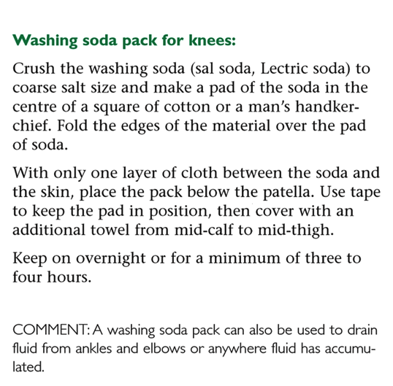
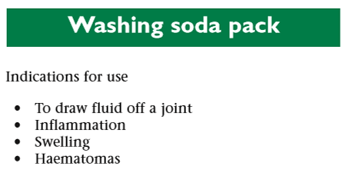
Revision
Washing Soda Pack Page 3.14
Photographs from Ossie & Elaine Rentsch, Bowtech Instruction Manuals
Muscle Illustrations from Joseph Muscolino, The Muscle System Manual

Slide 9
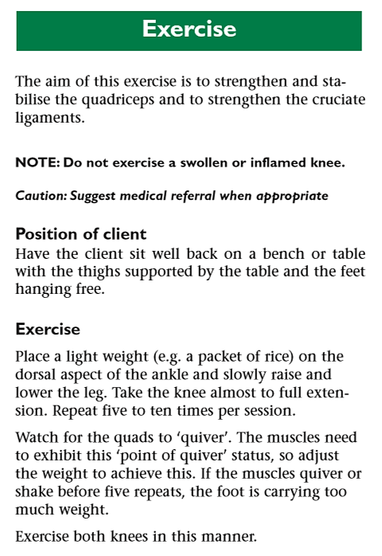
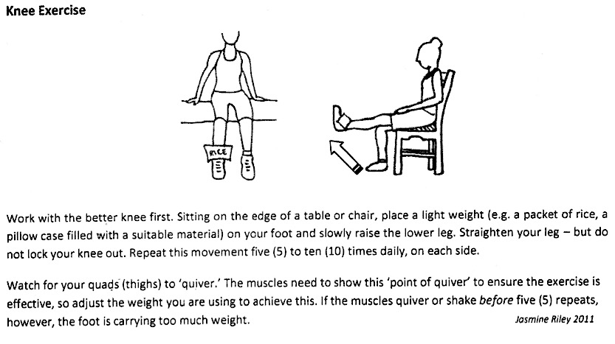
Revision
Knee Exercise Page 3.10
Photographs from Ossie & Elaine Rentsch, Bowtech Instruction Manuals
Muscle Illustrations from Joseph Muscolino, The Muscle System Manual

Slide 10

Morning tea

Slide 11
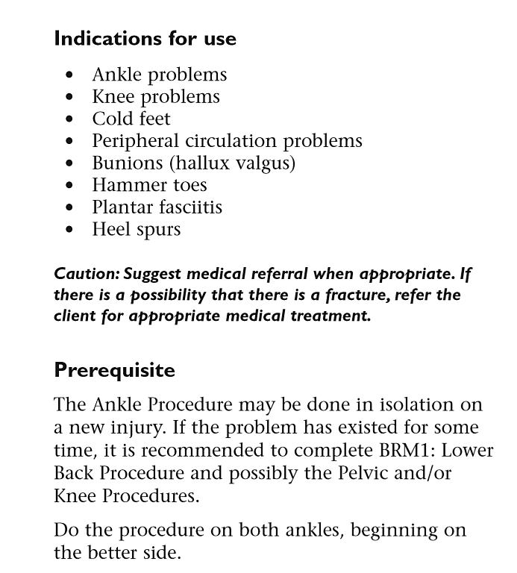
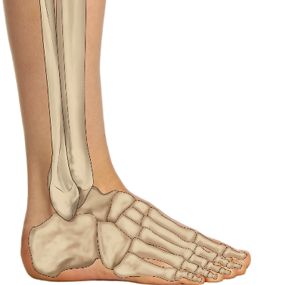
New Procedure
Ankle Page 4.2
Photographs from Ossie & Elaine Rentsch, Bowtech Instruction Manuals
Muscle Illustrations from Joseph Muscolino, The Muscle System Manual

Slide 12
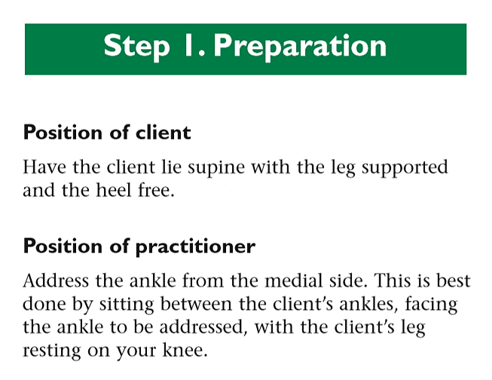
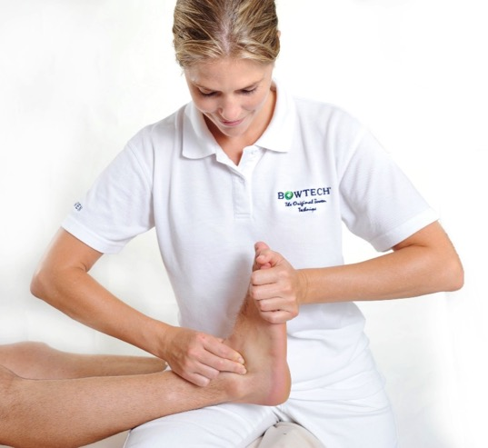
New Procedure
Ankle Page 4.2
Photographs from Ossie & Elaine Rentsch, Bowtech Instruction Manuals
Muscle Illustrations from Joseph Muscolino, The Muscle System Manual

Slide 13
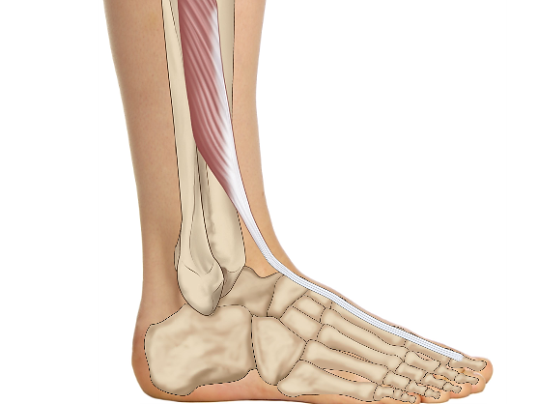
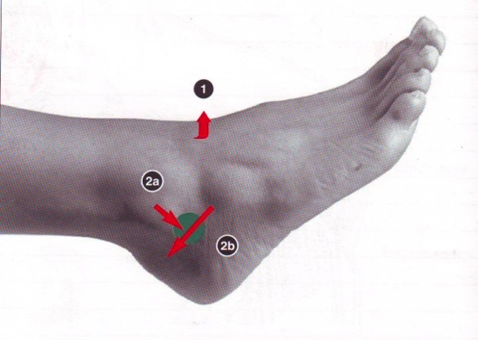
New Procedure
Ankle Page 4.2
Extensor hallucis longus
1
2
3
Lateral Malleolus
Photographs from Ossie & Elaine Rentsch, Bowtech Instruction Manuals
Muscle Illustrations from Joseph Muscolino, The Muscle System Manual

Slide 14
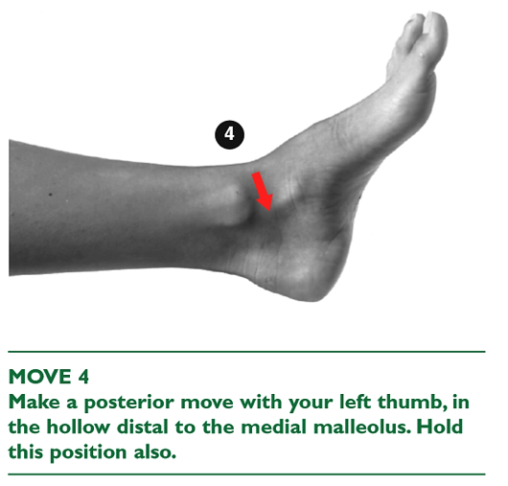
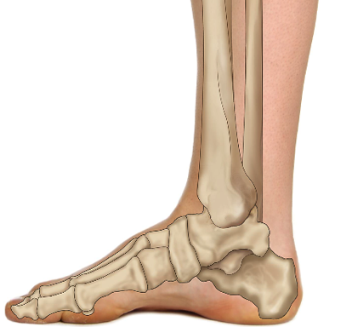
New Procedure
Ankle Page 4.3
Tibia
Medial
Malleolus
Calcaneus
Fibula
Talus
Photographs from Ossie & Elaine Rentsch, Bowtech Instruction Manuals
Muscle Illustrations from Joseph Muscolino, The Muscle System Manual

Slide 15
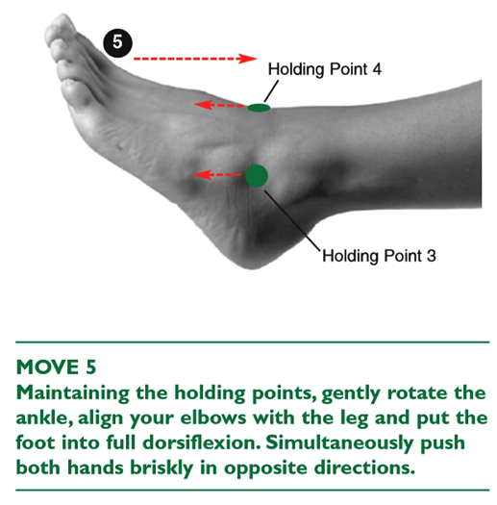
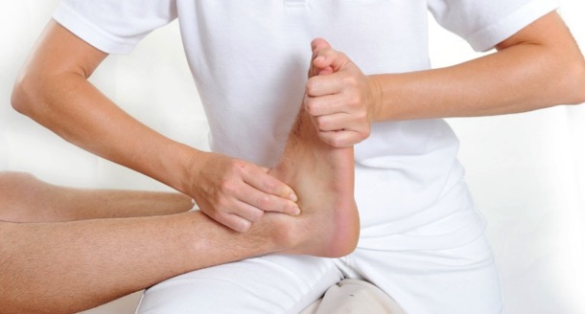
New Procedure
Ankle Page 4.3
If there is injury to the ankle perform the moves very lightly and simulate the thrust only
Photographs from Ossie & Elaine Rentsch, Bowtech Instruction Manuals
Muscle Illustrations from Joseph Muscolino, The Muscle System Manual

Slide 16
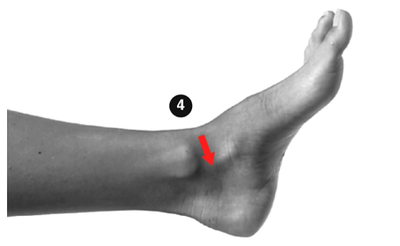
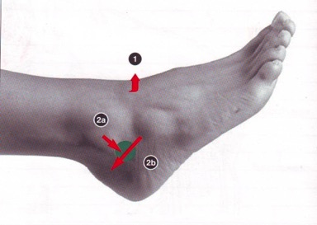
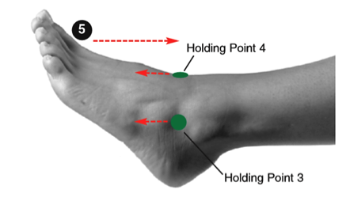


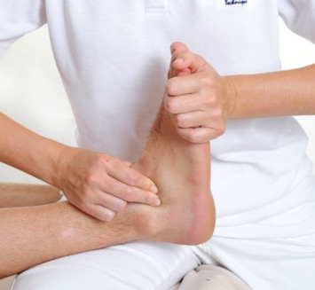
Overview
Ankle Page 4.2
5
1
2
3
Extensor hallucis longus
Tibia
Calcaneus
Fibula
Talus
Photographs from Ossie & Elaine Rentsch, Bowtech Instruction Manuals
Muscle Illustrations from Joseph Muscolino, The Muscle System Manual

Slide 17
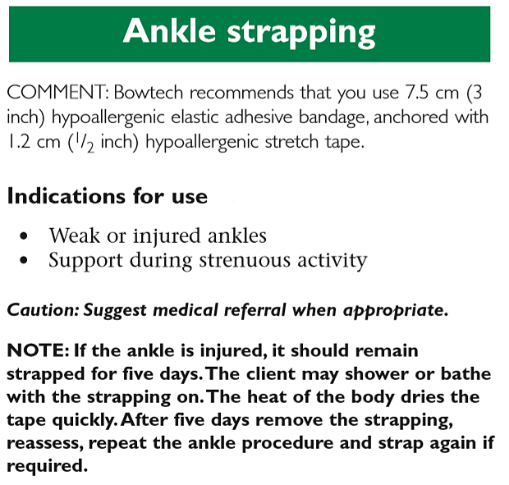
New
Ankle Strapping Page 4.4
Tape 7.5cm Cincotta Chemist online – Leuko 1078
Photographs from Ossie & Elaine Rentsch, Bowtech Instruction Manuals
Muscle Illustrations from Joseph Muscolino, The Muscle System Manual

Slide 18
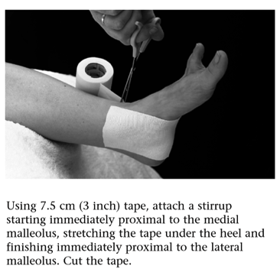
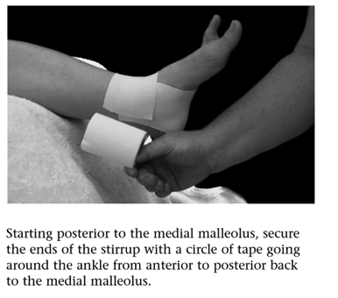
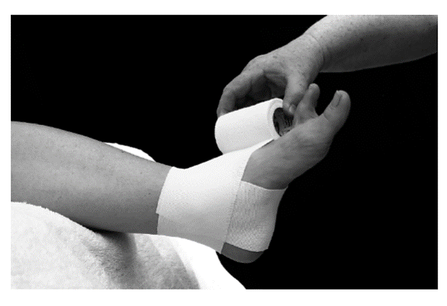
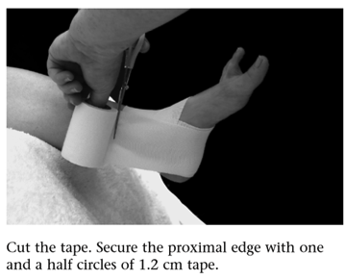
Ankle Strapping Page 4.4
Why strap? - To reduce movement and support ankle.
When? – After Bowen treatment and before sporting activities
STIRRUP
Maximum eversion
Medial malleolus
Anterior to posterior
Modified 8
Firm but not tight
Cut tape
Secure with 1.2cm tape
Tape 7.5cm Cincotta Chemist online – Leuko 1078

Slide 19
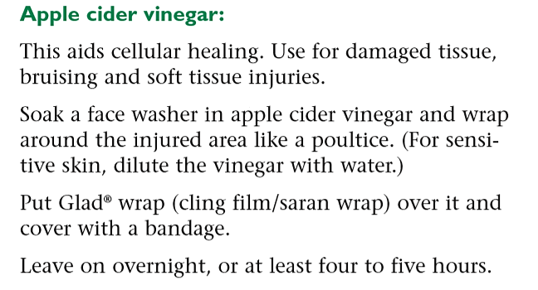
Apple Cider Vinegar Page 4.23

Slide 20
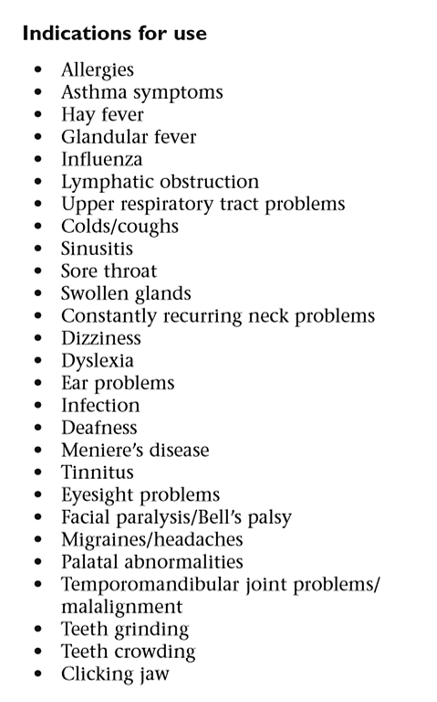
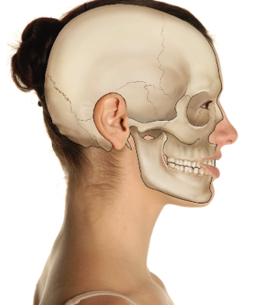
New Procedure
Upper Respiratory \ TMJ Page 4.6
Temporal Bone
Mandible
(Jaw)
Photographs from Ossie & Elaine Rentsch, Bowtech Instruction Manuals
Muscle Illustrations from Joseph Muscolino, The Muscle System Manual

Slide 21
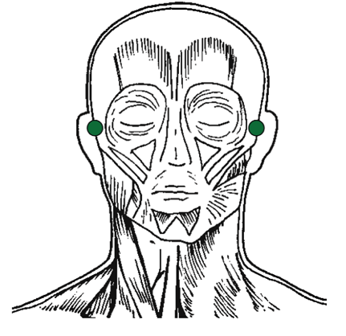
Assessment
Upper Respiratory \ TMJ Page 4.6
Temporal Mandibular Joint
Temporal Bone
Condylar process of mandible
Mandible
(Jaw)
Index fingers on condylar processes of mandible
Anterior to tragus
Ask client to open and close mouth
Assess tenderness and symmetry
Observe path of mandible
Assessment is done before starting the Upper respiratory
WHY DO WE ASSESS THE TMJ BEFORE STARTING?
To observe function of the joint. Is there abnormal tension? Does the jaw click or catch? Does the mandible deviate to one side on opening?
To inform the body we are going to work in this area.
Photographs from Ossie & Elaine Rentsch, Bowtech Instruction Manuals
Muscle Illustrations from Joseph Muscolino, The Muscle System Manual

Slide 22
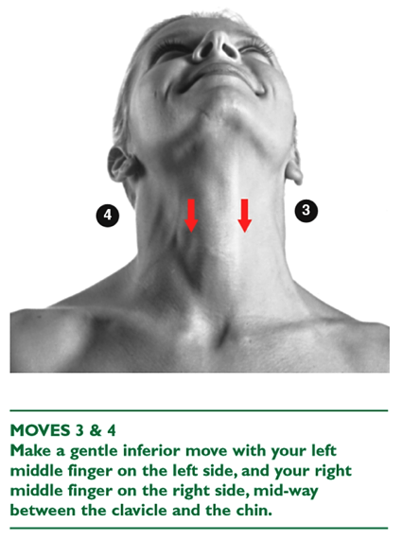
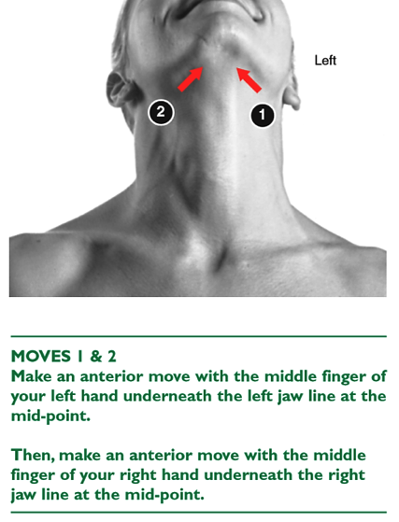
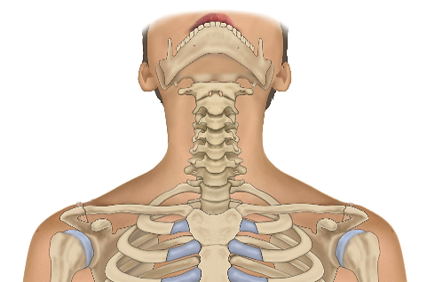
New Procedure
Upper Respiratory Page 4.7
Photographs from Ossie & Elaine Rentsch, Bowtech Instruction Manuals
Muscle Illustrations from Joseph Muscolino, The Muscle System Manual

Slide 23
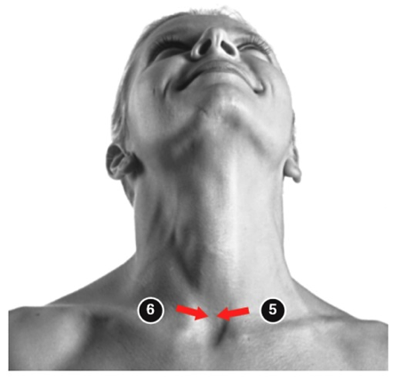
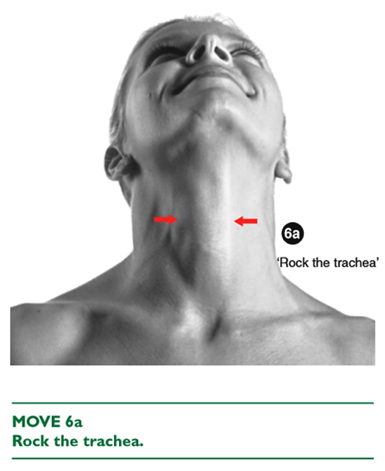
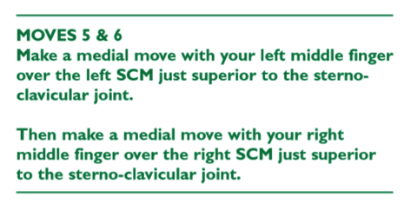
New Procedure
Upper Respiratory Page 4.7
Photographs from Ossie & Elaine Rentsch, Bowtech Instruction Manuals
Muscle Illustrations from Joseph Muscolino, The Muscle System Manual

Slide 24
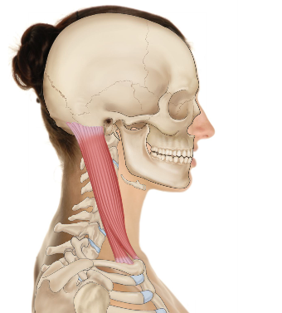

New Procedure
Upper Respiratory Page 4.8
Sternocleidomastiod
Photographs from Ossie & Elaine Rentsch, Bowtech Instruction Manuals
Muscle Illustrations from Joseph Muscolino, The Muscle System Manual

Slide 25


New Procedure
TMJ Page 4.8
Photographs from Ossie & Elaine Rentsch, Bowtech Instruction Manuals
Muscle Illustrations from Joseph Muscolino, The Muscle System Manual

Slide 26

New Procedure
TMJ Page 4.8
Still finger between teeth
Photographs from Ossie & Elaine Rentsch, Bowtech Instruction Manuals
Muscle Illustrations from Joseph Muscolino, The Muscle System Manual

Slide 27


New Procedure
TMJ Page 4.8
Still finger between teeth
Photographs from Ossie & Elaine Rentsch, Bowtech Instruction Manuals
Muscle Illustrations from Joseph Muscolino, The Muscle System Manual

Slide 28










Overview
Upper Respiratory \ TMJ Page 4.6
Practice prerequisite BRM 2 & BRM 3
Practice Upper Respiratory / TMJ with assessment
Mandible Thyroid cartilage SCM Sternal attachment Rock the trachea Drain the SCM
Cross at TMJ Ramus of mandible Anterior to ear
Photographs from Ossie & Elaine Rentsch, Bowtech Instruction Manuals
Muscle Illustrations from Joseph Muscolino, The Muscle System Manual

Slide 29

LUNCH

Slide 30











Re-demonstrate
Elbow / Wrist Page 3.5
Practice prerequisite solo shoulder procedure and exercises
Practice elbow/wrist
Photographs from Ossie & Elaine Rentsch, Bowtech Instruction Manuals
Muscle Illustrations from Joseph Muscolino, The Muscle System Manual

Slide 31


New Procedure
Forearm Page 4.11

Slide 32



New Procedure
Forearm Page 4.11
Practice forearm with assessment
Pronator teres
Flexor carpi radialis
Palmaris longus
Pronator quadratus
Photographs from Ossie & Elaine Rentsch, Bowtech Instruction Manuals
Muscle Illustrations from Joseph Muscolino, The Muscle System Manual

Slide 33
Scenario 2
Client presents with: Lower back and shoulder pain
Questioning reveals:
Iraqi migrant Taxi driver, works long hours to support family here and overseas
Has been putting up with pain for over 1 year
Lumbar flexion limited due to tight hamstrings
Shoulder abduction to 90 degrees right
Poor diet and little exercise
What procedures could you use?
BRM 1, 2, 3, hamstring, sacral, kidney, shoulder
Today we will do: Hamstring & Kidney

Slide 34


Practice Procedures
Hamstring with Exercises
Kidney with assessments

Slide 35

How Tom Bowen read bodies
From the moment a client walks in, to getting on and off the table to how they lay on the table. What can you notice?
Hand out flyer from Ossie’s notes how Mr. Bowen read clients bodies

Slide 36

Case Studies and log hours
Discuss
Questions
Case studies
Log hours
Notes:
Explain the additional 10 case studies on top of 100 log hours. Hand out folders and schedule

Slide 37

END OF DAY

Slide 38

Module 4
Welcome back Day 2
  How is everyone feeling?
  How did you sleep?
  Anything you noticed changing?
  Drink lots of water today.
  Any questions?

Slide 39

Revision Module 3
Study Questions page 3.15

Slide 40

Revision Module 3
Study Questions page 3.15
15. What other procedures could be used to support a non-responding knee condition?

Slide 41


New Procedure
Seated Bowen Page 4.13
Practice seated Bowen – BRM 1,2,3
Pregnancy
Elderly or immobile

Slide 42








Re-demonstrate
Pelvic Page 3.3
Practice Pelvic with assessment and explain exercise
Vastus Lateralis Gracilis & Sartorius Inguinal ligament
Adductor Longus
Photographs from Ossie & Elaine Rentsch, Bowtech Instruction Manuals
Muscle Illustrations from Joseph Muscolino, The Muscle System Manual

Slide 43



Revision
Pelvic Exercise Page 3.4
Start the exercise the day after appointment
Photographs from Ossie & Elaine Rentsch, Bowtech Instruction Manuals
Muscle Illustrations from Joseph Muscolino, The Muscle System Manual

Slide 44





Re-demonstrate and practice
Sacral Page 3.8
Sacrotuberous
ligament
Gluteus maximus
Gluteus maximus
Photographs from Ossie & Elaine Rentsch, Bowtech Instruction Manuals
Muscle Illustrations from Joseph Muscolino, The Muscle System Manual

Slide 45

MORNING TEA

Slide 46
Scenario 3
Client presents with: Skin eczema flaring with stress
Questioning reveals:
Student in transition from female to male, just started hormones
Being bullied at school and major family stress
Very depressed, under psychiatrist care
Has come to you for support through the process
What procedures could you use?
BRM 1, 2, 3, kidney, respiratory, head
Today we will do: Respiratory & Cramp

Slide 47

Practice Procedures
Respiratory and Cramp

Slide 48


New Procedure
Babies and children Page 4.15
Center of gravity is at mid thoracic level, Baby Bowen begins in this area
Not always necessary to observe waiting times with young children

Slide 49


New Procedure
‘Baby Bowen’ Page 4.15
2 medial moves
Level with inferior
angle of scapula
2 lateral moves
Level with inferior
angle of scapula
Supine moves 3, 4 and 5 of
Respiratory procedure

Slide 50



New Procedure
Babies and children Page 4.15

Slide 51

LUNCH

Slide 52
Re-demonstrate and practice
Upper Respiratory \ TMJ Page 4.6
Mandible Thyroid cartilage SCM Sternal attachment Rock the trachea Drain the SCM
Cross at TMJ Ramus of mandible Anterior to ear
Photographs from Ossie & Elaine Rentsch, Bowtech Instruction Manuals
Muscle Illustrations from Joseph Muscolino, The Muscle System Manual

Slide 53
Re-demonstrate and practice
Ankle Page 4.2
5
1
2
3
Extensor hallucis longus
Tibia
Calcaneus
Fibula
Talus
Photographs from Ossie & Elaine Rentsch, Bowtech Instruction Manuals
Muscle Illustrations from Joseph Muscolino, The Muscle System Manual

Slide 54


New Procedure
Hammer Toe Page 4.17
Photographs from Ossie & Elaine Rentsch, Bowtech Instruction Manuals
Muscle Illustrations from Joseph Muscolino, The Muscle System Manual

Slide 55


New Procedure
Hammer Toe Page 4.17
Photographs from Ossie & Elaine Rentsch, Bowtech Instruction Manuals
Muscle Illustrations from Joseph Muscolino, The Muscle System Manual

Slide 56


New Procedure
Hammer Toe Page 4.17
Photographs from Ossie & Elaine Rentsch, Bowtech Instruction Manuals
Muscle Illustrations from Joseph Muscolino, The Muscle System Manual

Slide 57



Strapping
Hammer Toe Page 4.18
Tape toe to heel
Plantar Flexion
Start dorsal aspect of little toe
Cuff level with MTP joints
(Metatarsal Phalanges)
Trim and remove excess tape
Tape 7.5cm Cincotta Chemist online – Leuko 1078

Slide 58



Strapping
Plantar Fasciitis Page 4.19
Assistant to plantar flex foot
Attach tape to toe pad
Pull tape down instep
Wrap around heel
Return to toe pad
Secure with cuff at MTP joints like for hammertoe

Slide 59
Strapping
Plantar Fasciitis Page 4.19
This strapping reduces tension and strain in the plantar fascia by bringing the toes closer to the heel. It creates and supports the arch allowing the fascia to heal without re-injury
It is important to leave the foot strapped until the tear in the fascia is healed.
Renew the strapping when needed.
Be aware that walking or standing without the strapping in the early stages may result in a re-tear of the fascia.

Slide 60



New Procedure
Bunion Page 4.20
Photgraphs from Ossie & Elaine Rentsch, Bowtech Instruction Manuals
Muscle Illustrations from Joseph Muscolino, The Muscle System Manual

Slide 61


New Procedure
Bunion Page 4.20

Slide 62



Tom Bowens Home Remedies
Page 4.23

Slide 63

Written Assessment

Slide 64
Homework to complete by Module 5
Minimum 10 log hours
3 case studies
Lock in date for Module 5
Answer Mod 4 study questions
Purchase and complete A&P3

