Slide 1

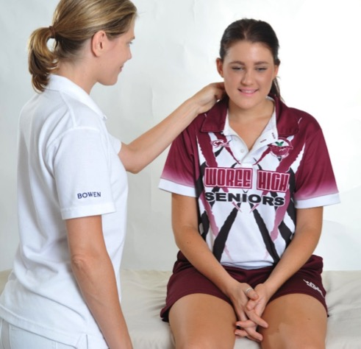
Module 5
Welcome
Certificate in Bowen Therapy - International
Module 3
Coccyx
North
East
South
West
Gallbladder
Chest
Notes:
Display on arrival

Slide 2

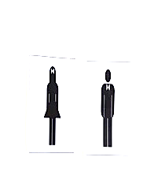
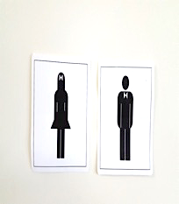

Module 5
Welcome
Register
Payment & receipts
Toilets
Breaks
Phones off or on silent
Exit and emergency meet point, fire extinguisher
Notes:
Run through basic housekeeping. Flow of day for breaks etc.

Slide 3
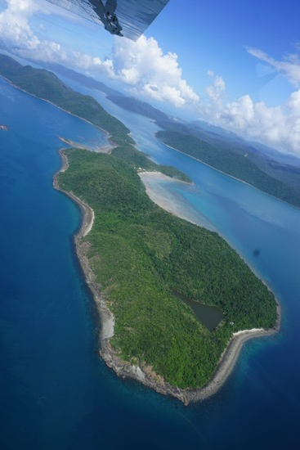
Module 5
Welcome back
Welcome back
Any questions from Module 4
Where are you at with distance subjects
Hand in Case studies & Log Hours
Fill in CEU card
Notes:
Check all students received welcome email. Check they are all enrolled and started A&P. Answer any questions.

Slide 4
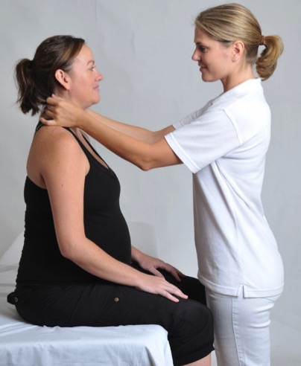
Module 5
Program
NEW PROCEDURES
Coccyx
North
East
South
West
Gallbladder
Chest

Slide 5
Module 5
Program
REVISION
Module 4 procedures
Ankle
Hammertoe
Bunion
Strapping
Forearm
Seated
Baby Bowen
Upper Respiratory / TMJ
PRACTICE and ASSESS
Modules 1 -3 procedures
BRM 1, 2 & 3
Kidney & Respiratory
Shoulder
Hamstring
Cramp
Head
Pelvic
Elbow/Wrist
Sacral
Knee

Slide 6
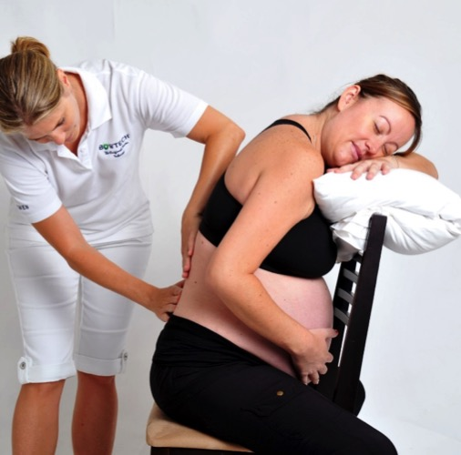
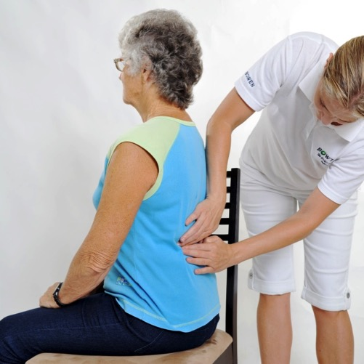
Practice
Seated Bowen Page 4.13
Practice seated Bowen – BRM 1,2,3
Pregnancy
Elderly or immobile

Slide 7
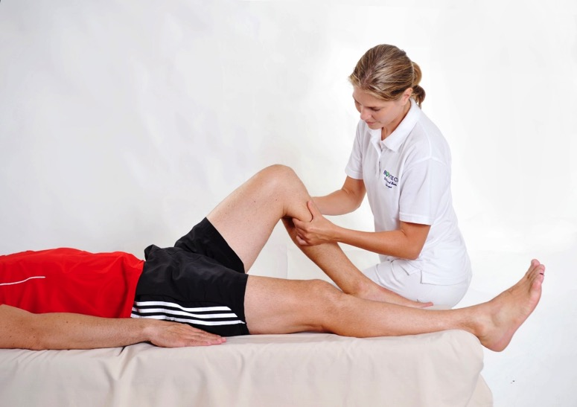
Practice
Knee page 3.10
Practice knee with assessment, exercise and explain washing soda pack

Slide 8
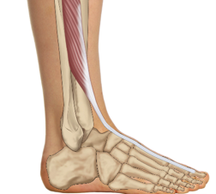
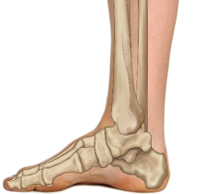
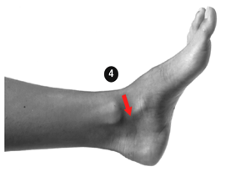
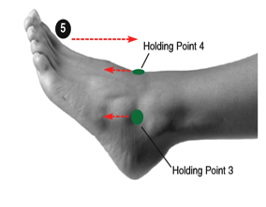
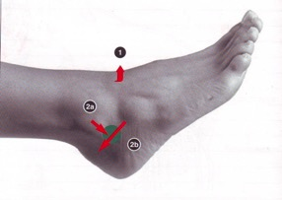
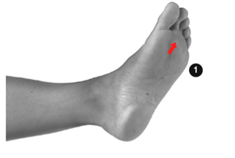
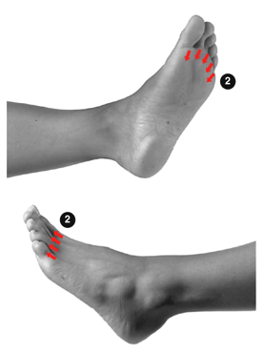
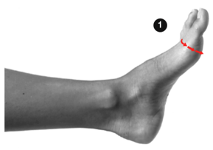
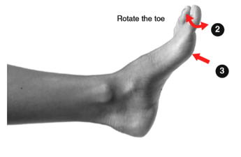
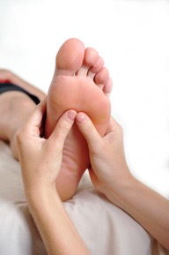

Re-demonstrate and practice
Ankle, Hammertoe, Bunion
5
1
Ankle
2
3
Bunion
Hammertoe
Photographs from Ossie & Elaine Rentsch, Bowtech Instruction Manuals
Muscle Illustrations from Joseph Muscolino, The Muscle System Manual

Slide 9
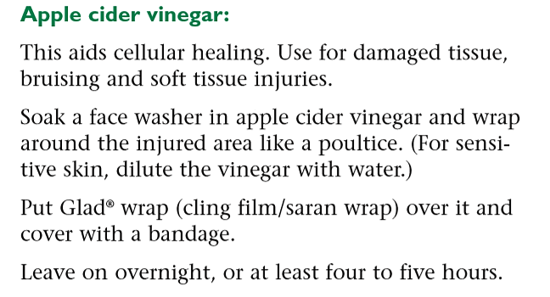
Apple Cider Vinegar Page 4.23

Slide 10
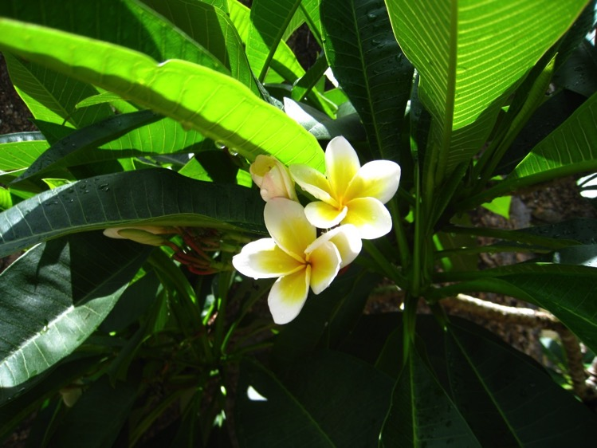
MORNING TEA

Slide 11
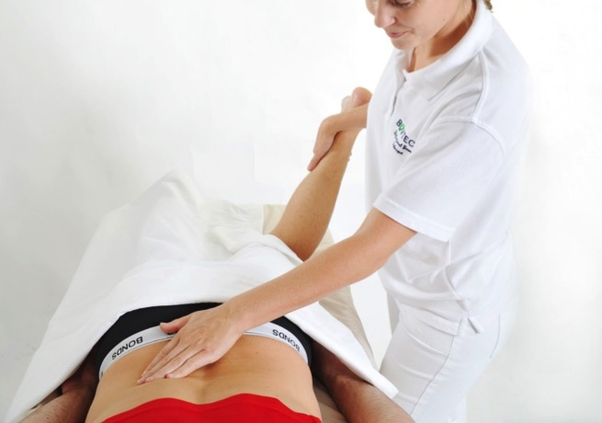
Practice Procedures
Kidney with assessments
Cramp

Slide 12
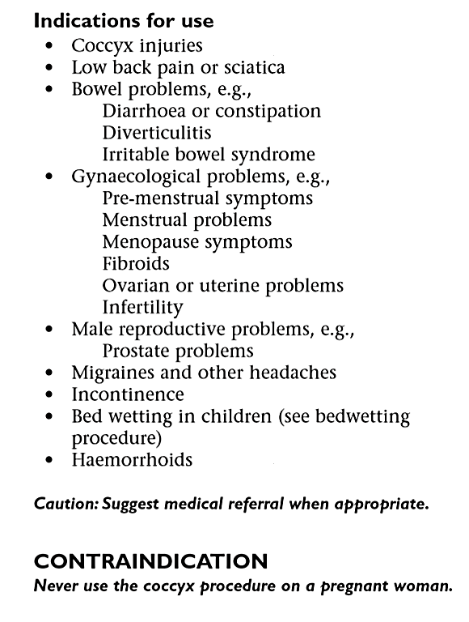
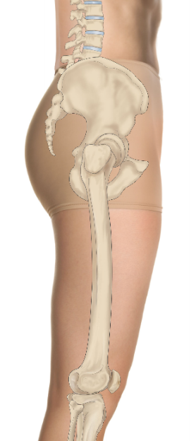
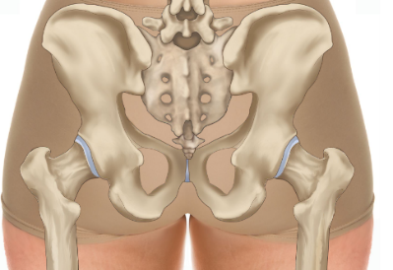
New Procedure
Coccyx page 5.2
Coccyx
Coccyx
CONTRAINDICATION
Never use the coccyx procedure on a pregnant woman
Photographs from Ossie & Elaine Rentsch, Bowtech Instruction Manuals
Muscle Illustrations from Joseph Muscolino, The Muscle System Manual

Slide 13
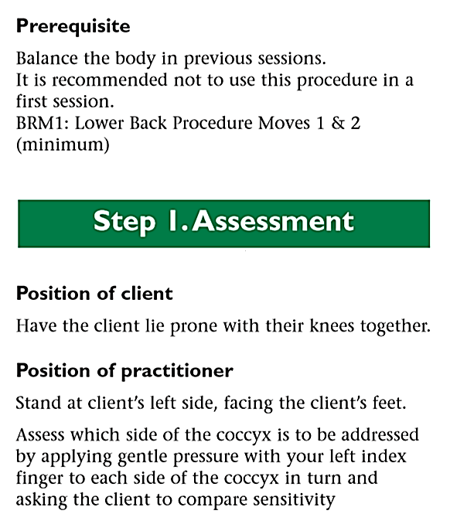
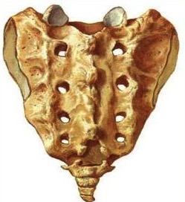
New Procedure
Coccyx page 5.2
Coccyx
Photographs from Ossie & Elaine Rentsch, Bowtech Instruction Manuals
Muscle Illustrations from Joseph Muscolino, The Muscle System Manual

Slide 14
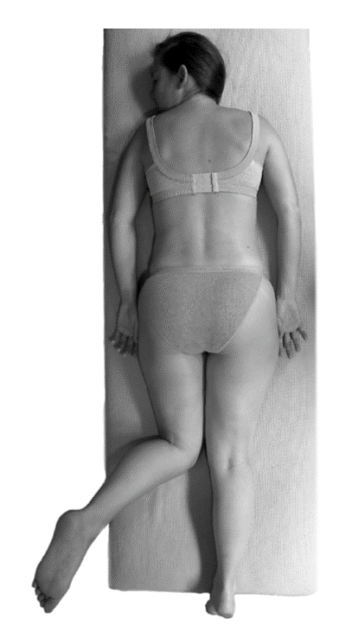
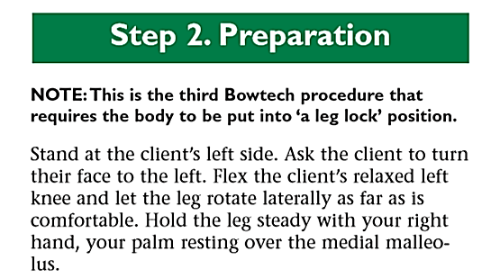
Leg Lock
Coccyx page 5.3
Photographs from Ossie & Elaine Rentsch, Bowtech Instruction Manuals
Muscle Illustrations from Joseph Muscolino, The Muscle System Manual

Slide 15
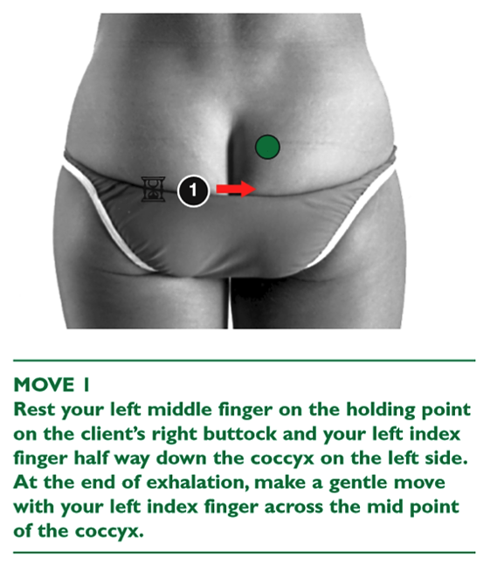
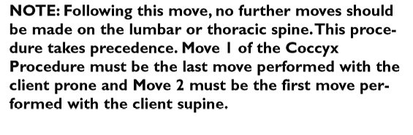
New Procedure
Coccyx page 5.3
ILA
Inferior
lateral
angle
Coccyx
Photographs from Ossie & Elaine Rentsch, Bowtech Instruction Manuals
Muscle Illustrations from Joseph Muscolino, The Muscle System Manual

Slide 16
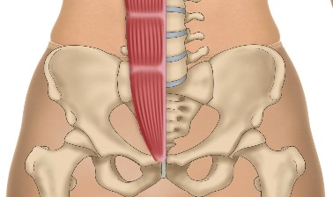
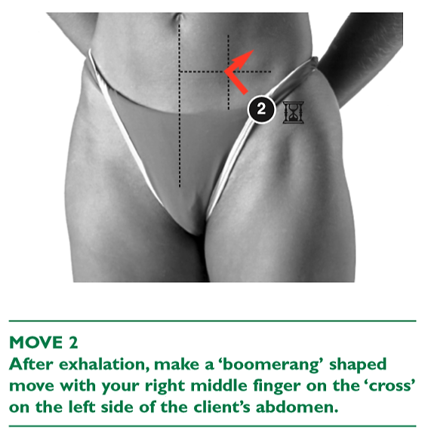

New Procedure
Coccyx page 5.3
Rectus
abdominis
ASIS
level
Photographs from Ossie & Elaine Rentsch, Bowtech Instruction Manuals
Muscle Illustrations from Joseph Muscolino, The Muscle System Manual

Slide 17
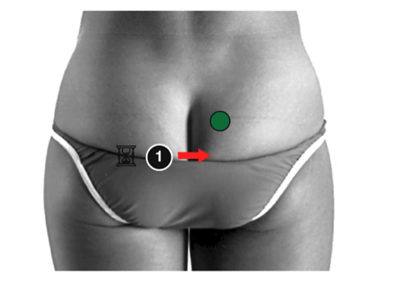
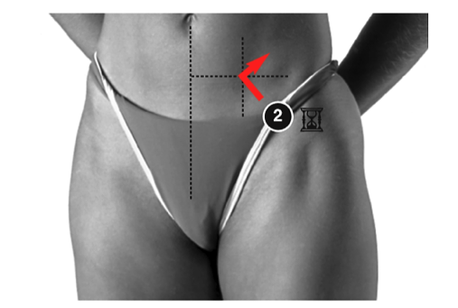
Overview
Coccyx page 5.3
CONTRAINDICATION
Never use the coccyx procedure on a pregnant woman
Rectus
abdominis
ILA
Inferior
lateral
angle
ASIS
level
Coccyx
Photographs from Ossie & Elaine Rentsch, Bowtech Instruction Manuals
Muscle Illustrations from Joseph Muscolino, The Muscle System Manual

Slide 18
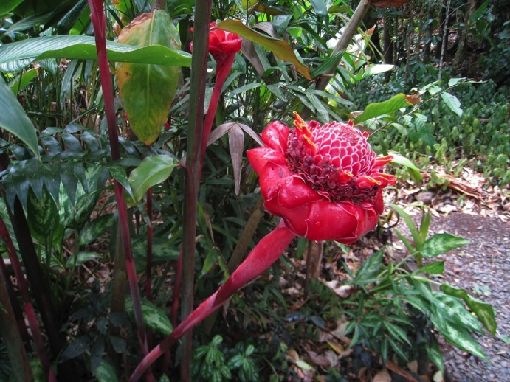
LUNCH

Slide 19

Practice
Hamstring page 2.10
Practice Hamstring with exercise

Slide 20
Scenario 4
Client presents with: Acute right groin pain, radiating to sacrum
Questioning reveals:
Injury occurred 3 days ago, jumping out of earthworks digger
Landed awkwardly and pain is not going away
You notice he is walking awkwardly
Pelvic assessment restricted right, pain groin and in sacrum
Diet average, likes beer, plays football
What procedures could you use?
BRM 1, 2, 3, Pelvic, sacral
Today we will do: Pelvic & Sacral

Slide 21
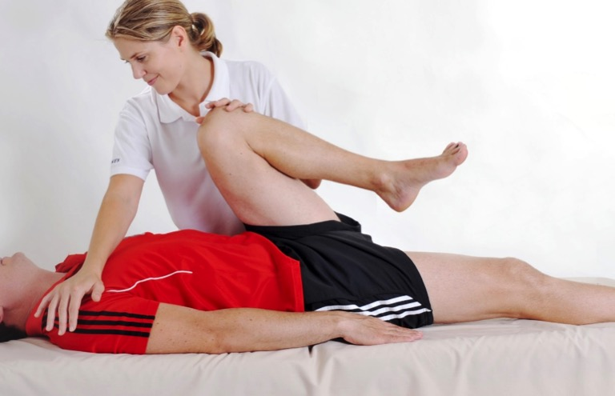
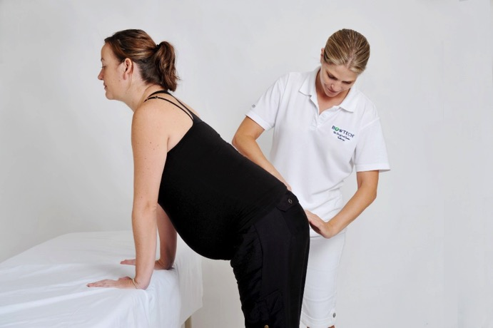
Practice
Pelvic & Sacral page 3.2 & 3.8
Practice Pelvic with
assessment and exercise
Practice Sacral

Slide 22
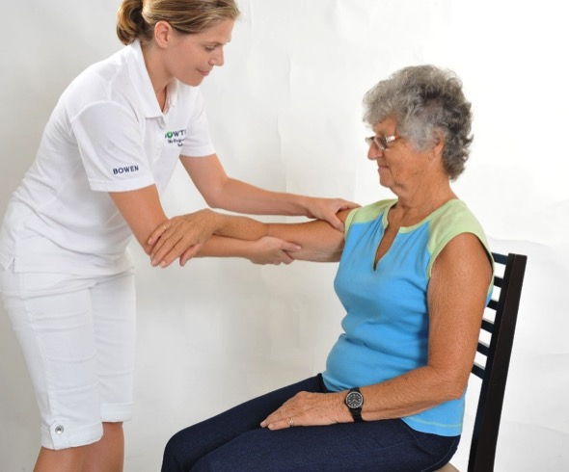
Practice
Shoulder page 2.8
Practice Shoulder solo with assessment and exercise

Slide 23
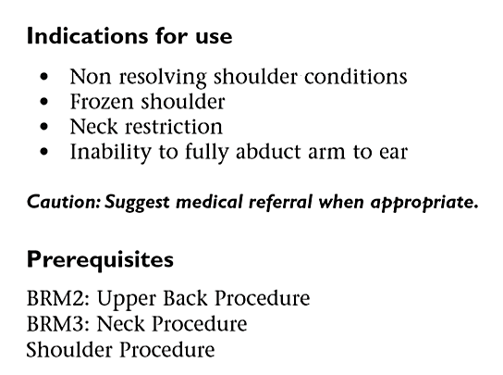
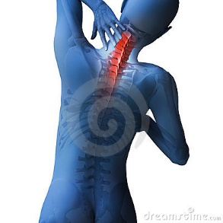
New Procedure
North Page 5.5
Photographs from Ossie & Elaine Rentsch, Bowtech Instruction Manuals
Muscle Illustrations from Joseph Muscolino, The Muscle System Manual

Slide 24
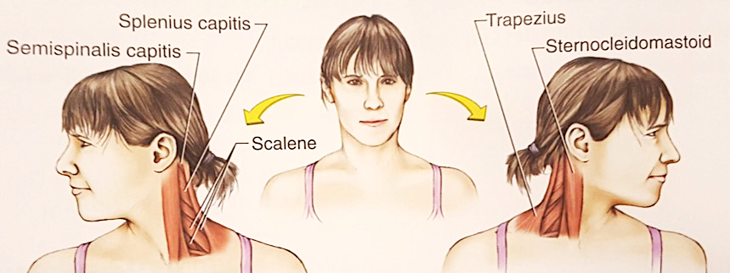
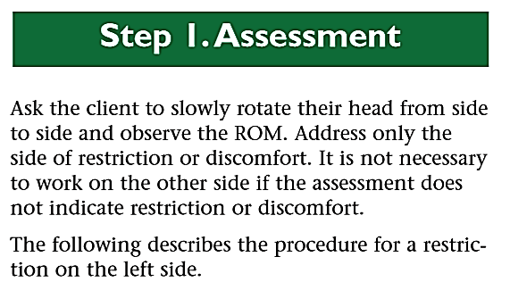
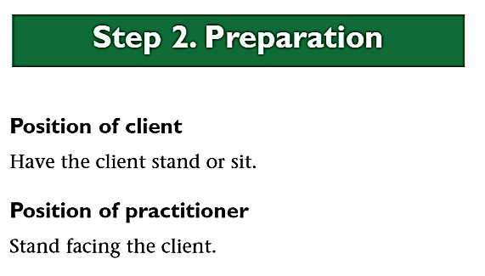
New Procedure
North Page 5.5
Image Source : Stretching Anatomy, Nelson\Kokkonen

Slide 25
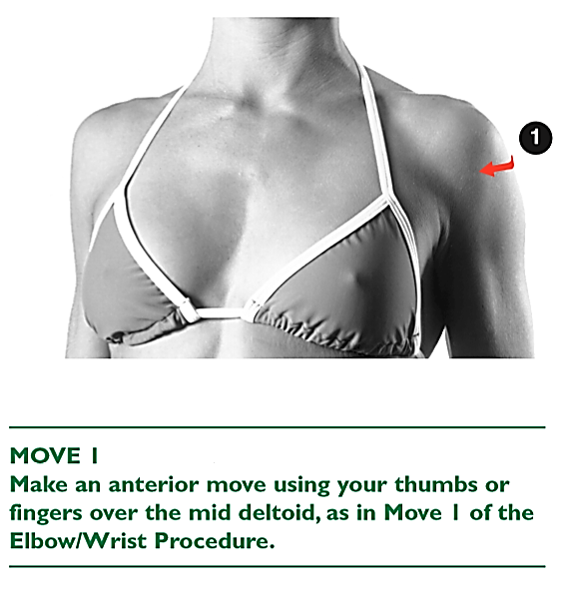
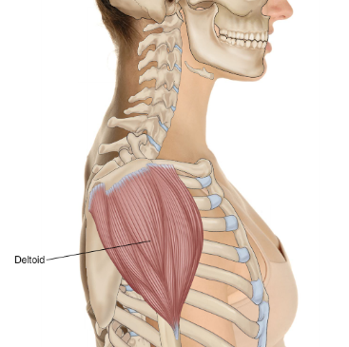
New Procedure
North Page 5.5
Middle fibers of Deltoid
Photographs from Ossie & Elaine Rentsch, Bowtech Instruction Manuals
Muscle Illustrations from Joseph Muscolino, The Muscle System Manual

Slide 26
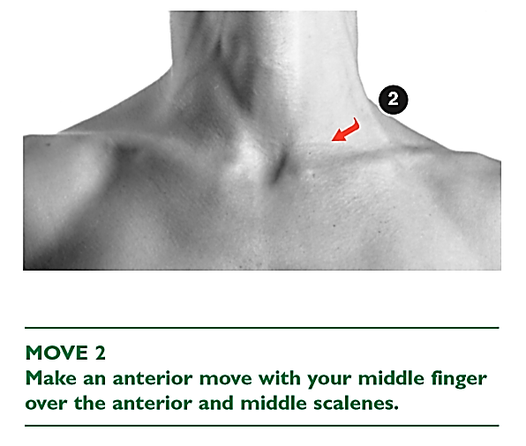
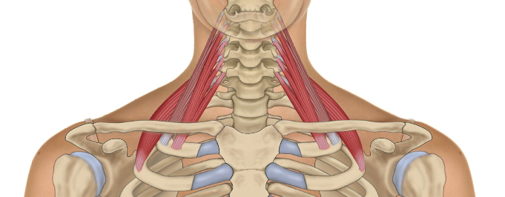
New Procedure
North Page 5.5
Anterior and Middle Scalenes
Photographs from Ossie & Elaine Rentsch, Bowtech Instruction Manuals
Muscle Illustrations from Joseph Muscolino, The Muscle System Manual

Slide 27
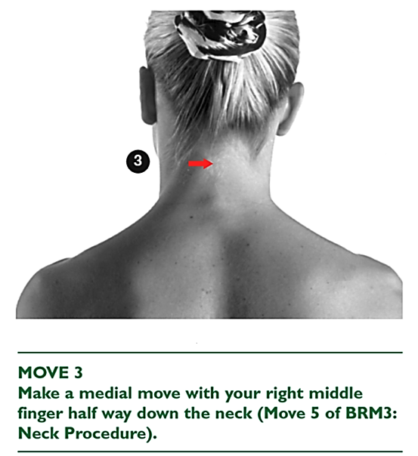
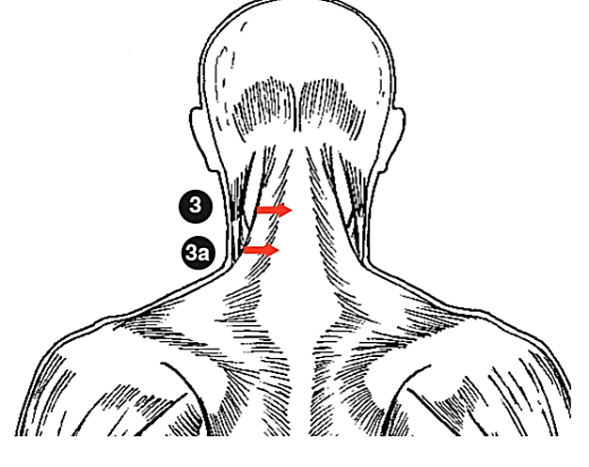
New Procedure
North Page 5.5
4
Upper Trapezius
Photographs from Ossie & Elaine Rentsch, Bowtech Instruction Manuals
Muscle Illustrations from Joseph Muscolino, The Muscle System Manual

Slide 28
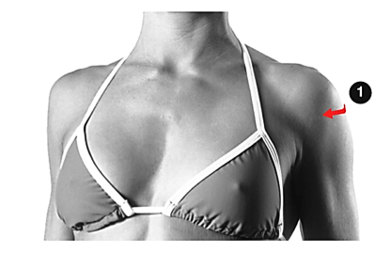





Overview
North page 5.5
Practice North with assessment
4
Middle fibers of Deltoid
Scalenes
Anterior and Middle
Trapezius

Slide 29


New Procedure
East Page 5.7
Photographs from Ossie & Elaine Rentsch, Bowtech Instruction Manuals
Muscle Illustrations from Joseph Muscolino, The Muscle System Manual

Slide 30


New Procedure
East Page 5.7
Practice East with assessment
Pectoralis Major
Photographs from Ossie & Elaine Rentsch, Bowtech Instruction Manuals
Muscle Illustrations from Joseph Muscolino, The Muscle System Manual

Slide 31


New Procedure
South Page 5.8
Photographs from Ossie & Elaine Rentsch, Bowtech Instruction Manuals
Muscle Illustrations from Joseph Muscolino, The Muscle System Manual

Slide 32

New Procedure
South Page 5.8
Photographs from Ossie & Elaine Rentsch, Bowtech Instruction Manuals
Muscle Illustrations from Joseph Muscolino, The Muscle System Manual

Slide 33


New Procedure
South Page 5.8
Practice South with assessment
Latissimus Dorsi
Photographs from Ossie & Elaine Rentsch, Bowtech Instruction Manuals
Muscle Illustrations from Joseph Muscolino, The Muscle System Manual

Slide 34

END OF DAY
Hand in Case Studies and Log Hours for marking

Slide 35

Module 5
Welcome back Day 2
  How is everyone feeling?
  How did you sleep?
  Anything you noticed changing?
  Drink lots of water today.
  Any questions?

Slide 36

Revision Module 4
Study Questions page 4.22

Slide 37

Revision Module 4
Study Questions page 4.22

Slide 38

Practice
Respiratory page 2.2
Practice Respiratory and give suggestions for asthma

Slide 39


New Procedure
Gallbladder page 5.10
Photographs from Ossie & Elaine Rentsch, Bowtech Instruction Manuals
Muscle Illustrations from Joseph Muscolino, The Muscle System Manual

Slide 40




New Procedure
Gallbladder page 5.10
Photographs from Ossie & Elaine Rentsch, Bowtech Instruction Manuals
Muscle Illustrations from Joseph Muscolino, The Muscle System Manual

Slide 41










Re-demonstrate and practice
Upper Respiratory \ TMJ Page 4.6
Prerequisite BRM 3 and TMJ Assessment
Mandible Thyroid cartilage SCM Sternal attachment Rock the trachea Drain the SCM
Cross at TMJ Ramus of mandible Anterior to ear
Photographs from Ossie & Elaine Rentsch, Bowtech Instruction Manuals
Muscle Illustrations from Joseph Muscolino, The Muscle System Manual

Slide 42

Morning tea

Slide 43
Scenario 5
Client presents with: Restriction in right shoulder
Questioning reveals:
Pain is referring to right elbow with tingling into the hand
Industrial laundry occupation for 15 years
Chronic pain for 5 years
Observation- Right shoulder dropped and scapula is winged
Assessment- Right shoulder abduction 30 degrees
What procedures could you use?
BRM 1, 2, 3, Shoulder, Elbow/wrist, forearm
Today we will do: Shoulder, Elbow/wrist, forearm

Slide 44



Practice
Shoulder, Elbow/wrist & Forearm Page 2.5, 3.5 & 4.11
Practice Shoulder with an assistant,
E/W & Forearm with assessment
Pronator teres
Flexor carpi radialis
Palmaris longus
Pronator quadratus
Photographs from Ossie & Elaine Rentsch, Bowtech Instruction Manuals
Muscle Illustrations from Joseph Muscolino, The Muscle System Manual

Slide 45





Re-demonstrate and practice
North, South & East
With each assessment
North South East
Neck rotation Long standing problem Policeman’s stop
4
Latissimus dorsi Pectoralis Major

Slide 46


New Procedure
West Page 5.9
Photographs from Ossie & Elaine Rentsch, Bowtech Instruction Manuals
Muscle Illustrations from Joseph Muscolino, The Muscle System Manual

Slide 47



New Procedure
West Page 5.9
Rhomboids
Photographs from Ossie & Elaine Rentsch, Bowtech Instruction Manuals
Muscle Illustrations from Joseph Muscolino, The Muscle System Manual

Slide 48

LUNCH

Slide 49



Re-demonstrate and practice
Coccyx Page 5.2
Practice prerequisite Lower Stoppers
Practice coccyx with assessment
Rectus
abdominis
ILA
Inferior
lateral
angle
ASIS level
Coccyx
Photographs from Ossie & Elaine Rentsch, Bowtech Instruction Manuals
Muscle Illustrations from Joseph Muscolino, The Muscle System Manual

Slide 50


New Procedure
Chest Page 5.12
CONTRAINDICATION
It is recommended that the Chest Procedure is not preformed
On anyone with breast or pectoralis implants.
Photographs from Ossie & Elaine Rentsch, Bowtech Instruction Manuals
Muscle Illustrations from Joseph Muscolino, The Muscle System Manual

Slide 51



New Procedure
Chest Page 5.12
Photographs from Ossie & Elaine Rentsch, Bowtech Instruction Manuals
Muscle Illustrations from Joseph Muscolino, The Muscle System Manual

Slide 52



New Procedure
Chest Page 5.12
Photographs from Ossie & Elaine Rentsch, Bowtech Instruction Manuals
Muscle Illustrations from Joseph Muscolino, The Muscle System Manual

Slide 53




Re-demonstrate strapping
Ankle Page 4.4
STIRRUP
Maximum eversion
Medial malleolus
Anterior to posterior
Modified 8
Firm but not tight
Cut tape
Secure with 1.2cm tape
Tape 7.5cm Cincotta Chemist online – Leuko 1078

Slide 54



Re-demonstrate Strapping
Hammer Toe Page 4.18
Tape toe to heel
Plantar Flexion
Start dorsal aspect of little toe
Cuff level with MTP joints
(Metatarsal Phalanges)
Trim and remove excess tape
Tape 7.5cm Cincotta Chemist online – Leuko 1078

Slide 55



Re-demonstrate Strapping
Plantar Fasciitis Page 4.19
Assistant to plantar flex foot
Attach tape to toe pad
Pull tape down instep
Wrap around heel
Return to toe pad
Secure with cuff at MTP joints like for hammertoe

Slide 56


Re-demonstrate
‘Baby Bowen’ Page 4.15
2 medial moves
Level with inferior
angle of scapula
2 lateral moves
Level with inferior
angle of scapula
Supine moves 3, 4 and 5 of
Respiratory procedure

Slide 57



Revision
Babies and children Page 4.15

Slide 58

Written Assessment

Slide 59
Homework to complete by Module 6
Minimum 10 log hours
2 case studies
Purchase and complete A&P4
Lock in date for Module 6
Answer Module 5 study questions

