Slide 1

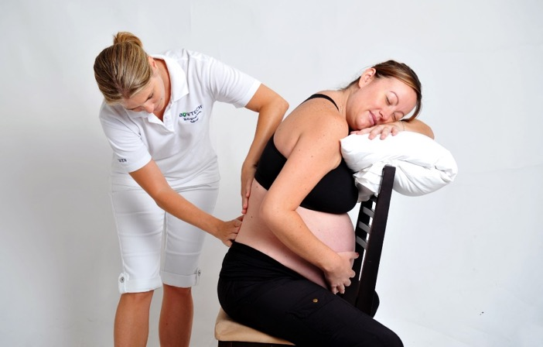
Module 6
Welcome
Certificate in Bowen Therapy - International
Module 3
5a & 7a Medially
Bursitis
Conception
Perineal
Bedwetting
Thoracic
Buttock Pain
Notes:
Display on arrival

Slide 2

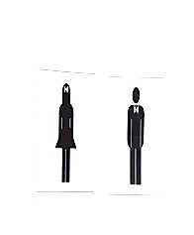
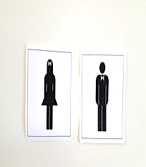

Module 6
Welcome
Register
Payment & receipts
Toilets
Breaks
Phones off or on silent
Exit and emergency meet point, fire extinguisher
Notes:
Run through basic housekeeping. Flow of day for breaks etc.

Slide 3

Module 6
Welcome back
Welcome back
Any questions from Module 5
Where are you at with distance subjects
Hand in Case studies & Log Hours
Fill in CEU card
Notes:
Check all students received welcome email. Check they are all enrolled and started A&P. Answer any questions.

Slide 4
Module 6
Program
NEW PROCEDURES
5a & 7a Medially
Bursitis
Conception
Perineal
Bedwetting
Thoracic
Buttock Pain
REVISION
Module 5 procedures
Coccyx Procedure
North Procedure
East Procedure
South Procedure
West Procedure
Gall Bladder Procedure
Chest Procedure

Slide 5
Module 6
Program
PRACTICE and ASSESS
Modules 1 - 3 procedures
BRM 1, 2 & 3
Kidney & Respiratory
Shoulder
Hamstring
Cramp
Head
Pelvic
Elbow/Wrist
Sacral
Knee
PRACTICE and ASSESS
Modules 4 procedures
Ankle
Hammertoe
Bunion
Strapping
Forearm
Seated
Baby Bowen
Upper Respiratory / TMJ

Slide 6
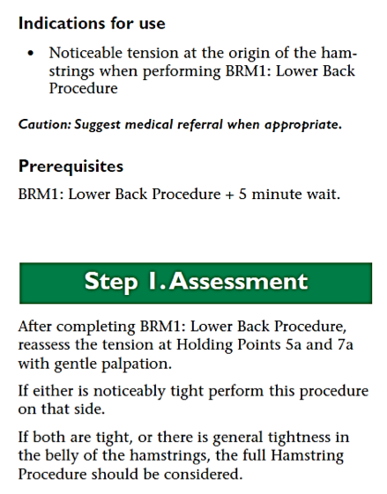
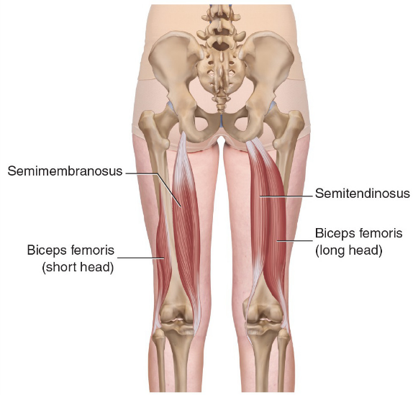
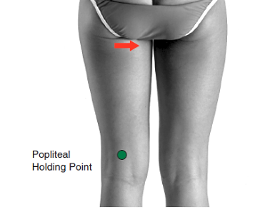
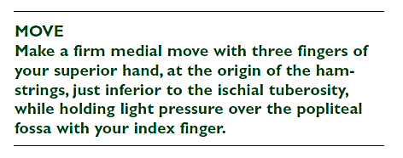
New Procedure
5a or 7a Medially page 6.2
Practice BRM 1 Lower Back
Practice 5a or 7a Medially
Photographs from Ossie & Elaine Rentsch, Bowtech Instruction Manuals
Muscle Illustrations from Joseph Muscolino, The Muscle System Manual

Slide 7
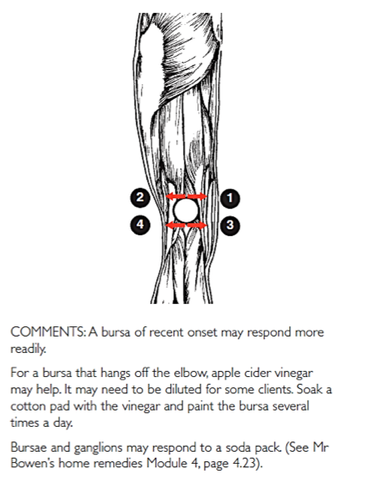
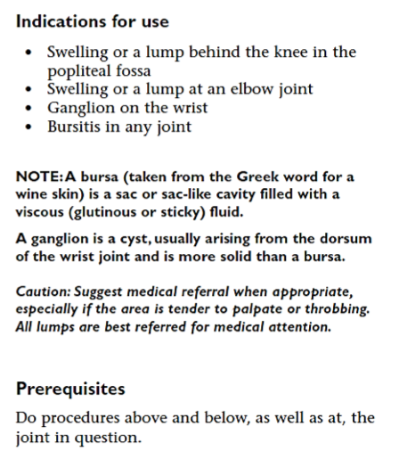
New Procedure
Bursitis page 6.3
Practice Knee with exercise
Practice Bursitis
Photographs from Ossie & Elaine Rentsch, Bowtech Instruction Manuals
Muscle Illustrations from Joseph Muscolino, The Muscle System Manual

Slide 8
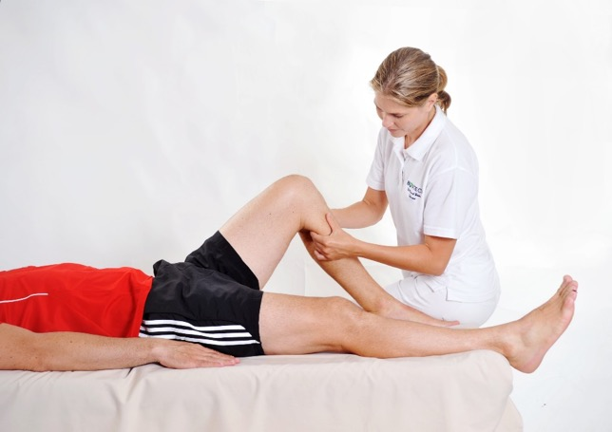
Practice
Hamstring page 2.10
Practice Hamstring with exercise

Slide 9
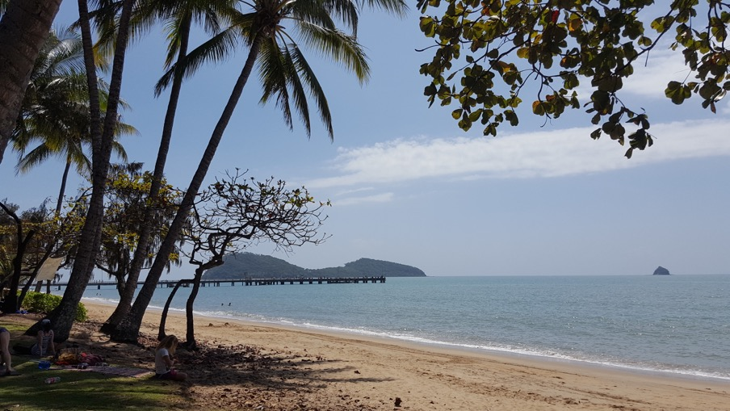
MORNING TEA

Slide 10
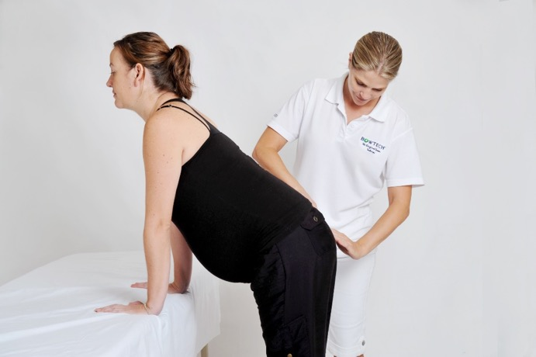
Practice
Sacral page 3.8
Practice Sacral

Slide 11
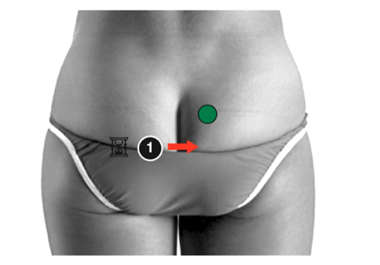
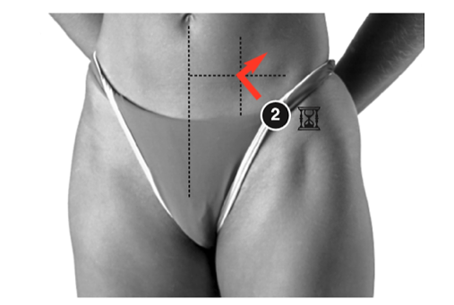

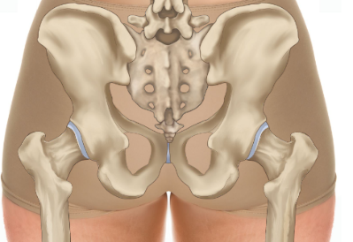
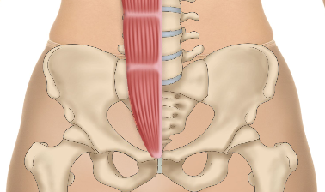
Re-demonstrate
Coccyx page 5.3
CONTRAINDICATION
Never use the coccyx procedure on a pregnant woman
Rectus
abdominis
ILA
Inferior
lateral
angle
ASIS
level
Coccyx
Photographs from Ossie & Elaine Rentsch, Bowtech Instruction Manuals
Muscle Illustrations from Joseph Muscolino, The Muscle System Manual

Slide 12
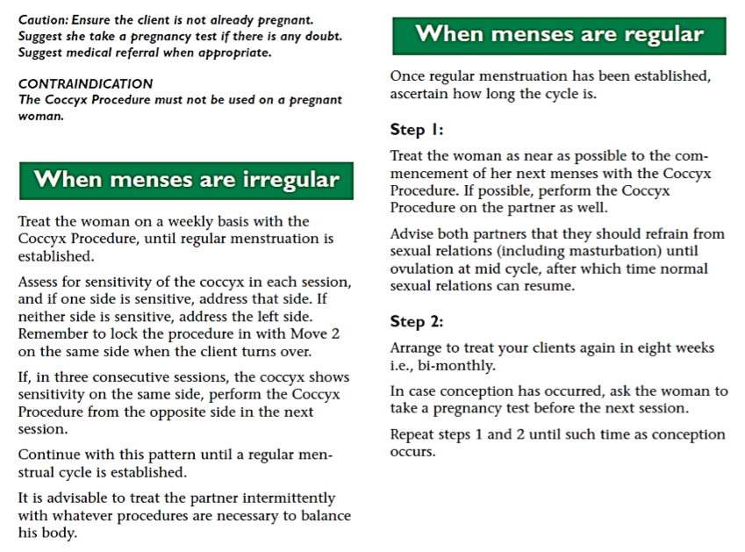
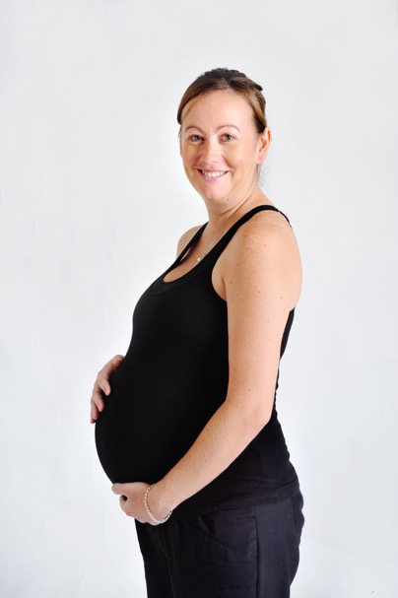
New Procedure page 6.4
Recommendations to assist conception
Photographs from Ossie & Elaine Rentsch, Bowtech Instruction Manuals
Muscle Illustrations from Joseph Muscolino, The Muscle System Manual

Slide 13
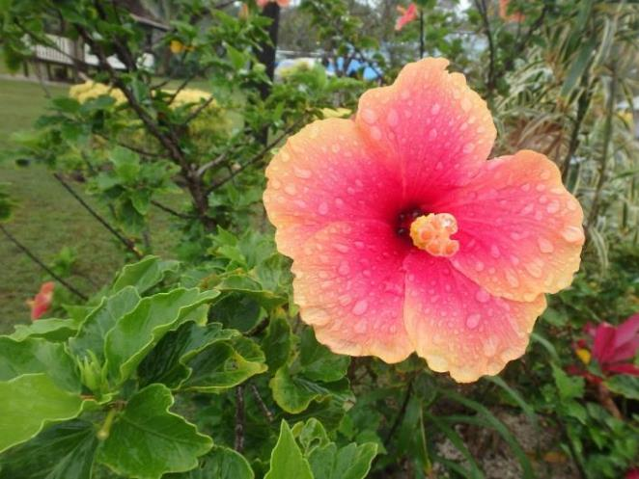
LUNCH

Slide 14
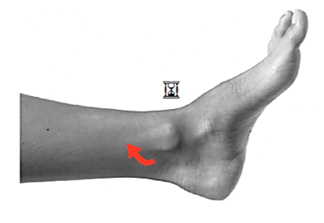
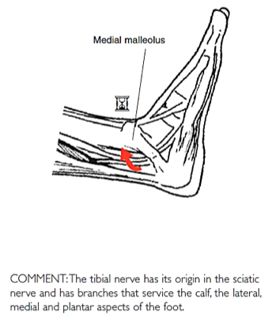
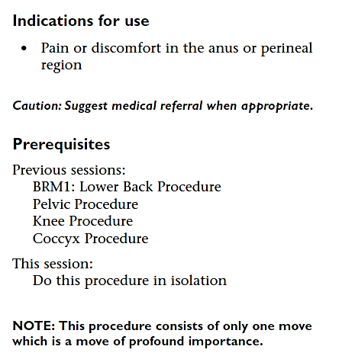
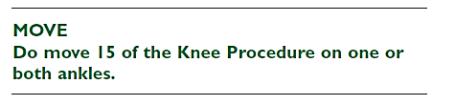

New Procedure
Perineal page 6.5
Photographs from Ossie & Elaine Rentsch, Bowtech Instruction Manuals
Muscle Illustrations from Joseph Muscolino, The Muscle System Manual

Slide 15
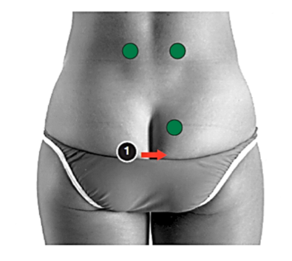
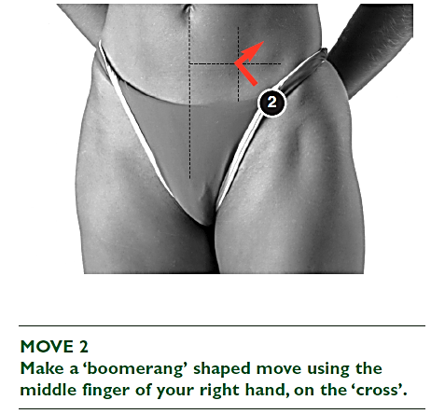
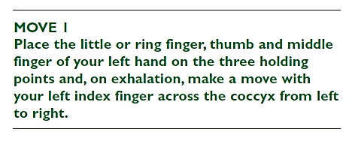
New Procedure
Bedwetting page 6.6 & 6.7
Photographs from Ossie & Elaine Rentsch, Bowtech Instruction Manuals
Muscle Illustrations from Joseph Muscolino, The Muscle System Manual

Slide 16
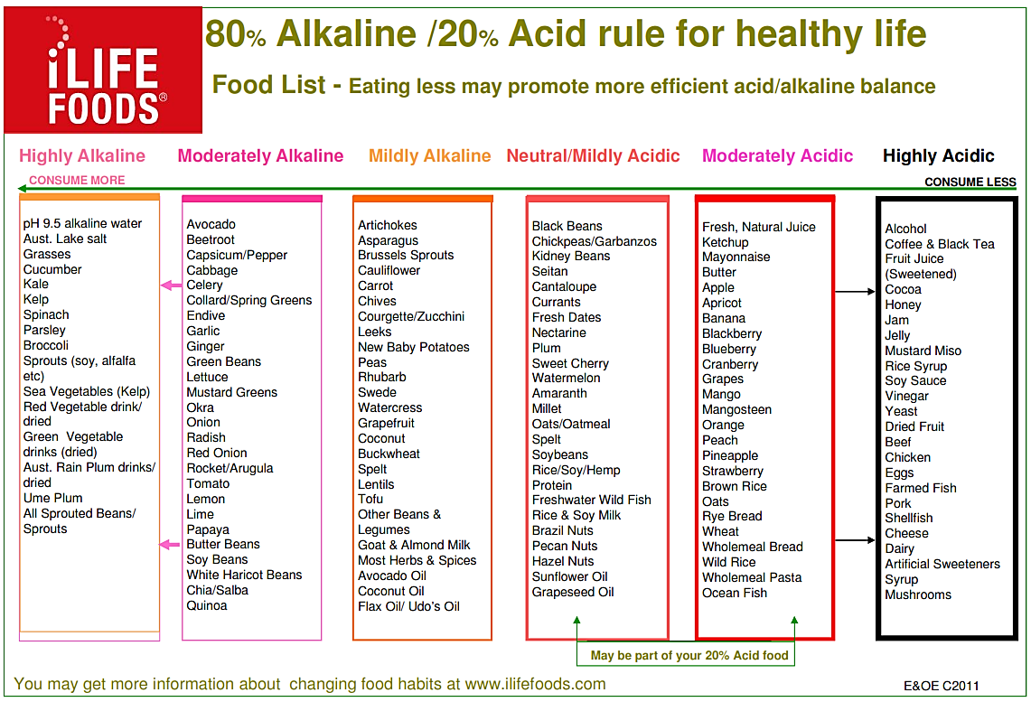
New Procedure
Bedwetting page 6.7
Photographs from Ossie & Elaine Rentsch, Bowtech Instruction Manuals
Muscle Illustrations from Joseph Muscolino, The Muscle System Manual

Slide 17
Scenario 6
Client presents with: Left shoulder and forearm pain, weak grip
Questioning reveals:
Electrician but hates his job
Recently separated, experiencing interrupted sleep
Tingling in lateral 3 fingers, recently diagnosed OOS
Anterior rotation left shoulder, head tilt left
What procedures could you use?
BRM 2, 3, Shoulder, North, East, Elbow/Wrist, Forearm
Today we will do: BRM 2, 3, Shoulder

Slide 18
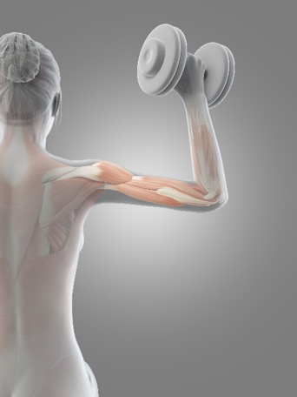
Practice
Practice
BRM 2 Upper back
BRM 3 Neck
Shoulder assessment
Shoulder assisted
Shoulder unassisted
Shoulder exercises

Slide 19
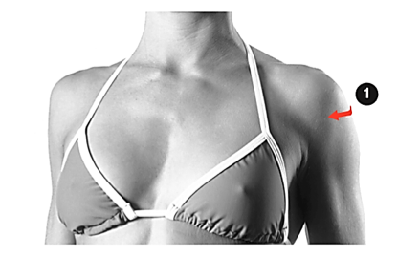
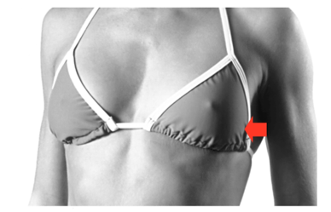
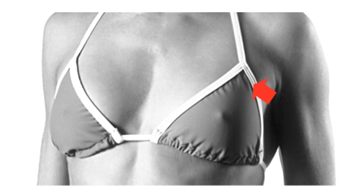
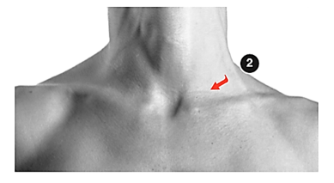
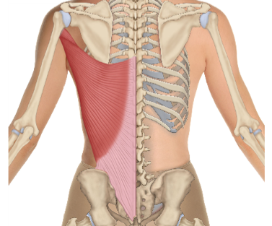
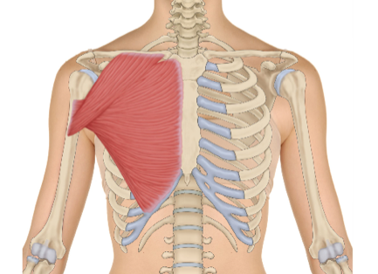
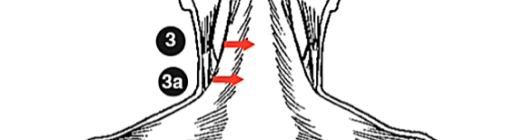
Re-demonstrate and practice
North, South & East
With each assessment
North South East
Neck rotation Long standing problem Policeman’s stop
4
Latissimus dorsi Pectoralis Major

Slide 20
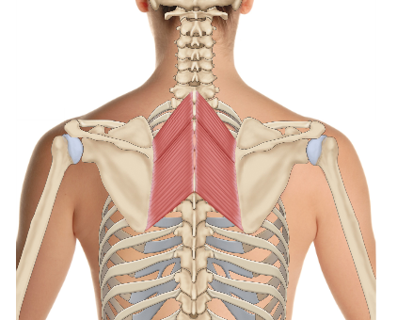
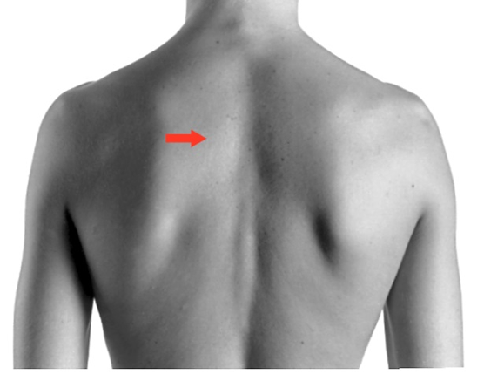

New Procedure
West Page 5.9
Rhomboids
Photographs from Ossie & Elaine Rentsch, Bowtech Instruction Manuals
Muscle Illustrations from Joseph Muscolino, The Muscle System Manual

Slide 21
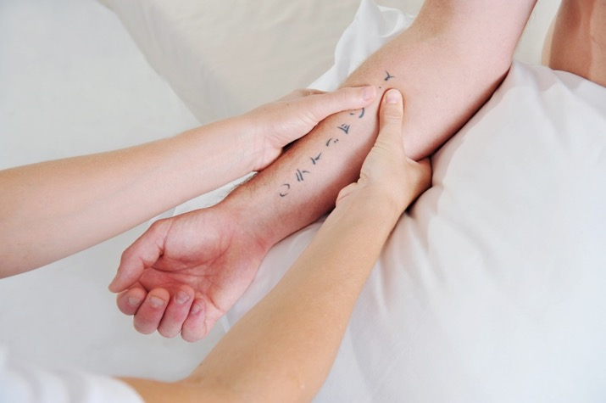
Practice
Elbow\Wrist & Forearm
Practice Elbow\ Wrist & Forearm

Slide 22
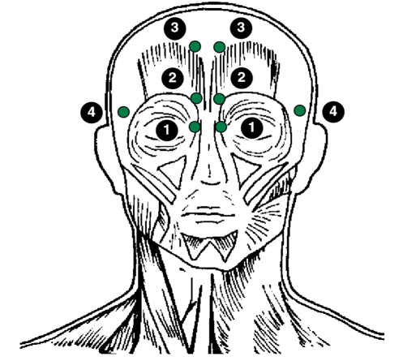
Practice
Head Procedure
Practice Head Procedure

Slide 23

END OF DAY
Hand in Case Studies and Log Hours for marking
Progress Sheet – complete and return

Slide 24

Module 6
Welcome back Day 2
  How is everyone feeling?
  How did you sleep?
  Anything you noticed changing?
  Drink lots of water today.
  Any questions?

Slide 25
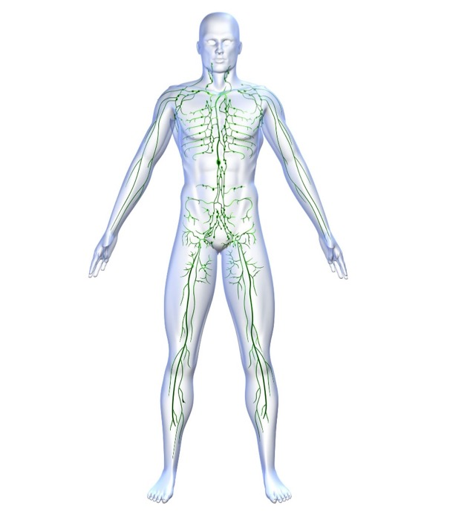
Lymphatic Drainage
  What Bowen Procedures would assist Lymphatic Drainage?
  Upper Respiratory / TMJ
  Chest
  Kidney
  Pelvic
  East

Slide 26
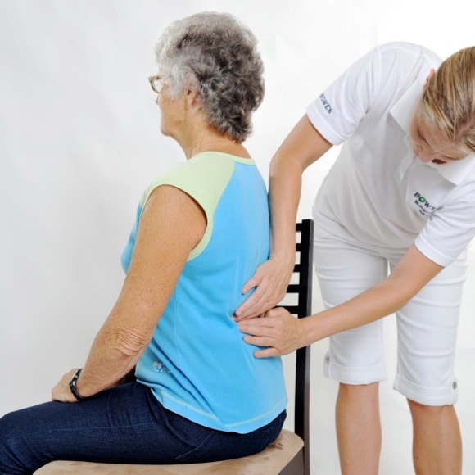
Practice
Seated Bowen Page 4.13
Practice seated Bowen – BRM 1 and 2

Slide 27
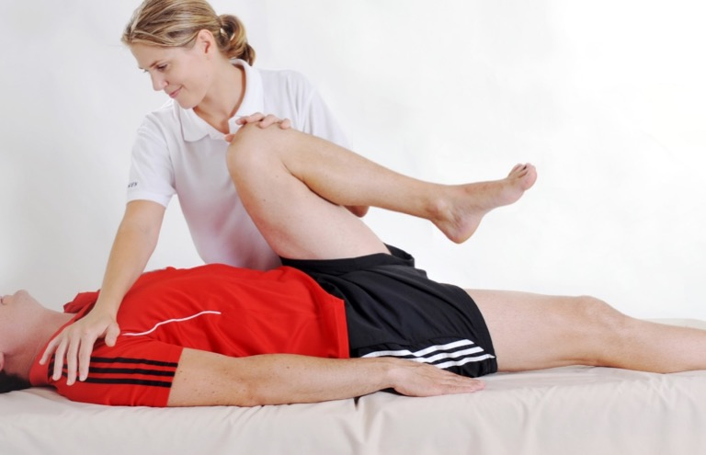
Practice
Pelvic page 3.2
Practice Pelvic with assessment and exercise

Slide 28
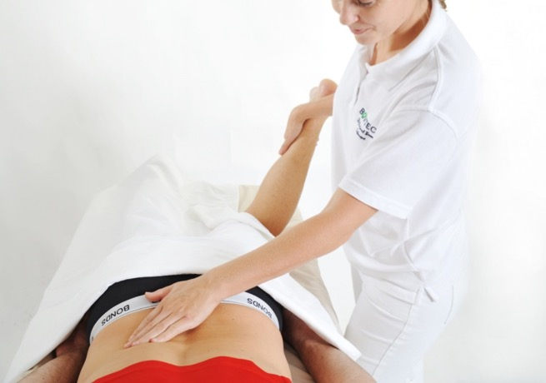
Practice Procedures
Kidney with assessments
Cramp

Slide 29
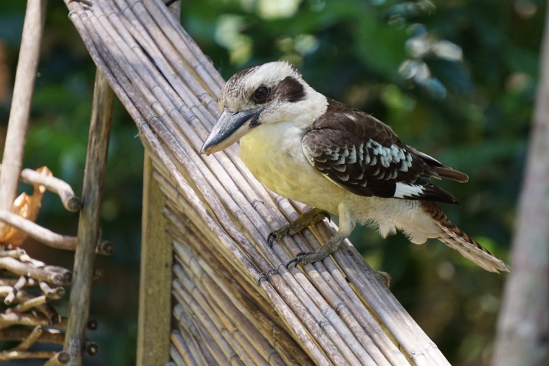
Morning tea

Slide 30
Scenario 7
Client presents with: Migraine and occasional dizziness
Questioning reveals:
Suffering with anxiety and stress
Home maker with little English, adult daughter is her translator
Has a stiff neck
Assessment facial asymmetry, clicking TMJ on opening
What procedures could you use?
BRM 2, 3, UR TMJ, Head, North, Coccyx
Today we will do: BRM 3, UR TMJ

Slide 31
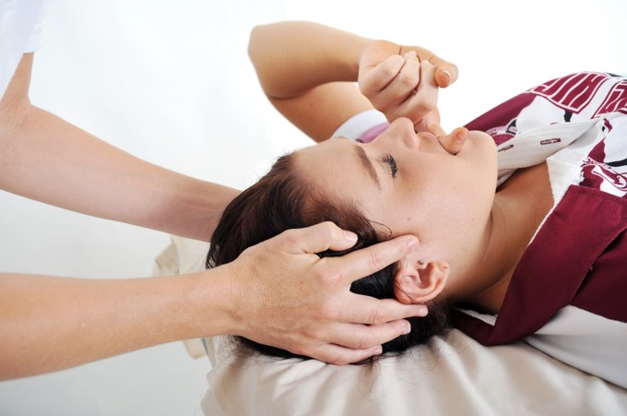
Practice Procedures
BRM 3 Neck
Upper respiratory/TMJ with assessment and aftercare

Slide 32
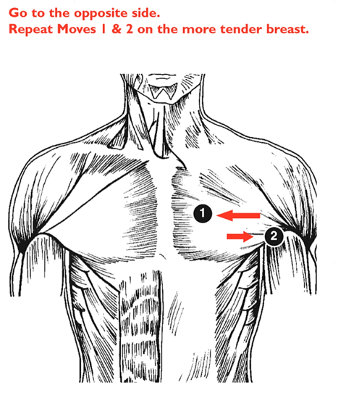
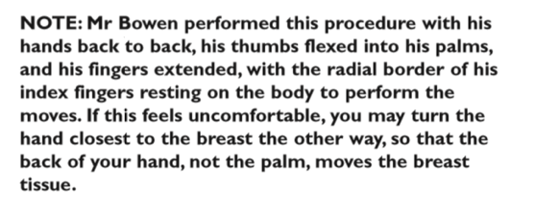
Re-demonstrate
Chest Page 5.12
Photographs from Ossie & Elaine Rentsch, Bowtech Instruction Manuals
Muscle Illustrations from Joseph Muscolino, The Muscle System Manual

Slide 33
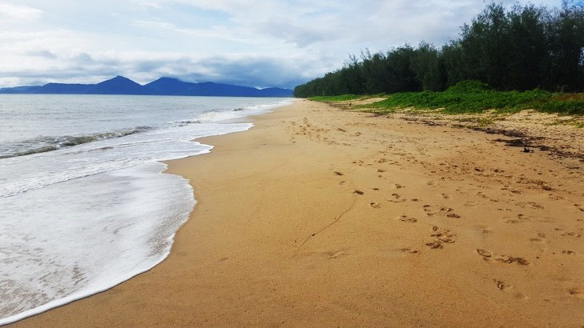
Lunch
Fill in and return student survey

Slide 34
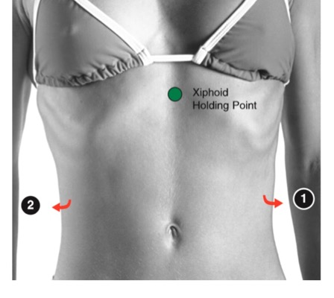
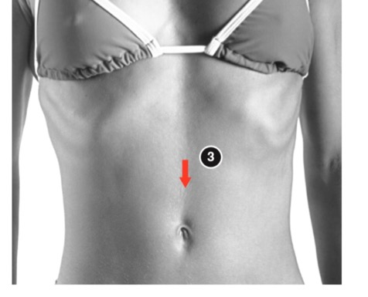
Re-demonstrate
Gallbladder page 5.10
Practice Respiratory with Asthma aftercare
Practice Gallbladder
Photographs from Ossie & Elaine Rentsch, Bowtech Instruction Manuals
Muscle Illustrations from Joseph Muscolino, The Muscle System Manual

Slide 35

New Procedure
Thoracic page 6.8
Photographs from Ossie & Elaine Rentsch, Bowtech Instruction Manuals
Muscle Illustrations from Joseph Muscolino, The Muscle System Manual

Slide 36


New Procedure
Thoracic page 6.8
Photographs from Ossie & Elaine Rentsch, Bowtech Instruction Manuals
Muscle Illustrations from Joseph Muscolino, The Muscle System Manual

Slide 37



New Procedure
Thoracic page 6.8
Photographs from Ossie & Elaine Rentsch, Bowtech Instruction Manuals
Muscle Illustrations from Joseph Muscolino, The Muscle System Manual

Slide 38

Practice Procedures and strapping
Procedures - Ankle \ Hammertoe \ Bunion
Strapping - Ankle \ Hammertoe \ Plantar Fasciitis

Slide 39





New Procedure
Buttock Pain page 6.10
Photographs from Ossie & Elaine Rentsch, Bowtech Instruction Manuals
Muscle Illustrations from Joseph Muscolino, The Muscle System Manual

Slide 40











Re-demonstrate and practice
Ankle, Hammertoe, Bunion
5
1
Ankle
2
3
Bunion
Hammertoe
Photographs from Ossie & Elaine Rentsch, Bowtech Instruction Manuals
Muscle Illustrations from Joseph Muscolino, The Muscle System Manual

Slide 41

Apple Cider Vinegar Page 4.23

Slide 42

Revision Module 5
Study Questions page 5

Slide 43

Revision Module 5
Study Questions page 5

Slide 44


Re-demonstrate
‘Baby Bowen’ Page 4.15
2 medial moves
Level with inferior
angle of scapula
2 lateral moves
Level with inferior
angle of scapula
Supine moves 3, 4 and 5 of
Respiratory procedure

Slide 45



Revision
Babies and children Page 4.15

Slide 46

Written Assessment

Slide 47
Homework to complete by Module 7
Case Studies should be completed by Module 6. Have you remembered to submit your final Case studies to your instructor?
Module 7
Minimum 10 log hours
Purchase and complete A&P 5
Lock in date for Module 7
Answer Module 6 study questions

Slide 48
What to expect at Module 7
Getting ready to be a therapist
Case Scenarios
Group Discussion
Practical Assessment
Satisfactory / Not yet satisfactory
10 points will be checked

Slide 49
What to bring to Module 7
Your table
Your linen
Your towels and pillows for client comfort
Your manuals
Your log hours

